Slide 1

Activity of Muscles Can Vary
Isotonic contractions
  muscle shortens, movement occurs
Isometric contractions
  muscle doesn’t shorten, no movement
Degree of nerve activation influences force

Slide 2
Degree of Nerve Activation Influences Force
Motor unit
  Motor neuron and all the muscle cells it controls
  Smallest functional unit of muscle contraction
Muscle tension
  Mechanical force that muscles generate when they contract
  Determined by
    Motor unit size
    Number of active motor units
    Frequency of stimulation of motor units

Slide 3
Degree of Nerve Activation Influences Force
All-or-none principle
  Individual muscle cells are completely contracting or are relaxed
Muscle tone
  Whole muscles – maintain intermediate level of force known as muscle tone
Recruitment
  Activation of additional motor units increases muscle tone

Slide 4
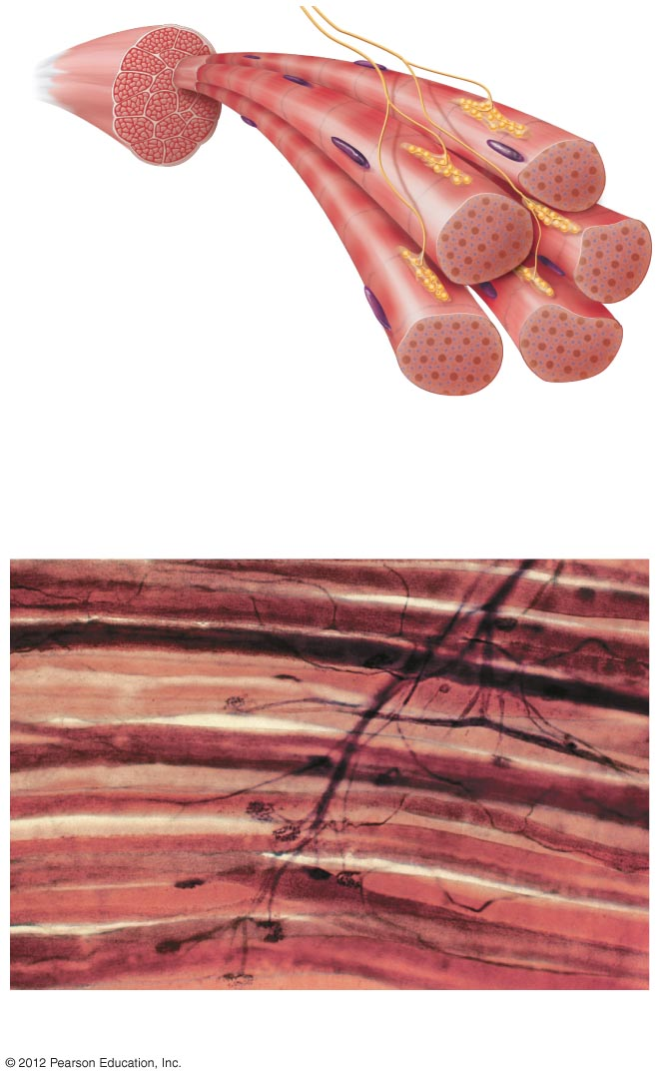
Two motor neurons
Muscle
Muscle cells
Neuromuscular junctions
A motor unit consists of a motor
neuron and all of the muscle cells
it controls. Any one muscle cell is
controlled by only one motor neuron,
but a motor neuron controls more than
one muscle cell.
b) Photograph of the muscle cells in a motor unit, showing
branches of the motor neuron and neuromuscular junctions.

Slide 5
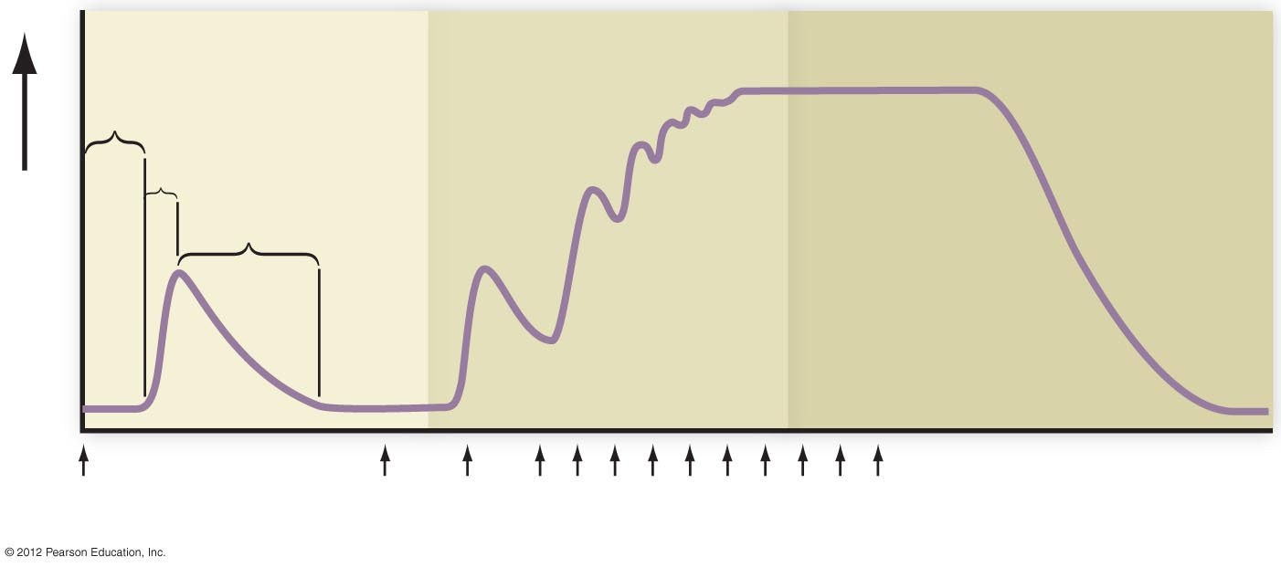
Muscle Twitch
Complete cycle of contraction-relaxation in response to stimulus
Can be observed using a myogram (laboratory recording of muscle activity)
Tetanus
Latent period
Summation
Contraction
Relaxation
Muscle force
Stimulus
0
Time (msec)
500

Slide 6
Muscle Activity
Two types of muscle fibers
  Slow twitch
    endurance, long duration contraction, contain myoglobin
      Jogging, swimming, biking
  Fast twitch
    strength, white muscle, short duration contraction
      Sprinting, weight lifting, tennis

Slide 7
Exercise Training
Strength training
  Resistance training
    Short, intense
    Builds more fast-twitch myofibrils
Aerobic training
  Builds endurance
  Increases blood supply to muscle cells
  Reach target heart rate for at least 20 minutes, three times a week

