Slide 1

Calcium Initiates the Sliding Filament Mechanism
Thick filaments
  myosin
Thin filaments
  strands of actin molecules
Contraction
  formation of cross-bridges between thin and thick filaments

Slide 2
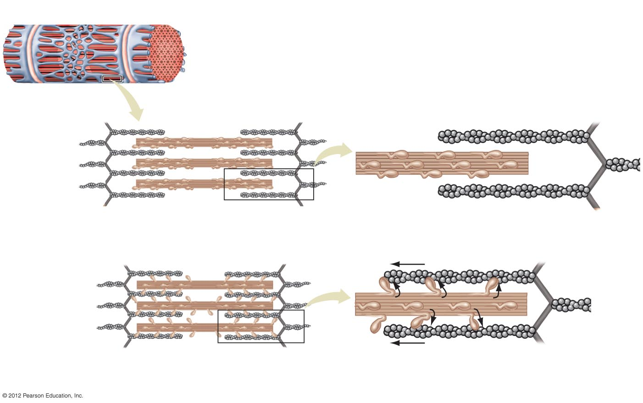
Myofibril
Myosin molecule head
Myosin molecule
Thick filament
Thin filament
Actin molecule
Relaxed state. The myosin heads do
not make contact with actin.
b) Contraction. The myosin heads form cross-bridges with actin and
then bend, pulling the actin filaments toward the center of the sarcomere.

Slide 3
Mechanism of Muscle Contraction
Calcium is released from sarcoplasmic reticulum
Calcium binds to troponin
Troponin–tropomyosin complex shifts position
Myosin binding site is exposed
Myosin heads form cross-bridges with actin
Actin filaments are pulled toward center of sarcomere

Slide 4
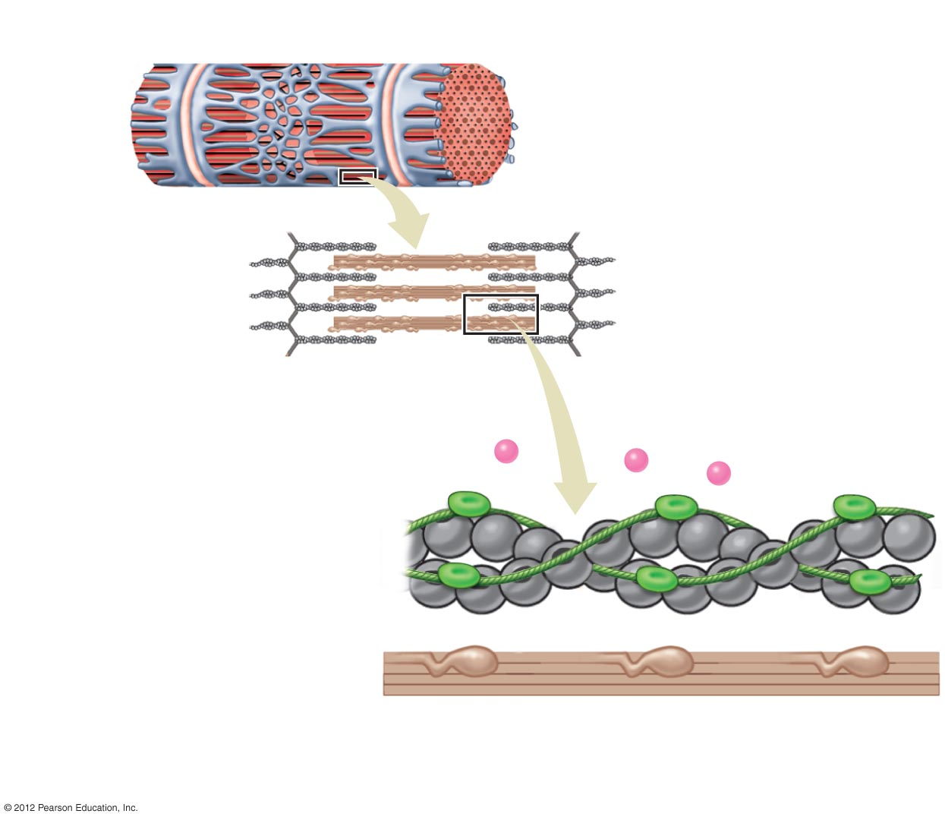
Myofibril
Sarcoplasmic
reticulum
Thick and thin filaments
Tropomyosin
Actin filament
Ca²⁺
Troponin
Myosin head
Myosin filament
Resting sarcomere. In the absence of calcium the muscle is
relaxed because the myosin heads cannot form cross-bridges
with actin.

Slide 5
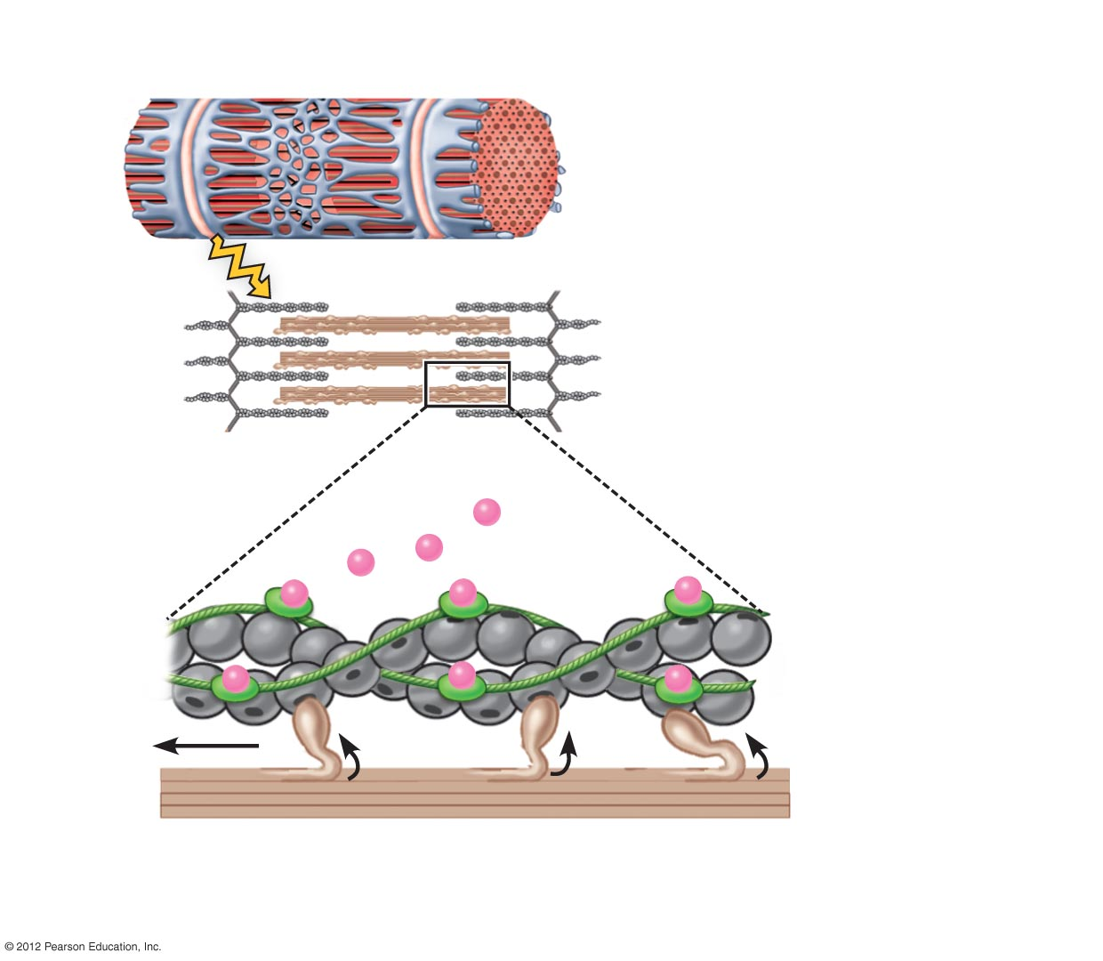
Sarcoplasmic reticulum
Electrical impulse
Calcium release
Ca²⁺
Myosin binding sites
Cross-bridge
b) Cross-bridge attachment. The binding of calcium
to troponin causes a shift in the troponin-tropomyosin
complex, allowing cross-bridges to form.

Slide 6
Muscle Relaxation
Nerve activation ends, contraction ends
Calcium pumped back into sarcoplasmic reticulum
Calcium removed from troponin
Myosin binding site covered
No calcium = no cross-bridges

Slide 7
Energy Required for Muscle Activity
Principle source of energy
  ATP
ATP required for contraction
ATP required for relaxation
ATP is replenished by a variety of means
  Creatine phosphate
  Stored glycogen
  Aerobic metabolism of glucose, fatty acids, and other high-energy molecules

