Slide 1

Skeletal Muscle Contractile Unit
Sarcomere: contractile unit
  Myosin
    forms thick filaments
  Actin
    forms thin filaments
Z Lines
  attachment points for sarcomeres
Arrangement of filaments gives rise to striated appearance of skeletal muscle

Slide 2
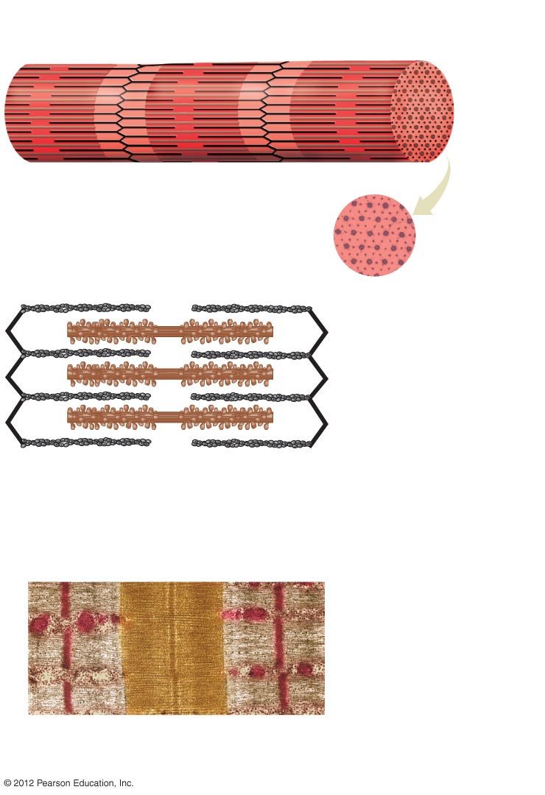
Myofibril
Z-line
Z-line
Sarcomere
a) A closer view of a section of a myofibril
showing that it is composed of
sarcomeres joined end to end at the Z-line
Myosin
Actin
d) An electron micrograph
cross section of a sarcomere
in a region that contains both
actin and myosin.
Thin filament (actin)
Thick filament (myosin)
b) Sarcomeres contain thin filaments of
actin that attach to the Z-lines and
thicker filaments of myosin that span
the gap between actin molecules.
c) A transmission electron micrograph (X 11,300)
of a longitudial section of a sarcomere. The
rounded red objects are mitochondria.

Slide 3
Nerve Activation of Individual Muscle Cells
Acetylcholine is released from motor neuron at neuromuscular junction
Electrical impulse transmitted along
T tubules
Calcium released from sarcoplasmic reticulum

Slide 4
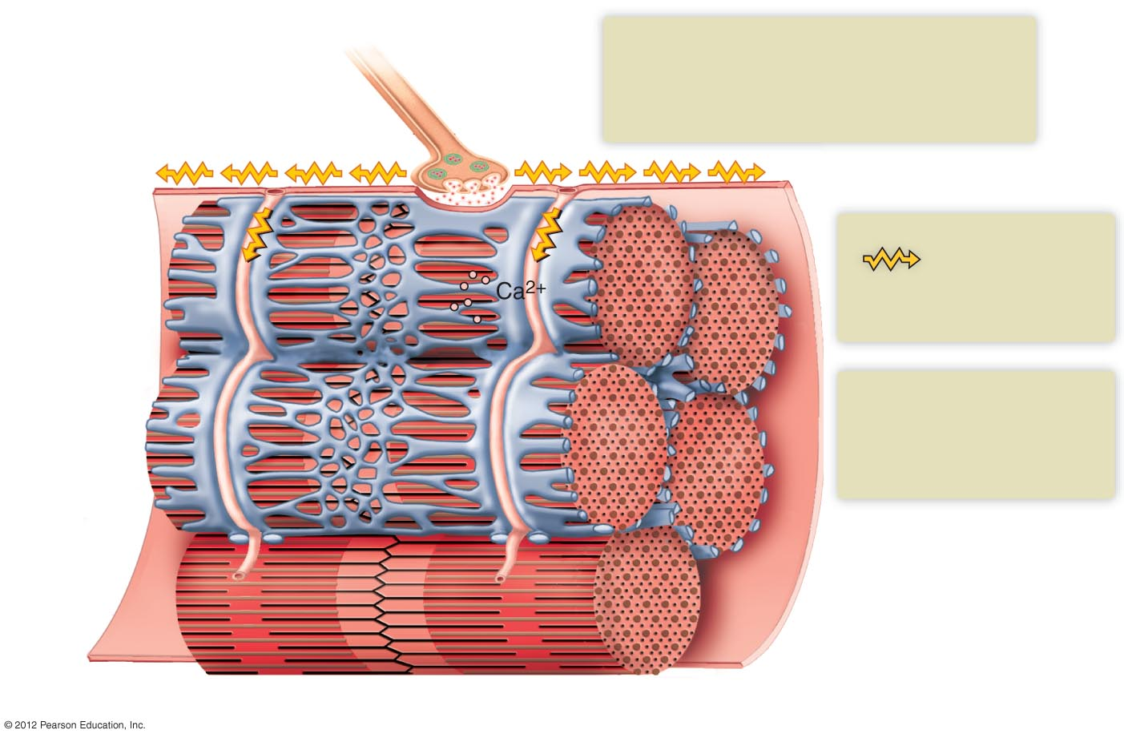
1
The release of acetylcholine at the neuromuscular junction causes an electrical impulse to be generated
in the muscle cell plasma membrane
Motor neuron
Acetylcholine
Electrical impulse
2
The electrical impulse
( ) is carried
to the cell’s interior by the T tubules
T tubule
Sarcoplasmic reticulum
3
The electrical impulse triggers the release of Ca²⁺ from the sarcoplasmic reticulum
Muscle cell plasma membrane
Myofibrils
Z-line

