Slide 1
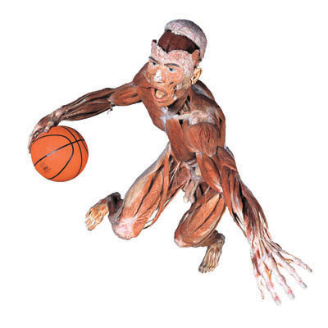

The Muscular System

Slide 2
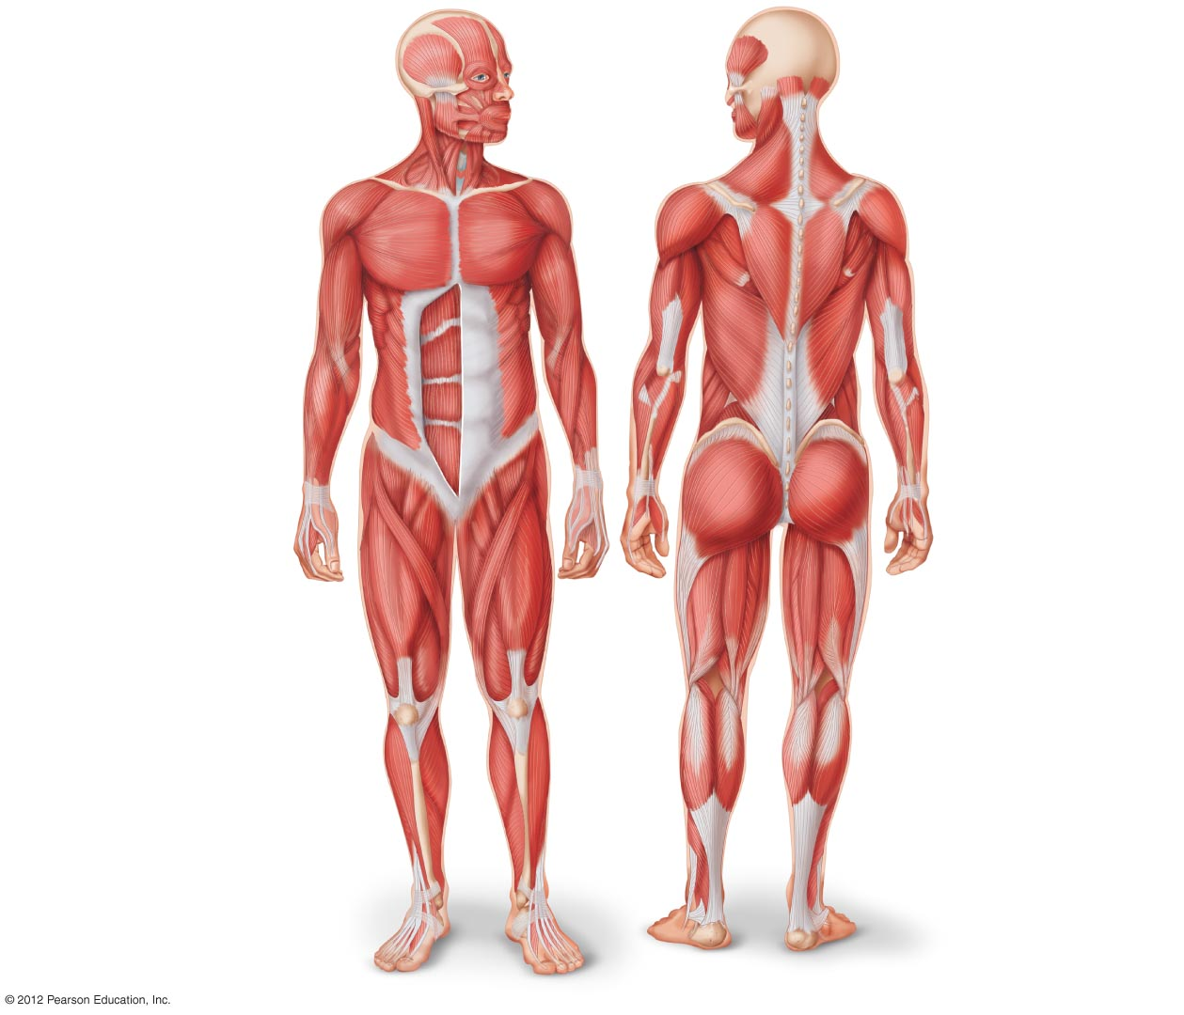
Pectoralis major
Draws arm forward
and toward the body
Serratus anterior
Helps raise arm
Contributes to pushes
Draws shoulder blade forward
Deltoid
Raises arm
Trapezius
Lifts shoulder blade
Braces shoulder
Draws head back
Biceps brachii
Bends forearm at elbow
Triceps brachi
Straightens forearm
at elbow
Rectus abdominus
Compresses abdomen
Bends backbone
Compresses chest cavity
Latissimus dorsi
Rotates and draws
arm backward and
toward body
External oblique
Lateral rotation of trunk
Compresses abdomen
Gluteus maximus
Extends thigh
Rotates thigh laterally
Adductor longus
Flexes thigh
Rotates thigh laterally
Draws thigh toward body
Sartorius
Bends thigh at hip
Bends lower leg at knee
Rotates thigh outward
Hamstring group
Draws thigh backward
Bends knee
Gastrocnemius
Bends lower leg at
knee
Bends foot away from
knee
Quadriceps group
Flexes thigh at hips
Extends leg at knee
Tibialis anterior
Flexes foot toward knee
Achilles tendon
Connects
gastrocnemius
muscle to heel

Slide 3
Muscle Function: Produce Movement or Generate Tension
Principle function
  Contraction
    shortens distance between bones
  Skeletal muscle moves bone
Muscle groups
  Synergistic
    groups work together
  Antagonistic
    groups oppose each other

Slide 4
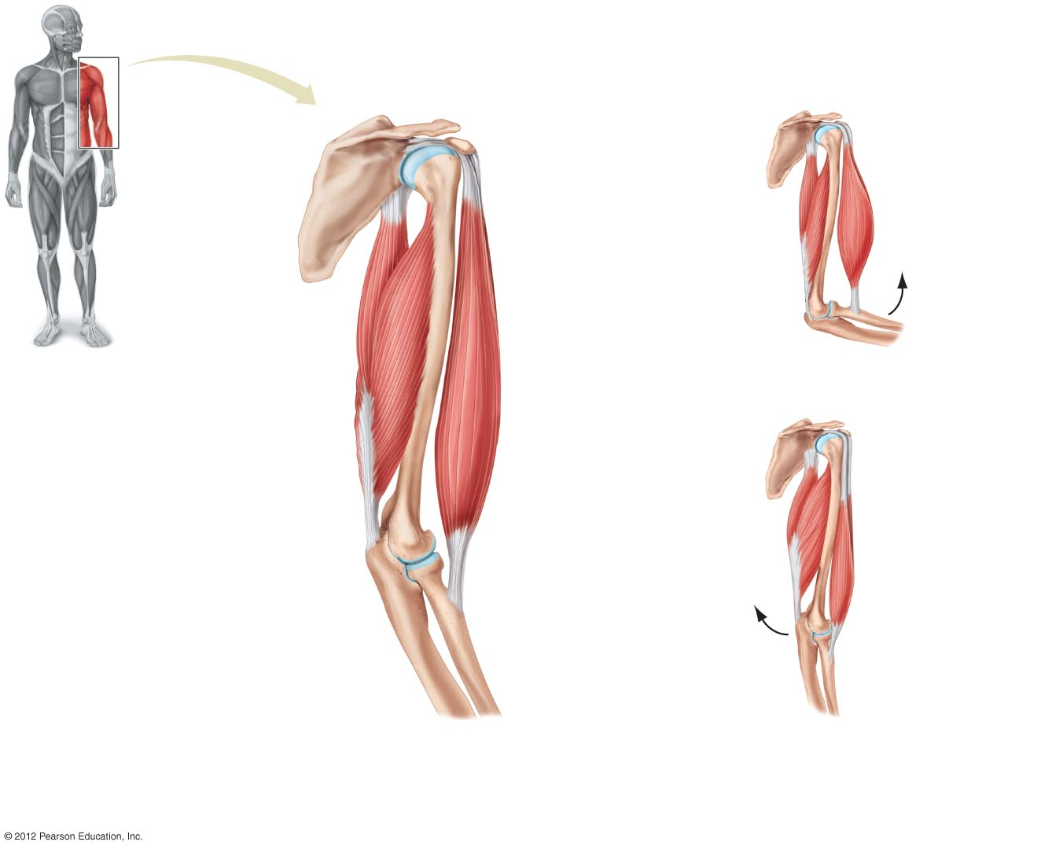
Origin / Insertion
Origins from scapula
Scapula
Tendons
Shoulder joint
Biceps contracts,
pulling forearm up
Triceps relaxes
Origins from
scapula and
humerus
Humerus
Biceps muscle
Triceps muscle
Tendon
Triceps contracts,
pulling forearm down
Insertion on ulna
Elbow joint
Tendon
Biceps relaxes
Insertion
on radius
Ulna
Radius
a) Origin and insertion. The point of attachment
of a muscle to the stationary bone is its origin;
the point of attachment to the movable bone is
its insertion.
b) Movement. Antagonistic muscles produce
opposite movements. The forearm bends when
the biceps contracts and the triceps relaxes. The
forearm straightens when the biceps relaxes
and the triceps contracts.

Slide 5
Muscle Structure
Fasicles
  Bundles of muscle fibers wrapped with connective tissue (fascia)
Muscle fibers (muscle cells)
  Long, tube shaped
  Multinucleate
  Packed with myofibrils
    Myofibrils contain
      Actin
      Myosin

Slide 6
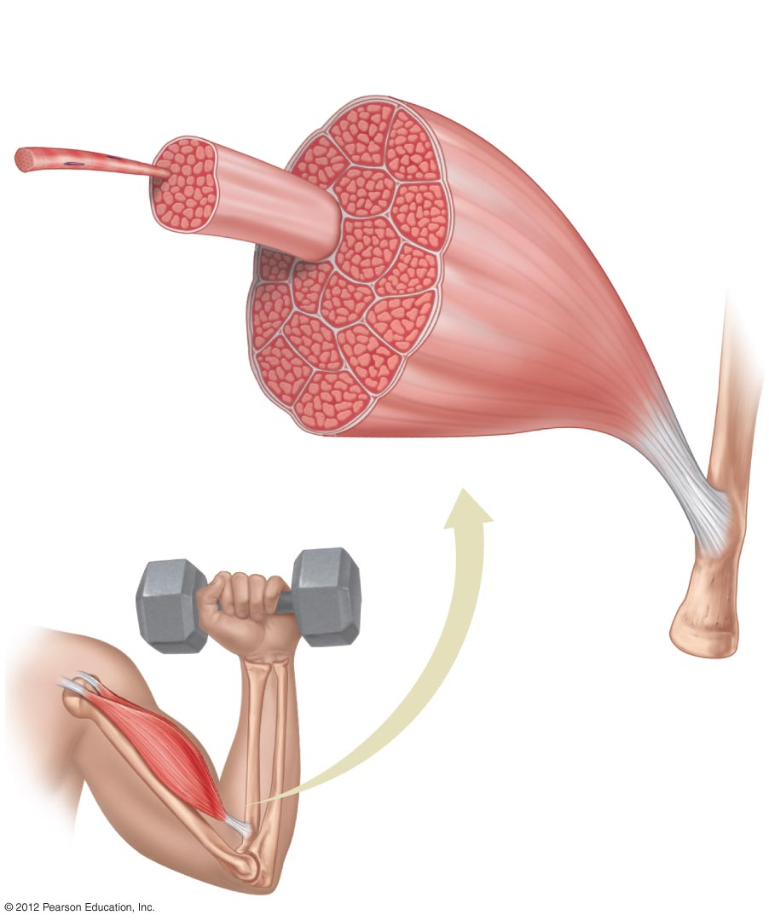
Muscle bundle (fascicle) surrounded by connective
tissue (fascia)
Whole muscle
Single muscle cell (fiber)
Tendon
Bone

Slide 7
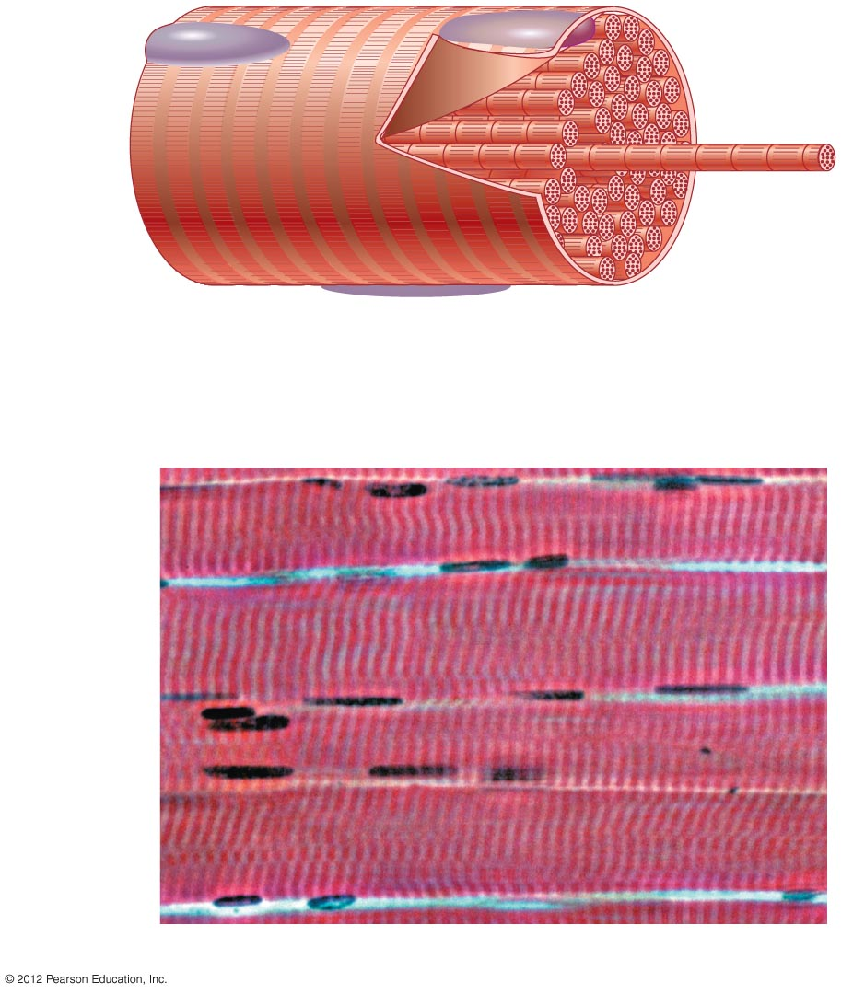
Muscle cell
Myofibril
A single muscle cell contains
many individual myofibrils
and has more than one
nucleus.
Nuclei
Muscle cell
b) A photograph of portions of several skeletal muscle cells.

