Slide 1

Diseases and Disorders of the Skeletal System
Sprains
  stretched or torn ligaments
Bursitis and tendinitis
  inflammations
Arthritis
  inflammation of joints
    Osteoarthritis
    Rheumatoid arthritis

Slide 2
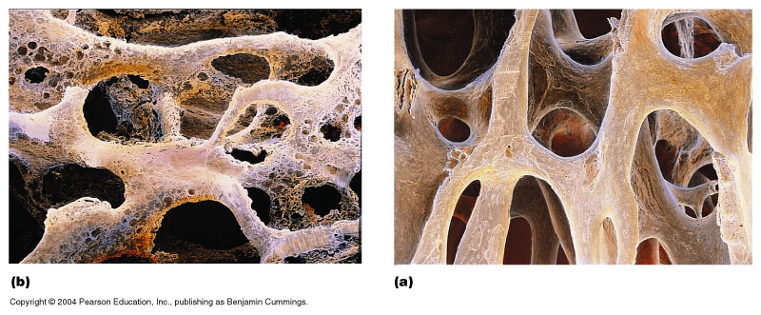
Diseases and Disorders of the Skeletal System
Osteoporosis
  excessive bone loss

