Slide 1

Joints (Articulations)
Classified by degree of movement
  Fibrous joint
    immovable (e.g., fontanels)
  Cartilaginous joint
    slightly movable, cartilage connection (e.g., backbone)
  Synovial joint
    freely movable (e.g., shoulder, hip)

Slide 2
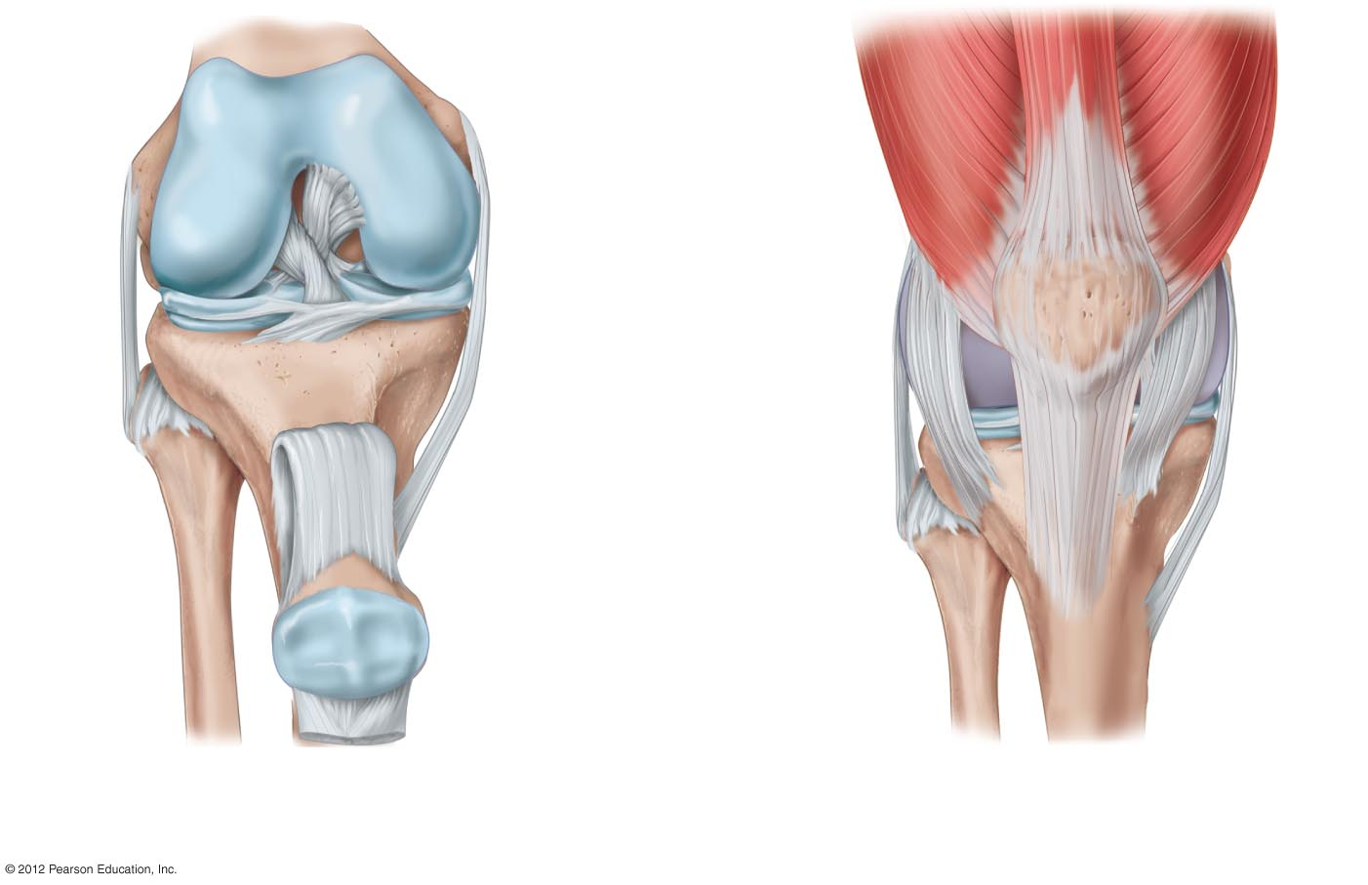
Femur
Hyaline cartilage
Thigh muscles
Posterior
cruciate ligament
Tendon
Ligament
Anterior
cruciate ligament
Patella
Meniscus
Meniscus
Joint
capsule
Fibula
Ligaments
Ligaments
Tibia
Ligament
Patella
Tendon
a) A cutaway anterior view of the right knee
with muscles, tendons, and the joint capsule removed
and the bones pulled slightly apart so that the two
menisci are visible.
b) A view of the knee with muscles, tendons, and
ligaments in their normal position surrounding the
intact joint capsule. The combination of ligaments,
tendons, and muscles holds the knee tightly together.

Slide 3
Synovial Joints
Joint capsule
  synovial membrane + hyaline cartilage
Synovial membrane secretes synovial fluid as a lubricant
Hyaline cartilage acts as a cushion
Types of synovial joints
  Hinge joint
  Ball and socket joint
Tendons – join bone to muscle

Slide 4
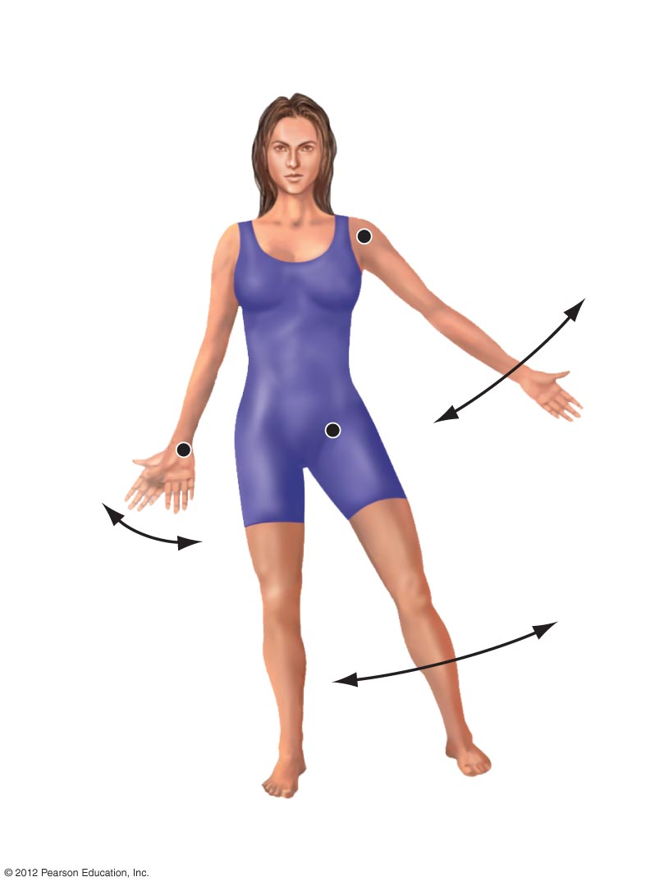
Abduction: Movement of a
limb away from a
body’s midline
Adduction:
Movement of a limb
toward the body’s
midline
Abduction
Adduction
Abduction
Adduction
Abduction
Adduction
a) Abduction and adduction.

Slide 5
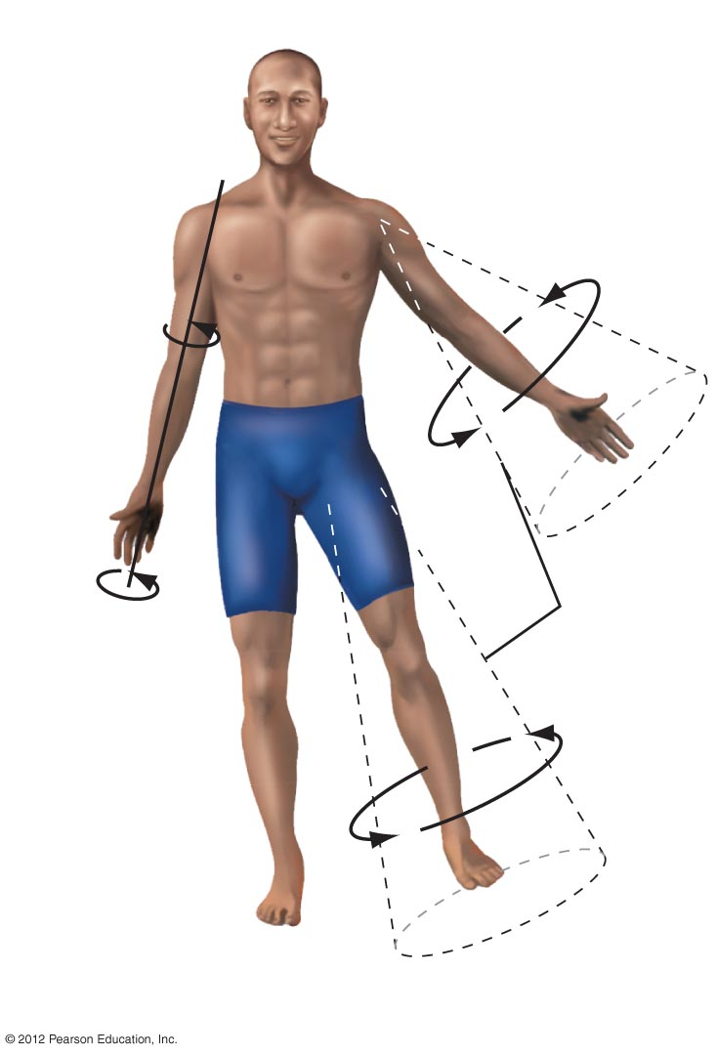
Circumduction:
Movement of a limb
so that it describes
a cone
Imaginary
cone of
movement
Rotation:
Movement of
a body part
around its own
axis
b) Rotation and circumduction.

Slide 6
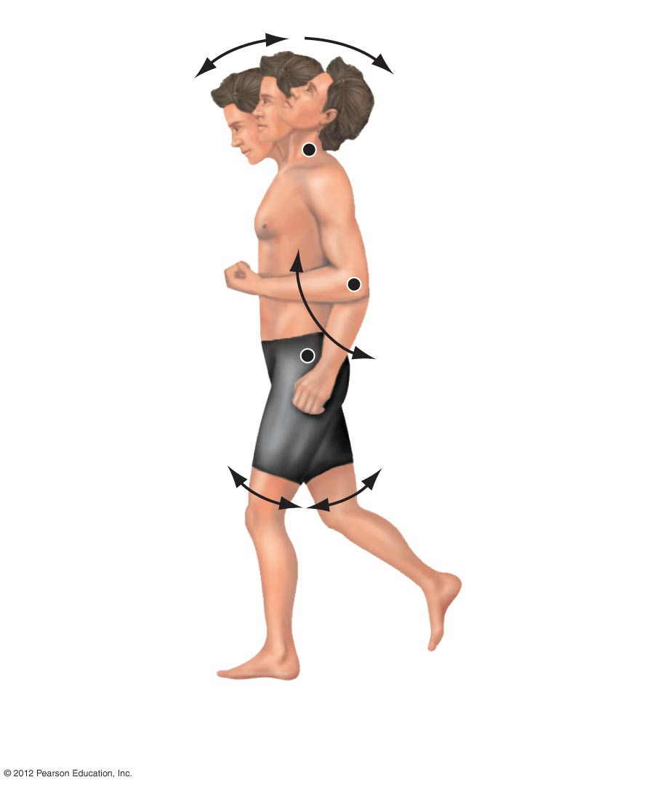
Extension
Flexion
Hyperextension
Flexion:
Decreases the
angle of a joint
Flexion
Hyperextension:
Extension beyond
the anatomical
position
Extension
Flexion
Hyperextension
Extension
Extension:
Increases the
angle of a joint
c) Flexion, extension, and hyperextension.

Slide 7
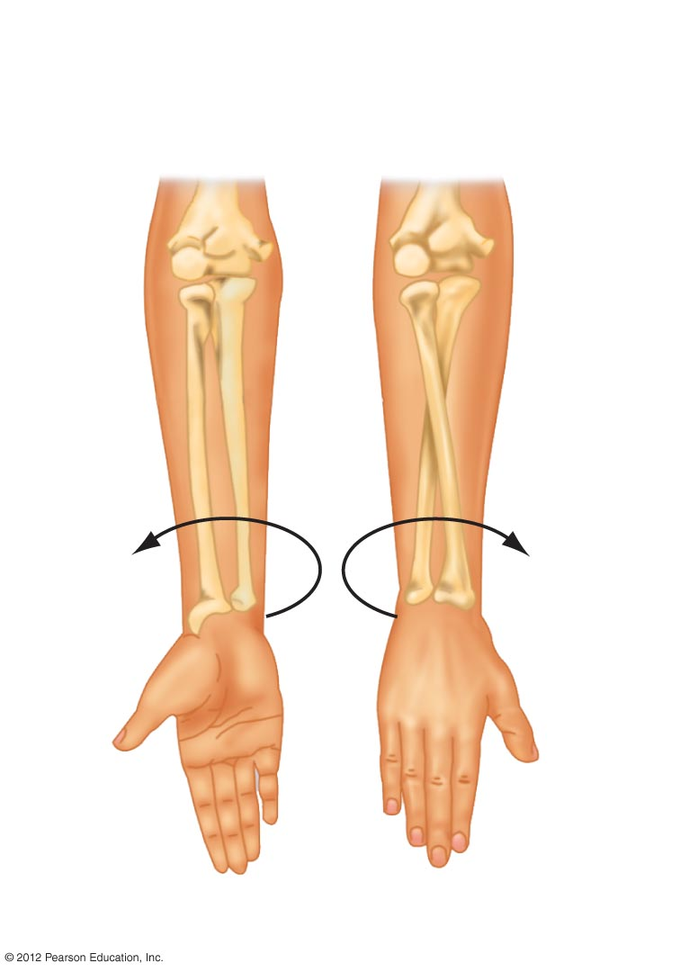
Supination:
Rotation of the
forearm so palm
faces anteriorly
Pronation:
Rotation of the
forearm so palm
faces posteriorly
Humerus
Ulna
Ulna
Radius
Radius
d) Supination and pronation.

