Slide 1

Appendicular Skeleton
Pectoral girdle: shoulder
  Clavicle and scapulas
Pelvic girdles: hip
  Coxal bones, sacrum
Arms
  humerus, radius, ulna, carpals, metacarpals and phalanges
Legs
  femur, tibia, fibula, tarsals, metatarsals and phalanges

Slide 2
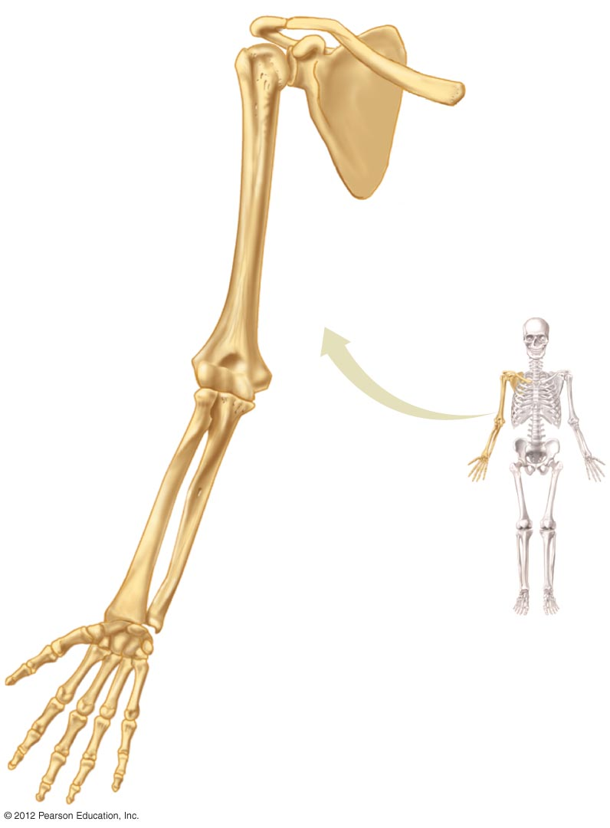
Clavicle
(collar bone)
Pectoral girdle
Scapula
(shoulder blade)
Humerus
(upper arm)
Ulna
Forearm
Radius
8 Carpals (wrist)
5 Metacarpals (hand)
14 Phalanges (finger bones)

Slide 3
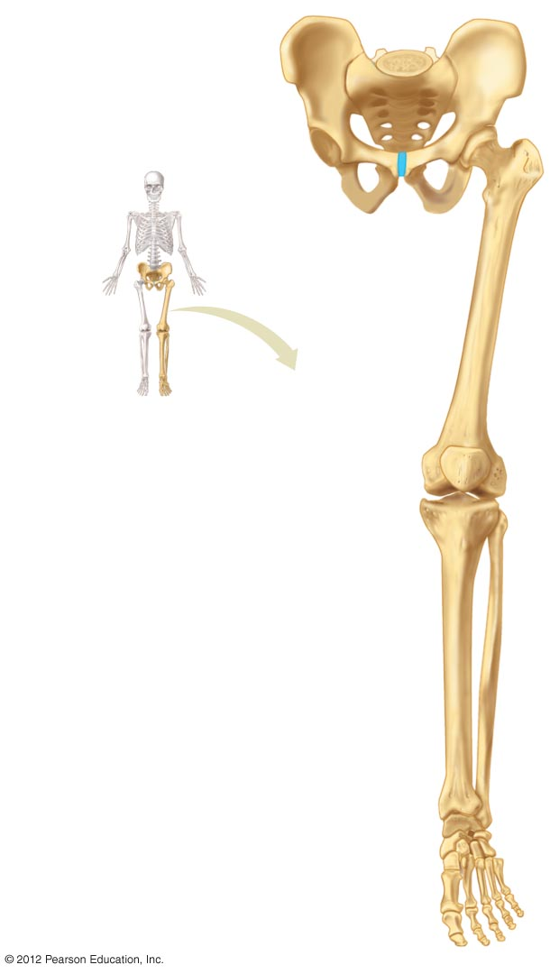
Coxal bones and
sacrum (pelvis)
Pubic symphysis
Femur (upper leg)
Patella (knee cap)
Tibia
Lower leg
Fibula
7 Tarsals (ankle)
5 Metatarsals (foot)
14 Phalanges (toe bones)

