Slide 1

Human Skeleton
206 bones
Axial skeleton
  Skull, vertebral column, sternum
Appendicular skeleton
  Pectoral girdle, pelvic girdle, limbs

Slide 2
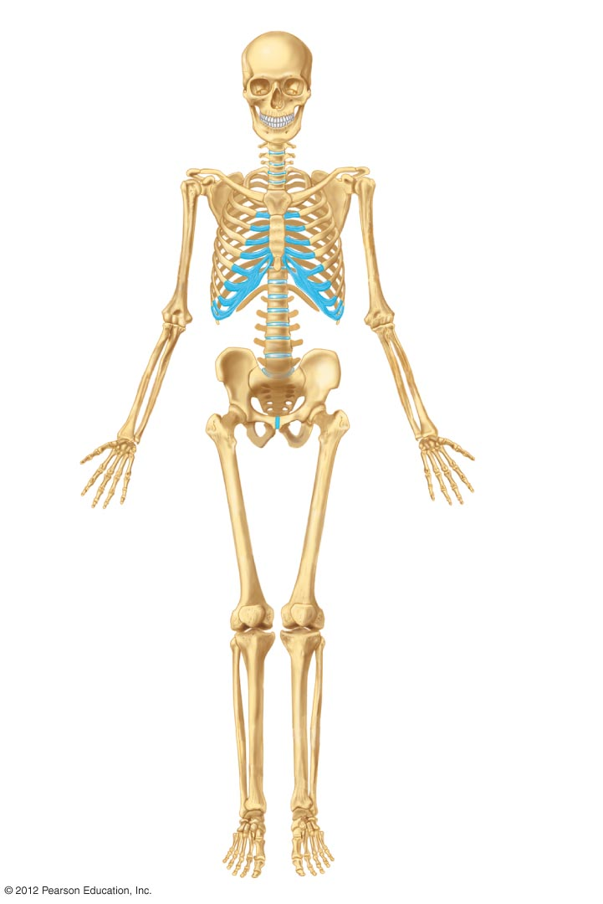
Axial skeleton
Appendicular skeleton
Cranium (skull)
Maxilla
Mandible
Clavicle
Scapula
Sternum
Ribs
Humerus
Vertebrae
Ulna
Radius
Carpals
Sacrum
Metacarpals
Phalanges
Coxal bone
Femur
Patella
Tibia
Fibula
Tarsals
Metatarsals
Phalanges

Slide 3
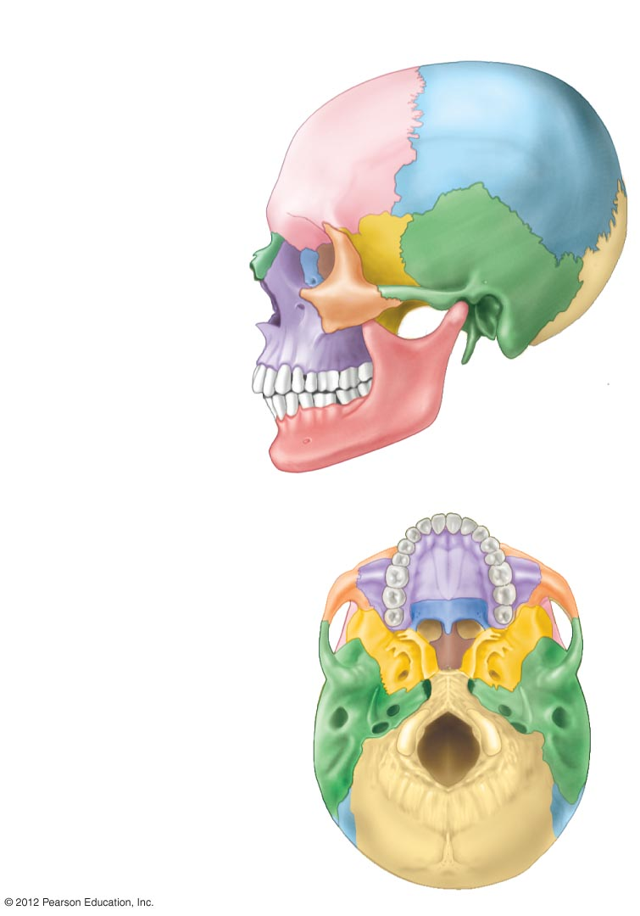
Temporal bone
Parietal bone
Frontal bone
Sphenoid bone
Ethmoid bone
Lacrimal bone
Nasal bone
Zygomatic bone
Maxilla
Occipital
bone
Mandible
External auditory
meatus
Maxilla
Zygomatic bone
Palatine bone
Sphenoid bone
Vomer bone
Foramen magnum
Occipital bone

Slide 4
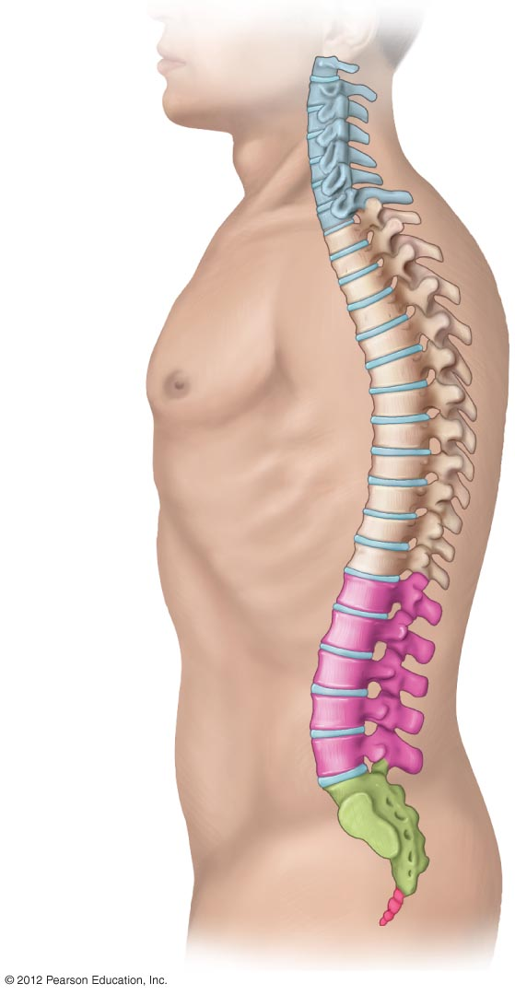
1
2
Cervical
vertebrae
(7)
3
4
5
6
7
1
2
3
4
5
6
Thoracic
vertebrae
(12)
7
8
9
10
11
12
1
2
Lumbar
vertebrae
(5)
3
4
5
Sacrum
(5 fused)
Coccyx
(4 fused)

Slide 5
Axial Skeleton: Vertebral Column (cont.)
Vertebral column
  Regions: cervical, thoracic, lumbar, sacral, coccygeal
  Intervertebral disks: cushion vertebrae; assist in movement and flexibility
Ribs
  Twelve pairs
  Bottom two pair floating
Sternum
  Three bones fused together

Slide 6
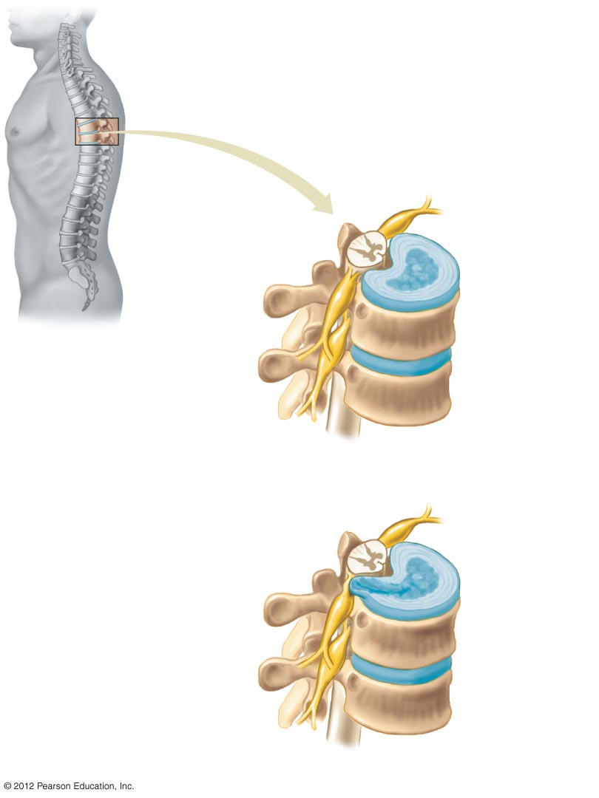
Spinal cord
Articulations with another vertebra
Intervertebral
disk
Spinal nerve
Articulation with ribs
Main bodies
of vertebrae
a) Healthy disks.
Herniated area
pressing against
a nerve
b) A herniated disk.

Slide 7
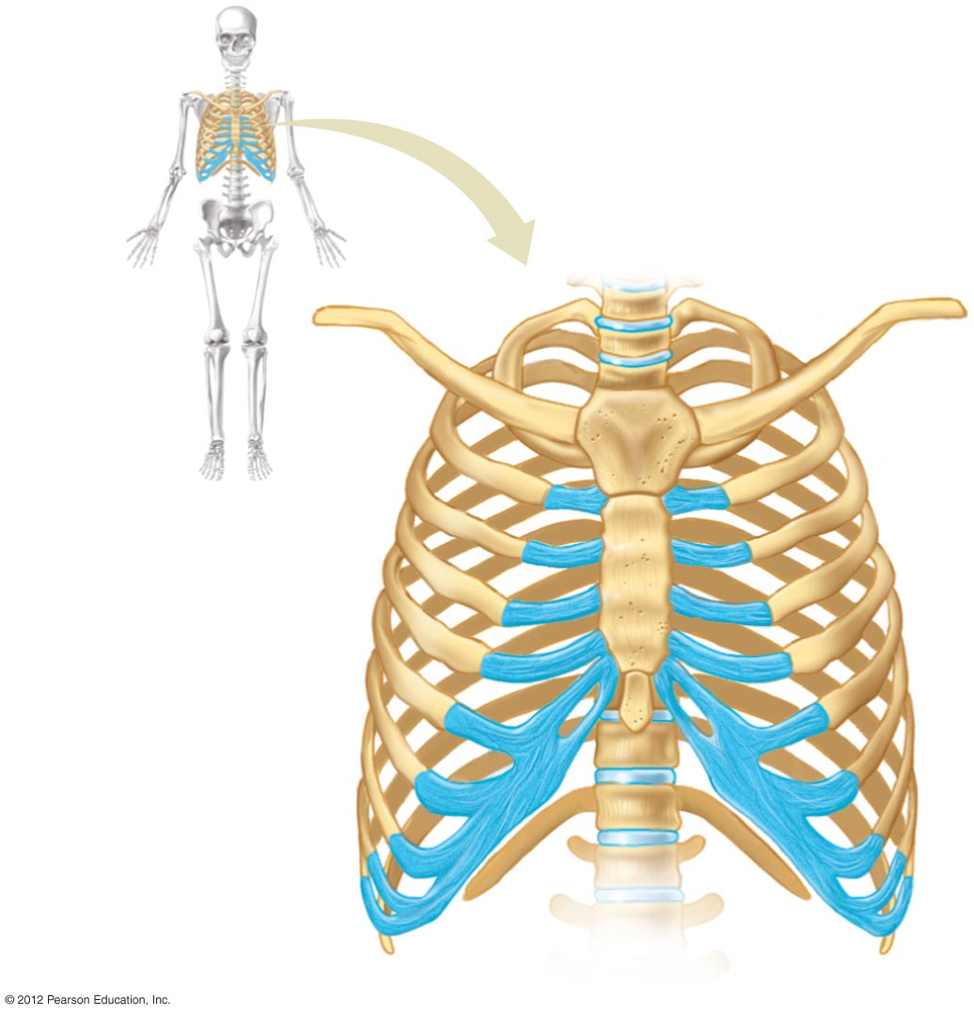
C₇
T₁
1
2
Sternum (breastbone)
3
4
Ribs
5
6
Cartilage
T₁₁
7
T₁₂
8
9
Vertebral column
L₁
10
12
L₂
Floating ribs
11

