Slide 1

Hormonal Control of Bone Growth
Preadolescence
  Growth hormone stimulates bone lengthening
Early Adolescence
  Estrogen and testosterone stimulate bone lengthening
Late Adolescence
  Estrogen and testosterone cause replacement of cartilage growth plates with bone

Slide 2
Cells Involved in the Development and Maintenance of Bone
Chondroblasts
  cartilage-forming cells
Osteoblasts
  young bone-forming cells
Osteocytes
  mature bone cells
Osteoclasts
  bone-dissolving cells

Slide 3
Mature Bone Remodeling and Repair
Changes in shape, size, strength
  Dependent on diet, exercise, age
Bone cells regulated by hormones
  Parathyroid hormone (PTH)
    removes calcium from bone
  Calcitonin
    adds calcium to bone
Repair
  hematoma and callus formation

Slide 4
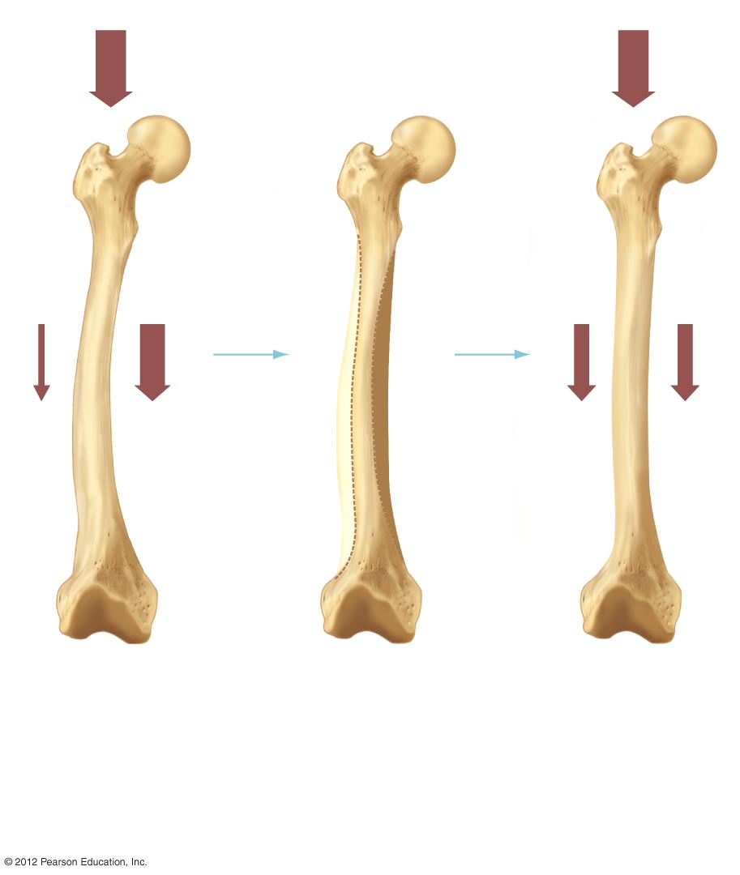
Compressive force
Bone removed here
New bone
added here
a) The application of force
to a slightly bent bone
produces a greater
compressive force on the
inside curvature.
Compressive force
produces weak electrical
currents which stimulate
osteoblasts.
(b) Over time, bone is
deposited on the inside
curvature and removed
from the outside
curvature.
c) The final result is
a bone matched to
the compressive
force to which it is
exposed.

