Slide 1

Bone Development
Early fetal development
  Formed by chondroblasts (cartilage-forming cells)
Later fetal development
  osteoblasts replace cartilage with bone
Childhood
  primary and secondary ossification sites formed
Adolescence
  elongation at growth plates

Slide 2
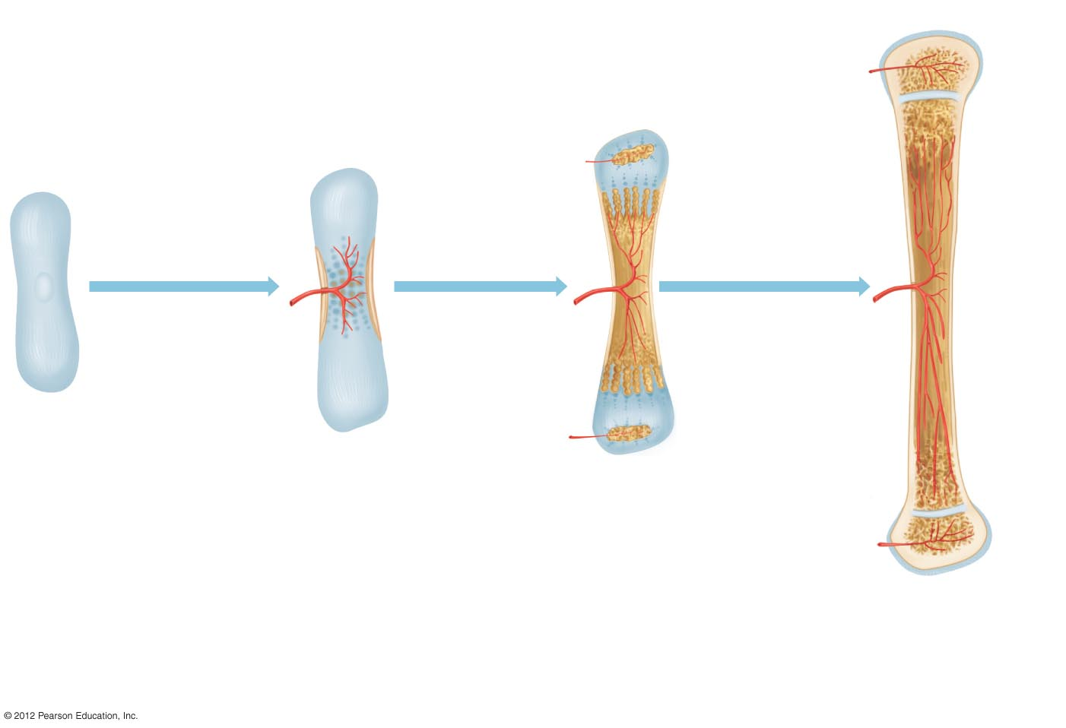
Adolescence
Early
Childhood
Cartilage growth
plate
Fetus: At
2–3 months
Fetus: First
2 months
Developing periosteum
Compact
bone
containing osteocytes
Blood vessel
Cartilage
growth
plate
a) Chondroblasts form
hyaline cartilage,
creating a rudimentary
model of future bone.
b) The periosteum
begins to develop
and cartilage starts
to dissolve. Newly
developing blood
vessels transport
osteoblasts into
the area from the
periosteum.
c) Osteoblasts secrete
osteoid and enzymes,
facilitating the deposition
of hard hydroxyapatite
crystals.
d) The growth plates in long bones
move farther apart and
osteoblast activity continues
just below the periosteum. The
bone lengthens and widens.

Slide 3
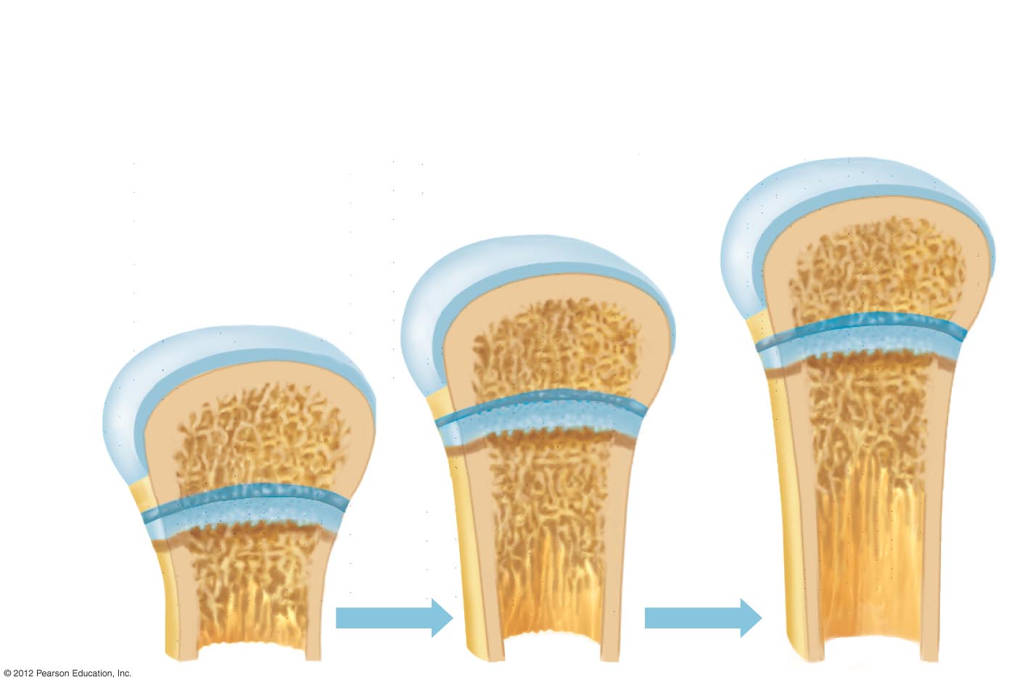
Osteoblasts
convert cartilage
to bone at the
inner surface
Chondroblasts deposit new
cartilage at the outer surface
Joint
cartilage
Growth plate

