Slide 1
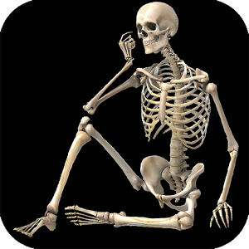

The Skeletal System

Slide 2
Skeletal System: Made of Connective Tissue
Three types of connective tissue
  Bone (Osseous tissue)
  Ligaments
  Cartilage

Slide 3
Bones – Functions
Bones
  hard elements of the skeleton
Five important functions
  Support
  Protection
  Movement
  Blood cell formation
  Mineral storage
    Calcium
    Phosphate

Slide 4
Bone – Structure
Bone:hard inorganic matrix of calcium salts
  Compact: forms shaft and ends, contains marrow space
  Spongy: trabeculae
  Cells: osteoblast, osteocytes, osteoclasts
  Types: long, flat, irregular
Osteons/haversian system
  cellular arrangement
Periosteum
  connective tissue covering

Slide 5
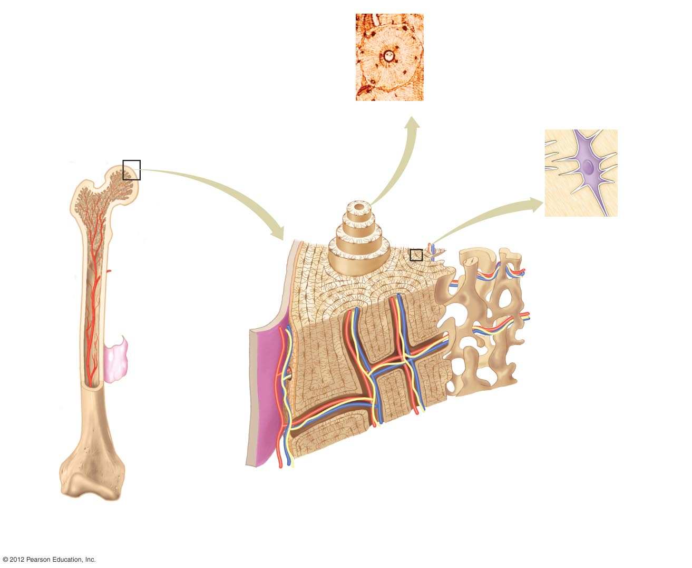
Central canal
Osteon
Osteocytes
c) A photograph of an
osteon of compact bone
showing osteocytes
embeded within the
solid structure.
Osteocyte
Lacuna
Spongy bone (spaces contain red bone marrow)
Osteon
Epiphysis
Canalicula
d) A single osteocyte in a
lacuna. Osteocytes remain
in contact with each other by
cytoplasmic extensions into
the canaliculi between cells.
Compact
bone
Yellow bone marrow
Blood
vessel
Diaphysis
Periosteum
Central cavity (contains yellow bone marrow)
Spongy bone
Compact bone
Epiphysis
Osteoblasts
Blood vessels and
nerve in central canal
a) A partial cut through a long bone.
b) A closer view of a section of bone.
Compact bone is a nearly solid structure
with central canals for the blood vessels
and nerves.

Slide 6
Cartilage and Ligaments
Cartilage
  Function
    support
  Types
    Fibrocartilage
    Hyaline
    Elastic cartilage
Ligaments
  Function
    attach bone to bone
  Dense fibrous connective tissue

