Slide 1

Multicellular Organisms Must Maintain Homeostasis
Maintenance of relative constancy of the conditions of the internal environment
Negative feedback control system
  deviations from normal are detected and counteracted
Components of a negative feedback control system
  Controlled variable
  Sensor
  Control center
  Effector

Slide 2
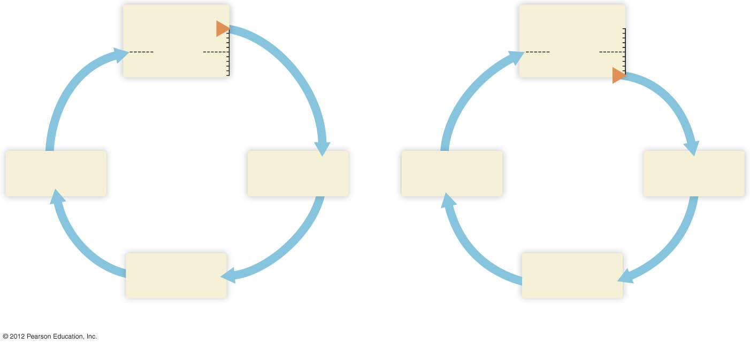
Controlled variable
Controlled variable
Higher
Higher
Set point
Set point
Lower
Lower
Effector
Sensor
Effector
Sensor
Control center
Control center
a) An increase in the controlled variable causes events that lower
the controlled variable toward its set point again.
b) A decrease in the controlled variable causes events that raise
the controlled variable toward its set point again.

Slide 3
Negative Feedback Helps Maintain Core Body Temperature
Controlled variable: body temperature
Sensors: temperature sensors in skin and internal organs
Control center: hypothalamus
Effectors
  Blood vessels
  Sweat glands
  Skeletal muscles

Slide 4
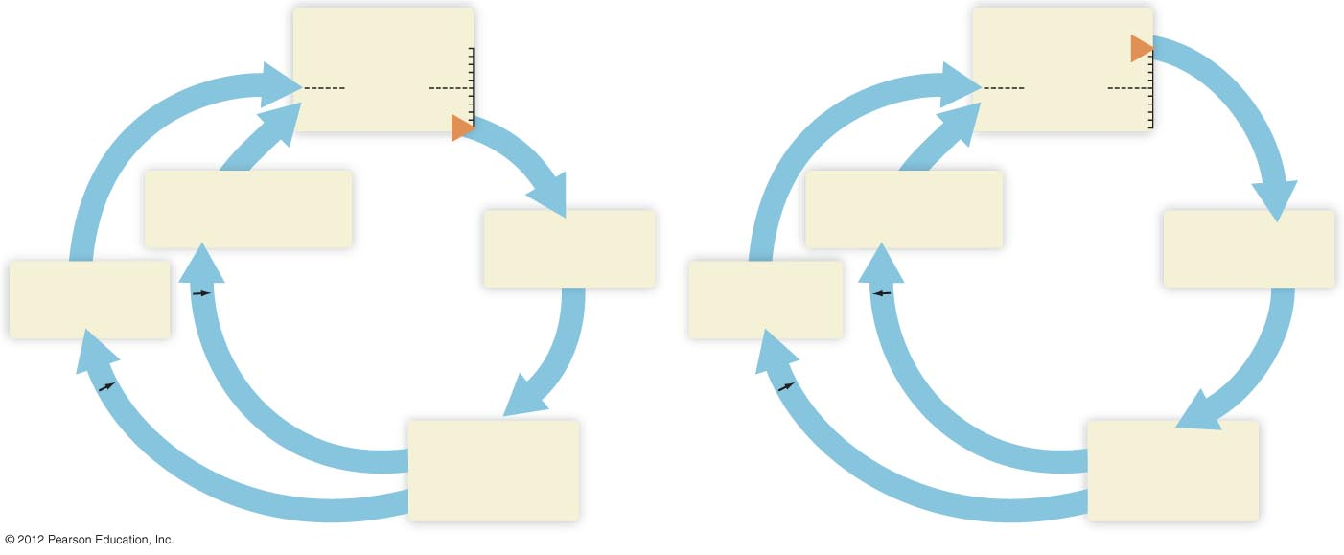
Core temperature
Core temperature
Higher
Higher
Set point
Set point
Lower
Lower
Constriction of blood
vessels in skin
(saves heat)
Dilation of blood
vessels in skin
(promotes heat loss)
Sensors
Sensors
Shivering
(generates heat)
Sweating
Nerve activity
Nerve activity
to
to
Nerve activity
blood vessels
Control center
(hypothalamus)
Nerve activity
blood vessels
Control center
(hypothalamus)
to
to
skeletal muscle
sweat glands

