Slide 1

Muscle Tissue Contracts to Produce Movement
Skeletal muscle
  Moves body parts
  Voluntary, multinucleated
Cardiac muscle
  Functions in the heart
  Involuntary, single nucleus
Smooth muscle
  Surrounds hollow structures
  Involuntary, single nucleus

Slide 2
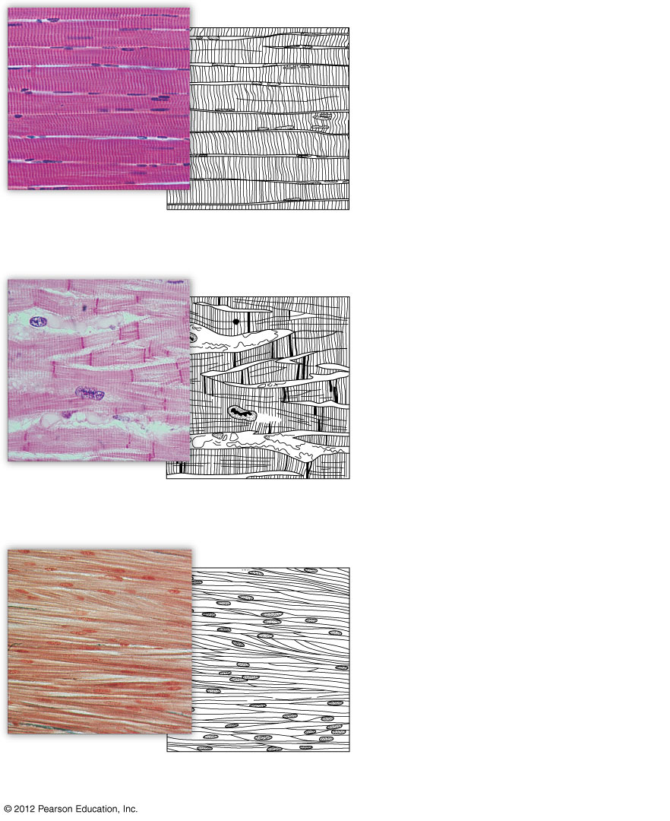
Nuclei
Width of one muscle cell
a) Skeletal muscle (X 100). Skeletal muscle cells are very long
and have many nuclei.
Intercalated disc
Nucleus
b) Cardiac muscle (X 225). Cardiac muscle cells interconnect
with each other.
Smooth muscle cell
Nucleus
c) Sheet of smooth muscle (X 250). Smooth muscle cells are
thin and tapered.

Slide 3
Nervous Tissues Transmit Impulses
Neuron
  specialized nervous system cell
    Function: generate and transmit electrical impulses
    Structural components: cell body, dendrites, axon
Glial cells support neurons

Slide 4
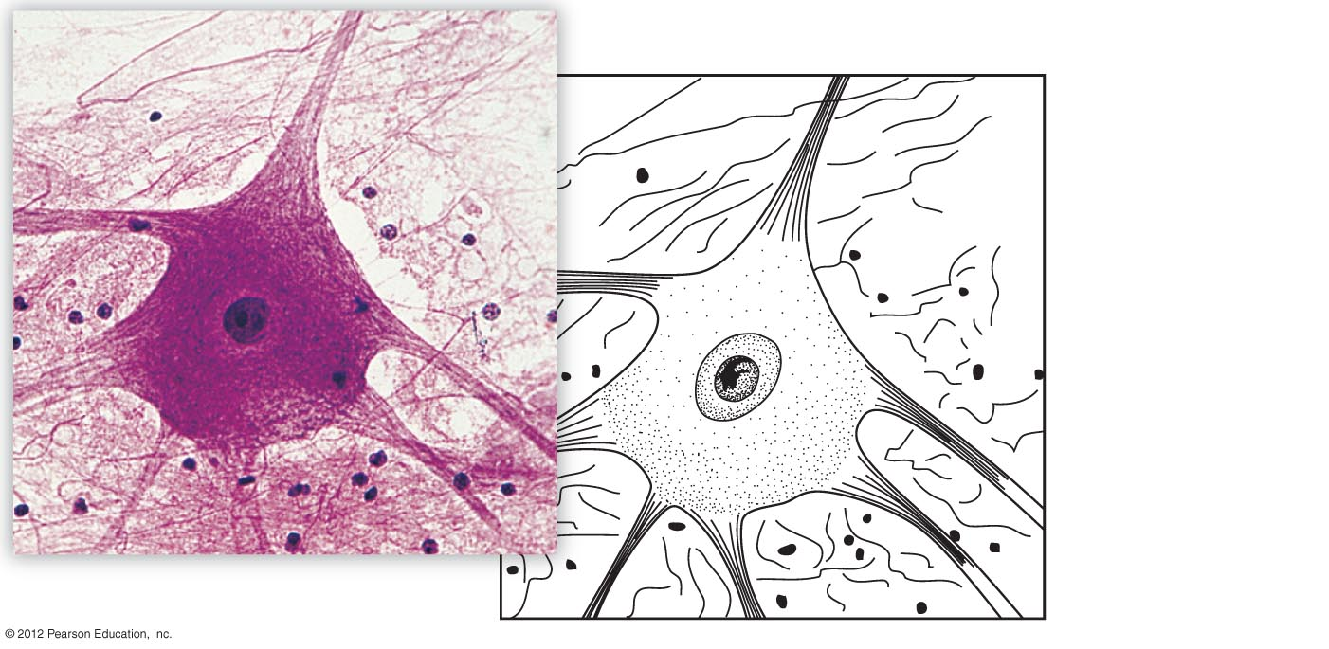
Axon
Nuclei of glial cells
Cell body
Dendrites

