Slide 1

Connective Tissue
General functions
  Supports softer organs of body
  Connects parts of body
  Stores fat
  Produces blood cells
Contains fibers and cells embedded in nonliving extracellular matrix
Matrix provides the strength
Two general types
  Fibrous and special

Slide 2
Fibrous Connective Tissue
Function
  provides strength and elasticity
Cells
  Fibroblasts
  Macrophages
  Lymphocytes
  Neutrophils
Fibers
  Collagen
  Elastic
  Reticular

Slide 3
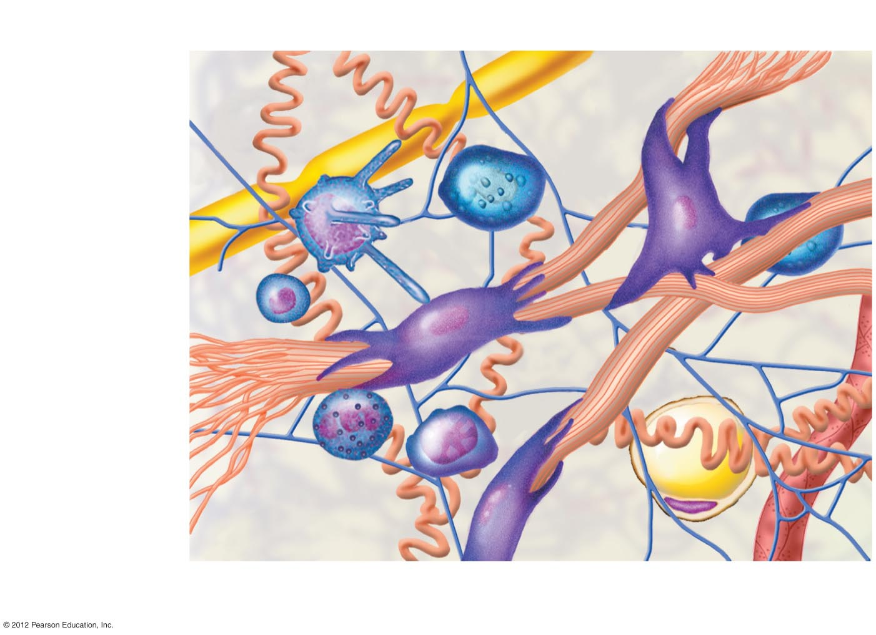
Mast cell
Fibroblast
Elastic fiber
Reticular fiber
Macrophage
Nerve fiber
Lymphocyte
Collagen fiber
Neutrophil
Plasma cell
Ground substance
Fat cell
Capillary

Slide 4
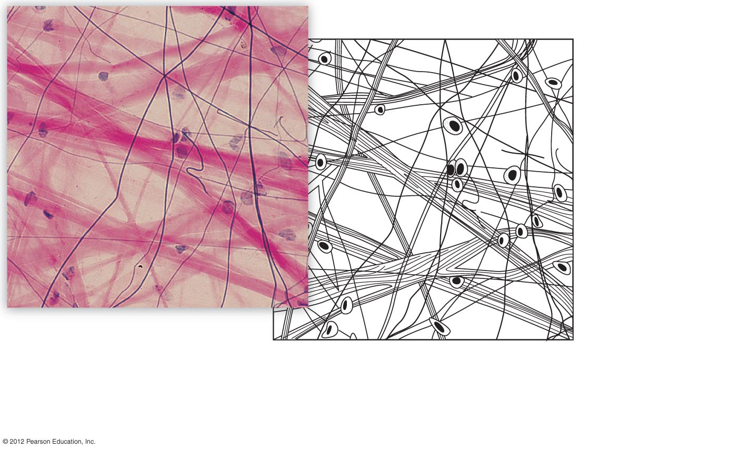
Elastin fibers
Fibroblast
Collagen fibers
Loose areolar connective tissue (X 160). In loose connective tissue the collagen and elastin fibers are arrayed in a random
pattern.

Slide 5
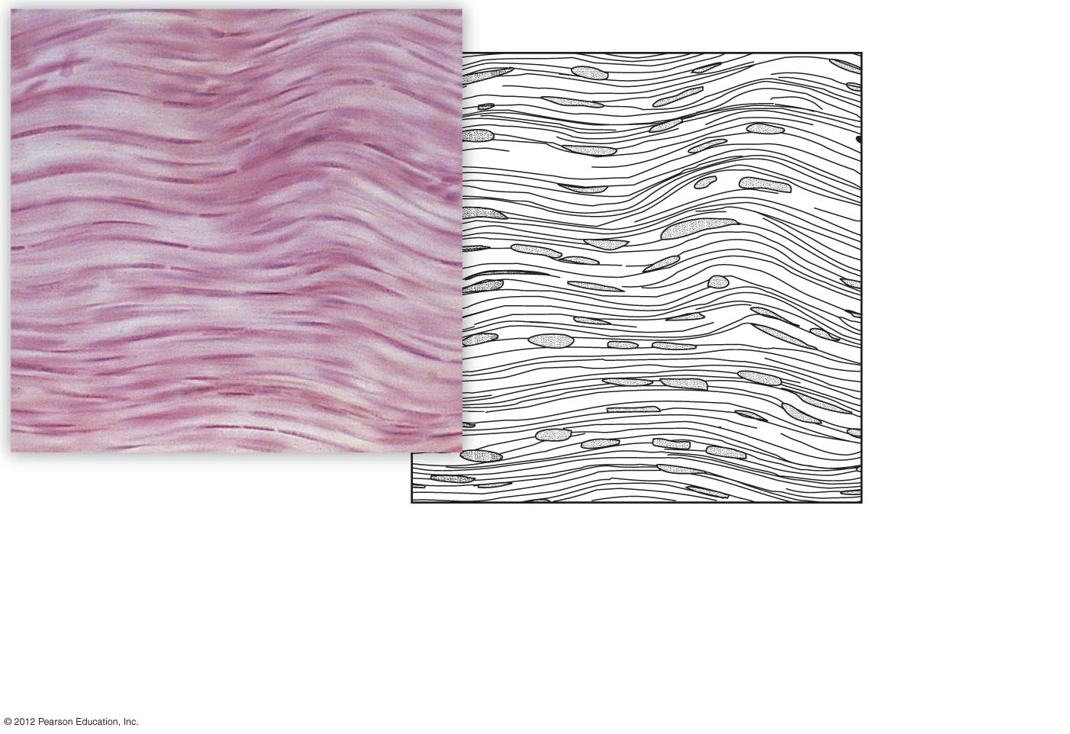
Collagen fibers
Nuclei of fibroblasts
b) Dense connective tissue (X 160). In dense connective
tissue the fibers are primarily collagen fibers. In tendons and
ligaments the fibers are oriented all in the same direction,
with fibroblasts occupying narrow spaces between adjacent
fibers.

Slide 6
Specialized Connective Tissues
Cartilage
  produced by chondroblasts found in lacunae
  no blood vessels
  high collagen content

Slide 7
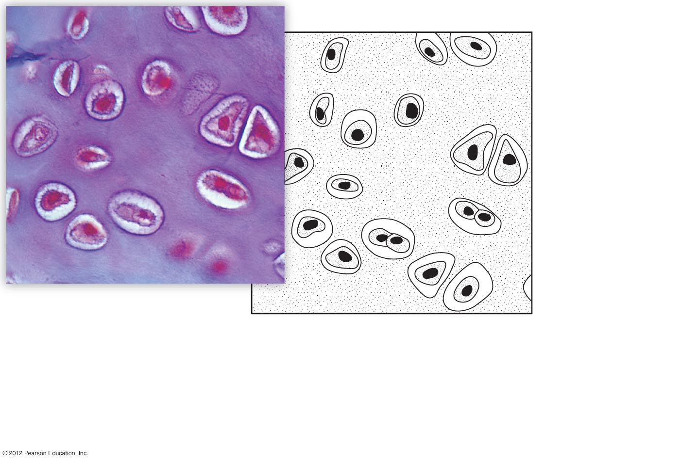
Chondrocyte in lacuna
Ground substance
Cartilage from the trachea (X 300). Mature cartilage cells, called chondrocytes, become trapped in chambers called lacunae within the hard, rubbery ground substance. Ground substance is composed of collagen fibers, polysaccharides, proteins, and water.

Slide 8
Specialized Connective Tissues
Bone
  inorganic matrix with calcium salts for hardness

Slide 9
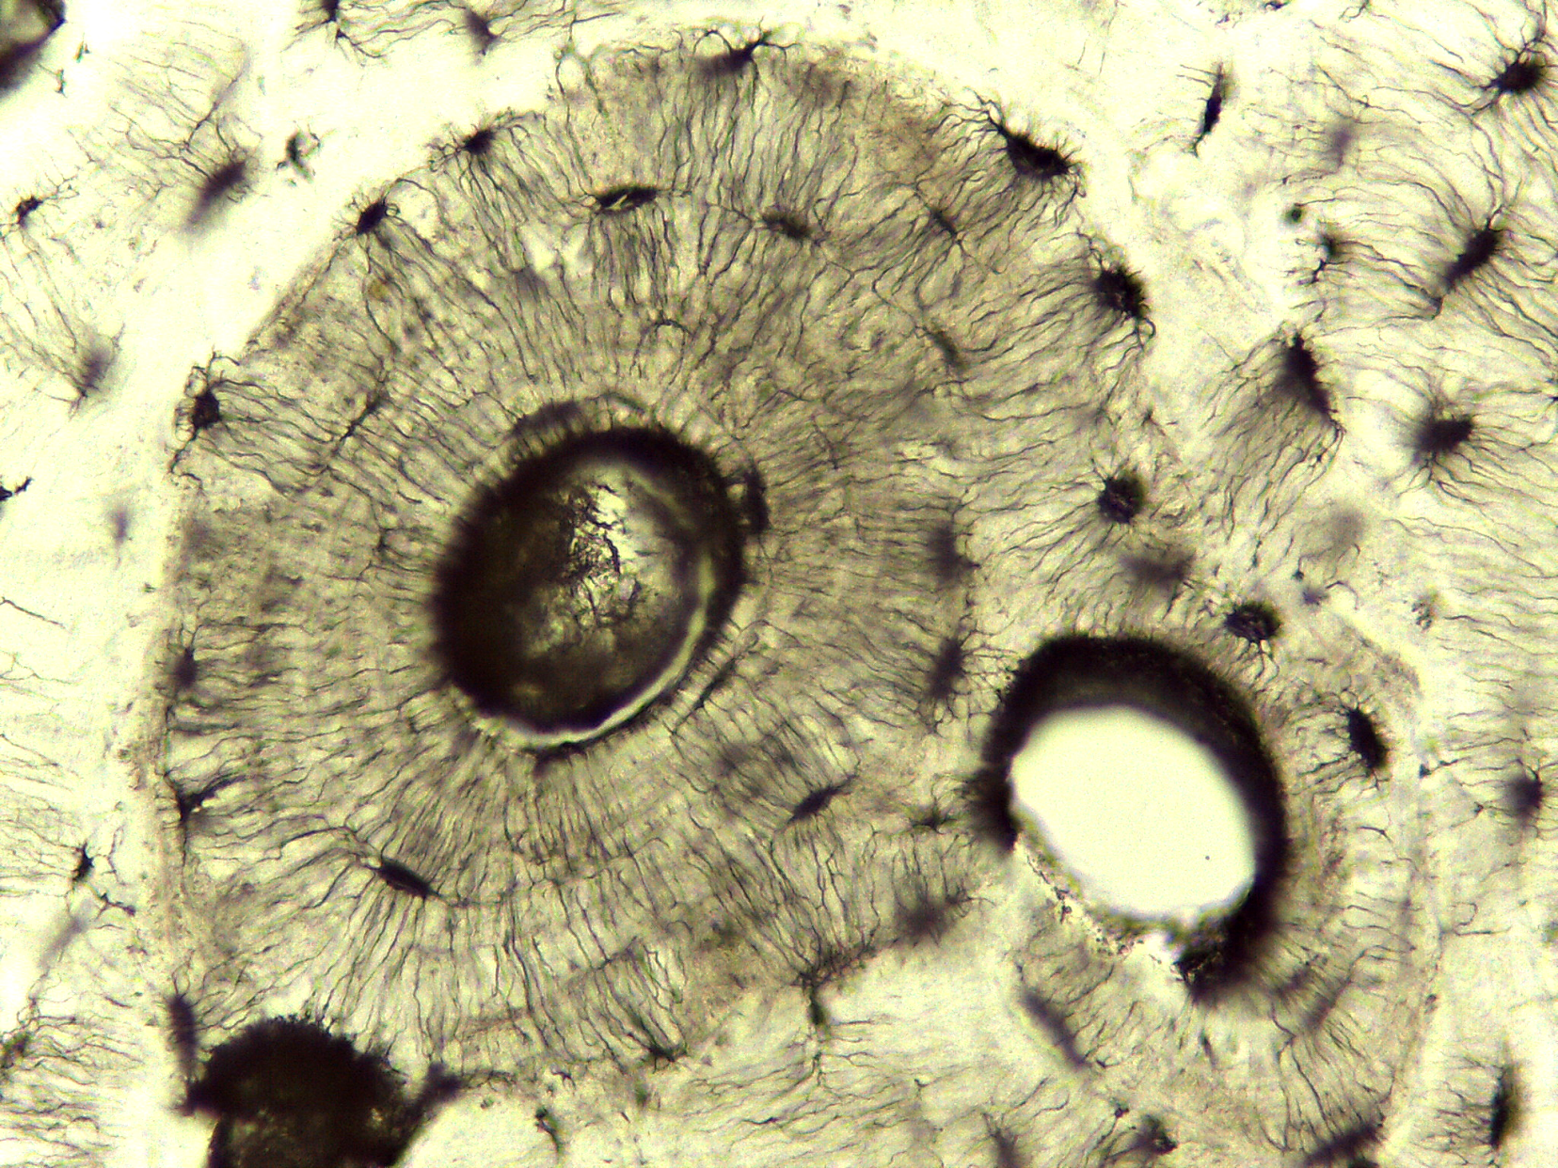
Bone Connective Tissue

Slide 10
Specialized Connective Tissues
Blood
  fluid matrix of plasma
  red blood cells
  white blood cells
  platelets

Slide 11
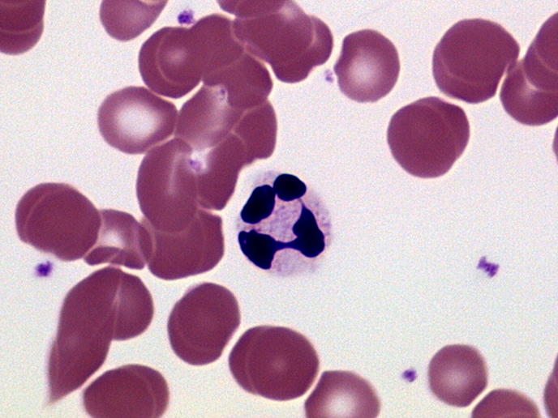
Blood Connective Tissue
Red
Blood
Cells
White
Blood
Cell
Platelet

Slide 12
Specialized Connective Tissues
Adipose tissue
  fat cells
  function in insulation, protection, and energy storage

Slide 13
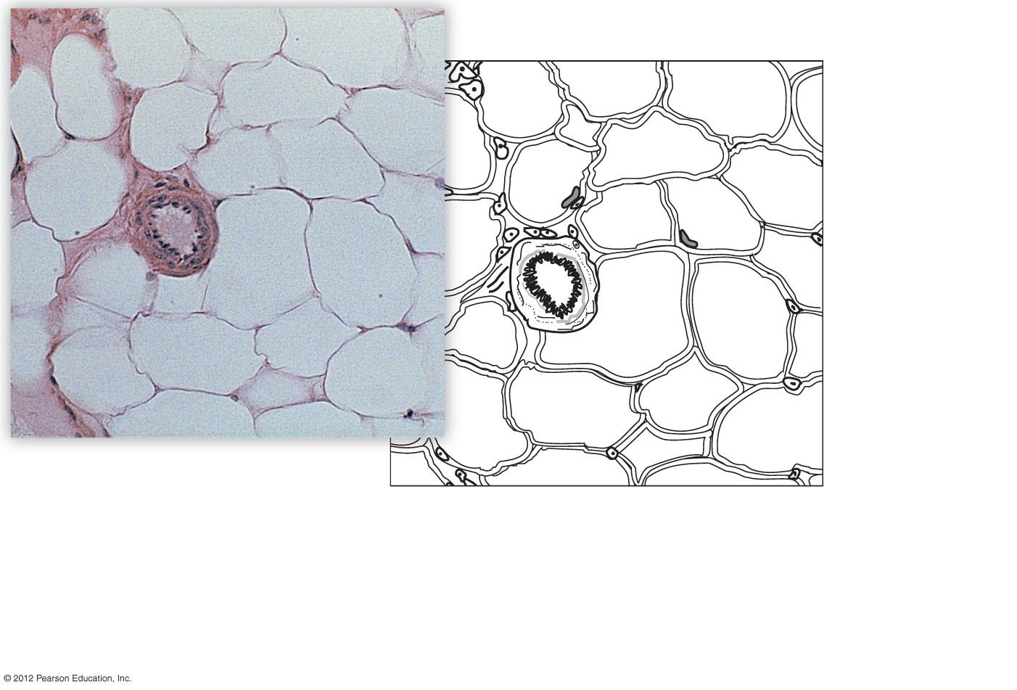
Vacuole containing stored fat
Blood vessel
Nuclei of fat cells
b) Adipose tissue from the subcutaneous layer under the
skin (X 140). Adipose tissue consists almost entirely of fat cells.
The fat deposit within a fat cell can become so large that the
nucleus is pushed to the side.

