Slide 1
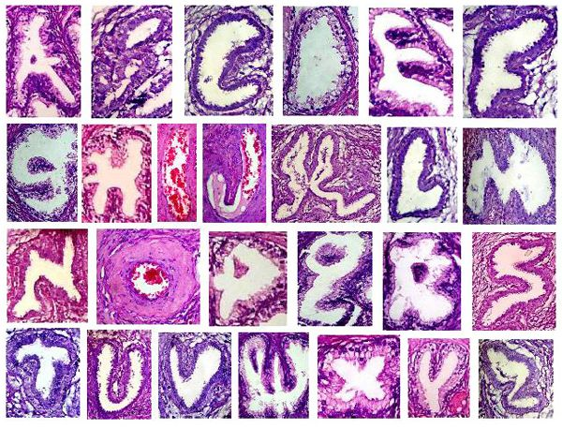

Tissues (Histology)

Slide 2
Tissues
Groups of cells with a common function
Four primary tissues
  Epithelia
  Connective tissues
  Muscle
  Nervous

Slide 3
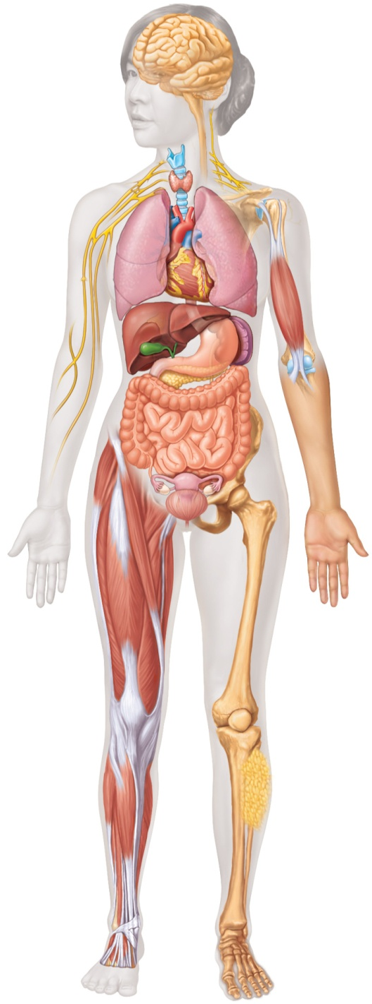
Various Tissue Locations - Informational
Nervous tissue: Internal communication
• Brain, spinal cord, and nerves
Muscle tissue: Contracts to cause movement
• Muscles attached to bones (skeletal)
• Muscles of heart (cardiac)
• Muscles of walls of hollow organs (smooth)
Epithelial tissue: Forms boundaries between different
environments, protects, secretes, absorbs, filters
• Skin surface (epidermis)
• Lining of GI tract organs and other hollow organs
Connective tissue: Supports, protects, binds
other tissues together
• Bones
• Tendons
• Fat and other soft padding tissue

Slide 4
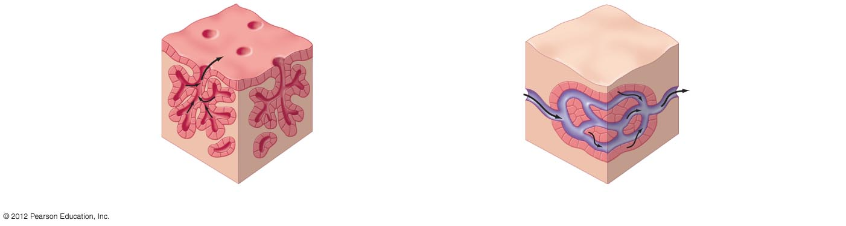
Epithelial Tissues
Line body cavities and cover surfaces
Glandular epithelia
  Epithelial cells adapted to make up glands
  Exocrine glands
    Secrete into ducts to exterior of body
  Endocrine glands
    Secrete into the blood
Exocrine gland
Endocrine gland
Gland cells
Gland cells
Blood flow
b) Glandular epithelia secrete a product.

Slide 5
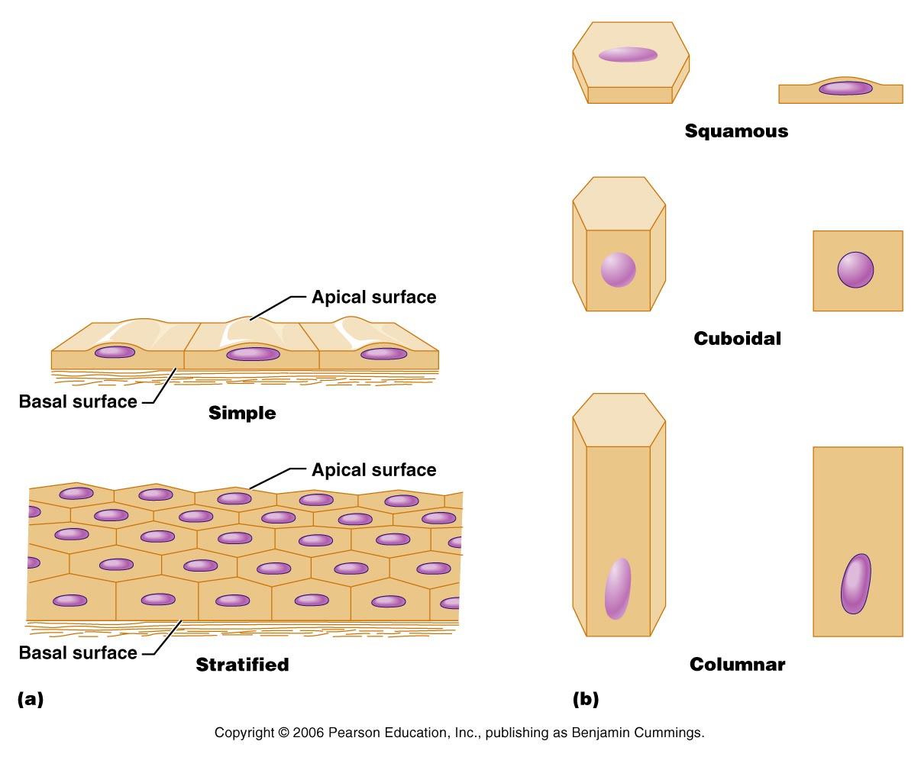
Epithelial Tissues: Classification
Shape
  Squamous
    Flattened cells (scale like)
  Cuboidal
    Cube shaped (box-like)
  Columnar
    Column shaped

Slide 6
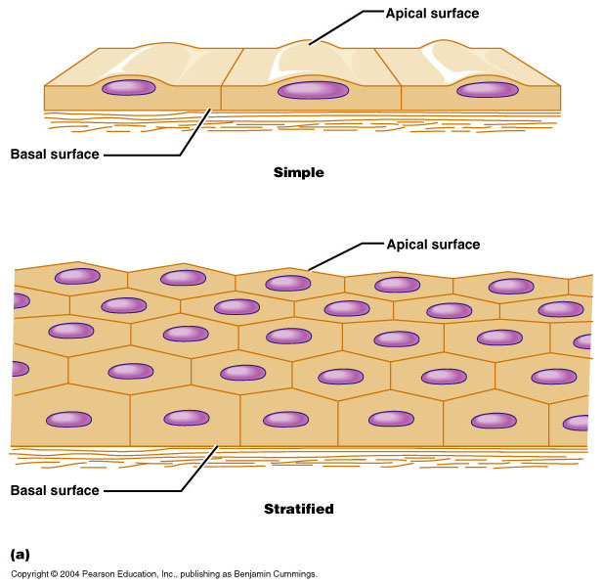
Epithelial Tissues: Classification
Number of layers
  Simple/single–layered
    Adapted for diffusion across cell barriers
  Stratified/multiple–layered
    Provide protection, as in the skin surface

Slide 7
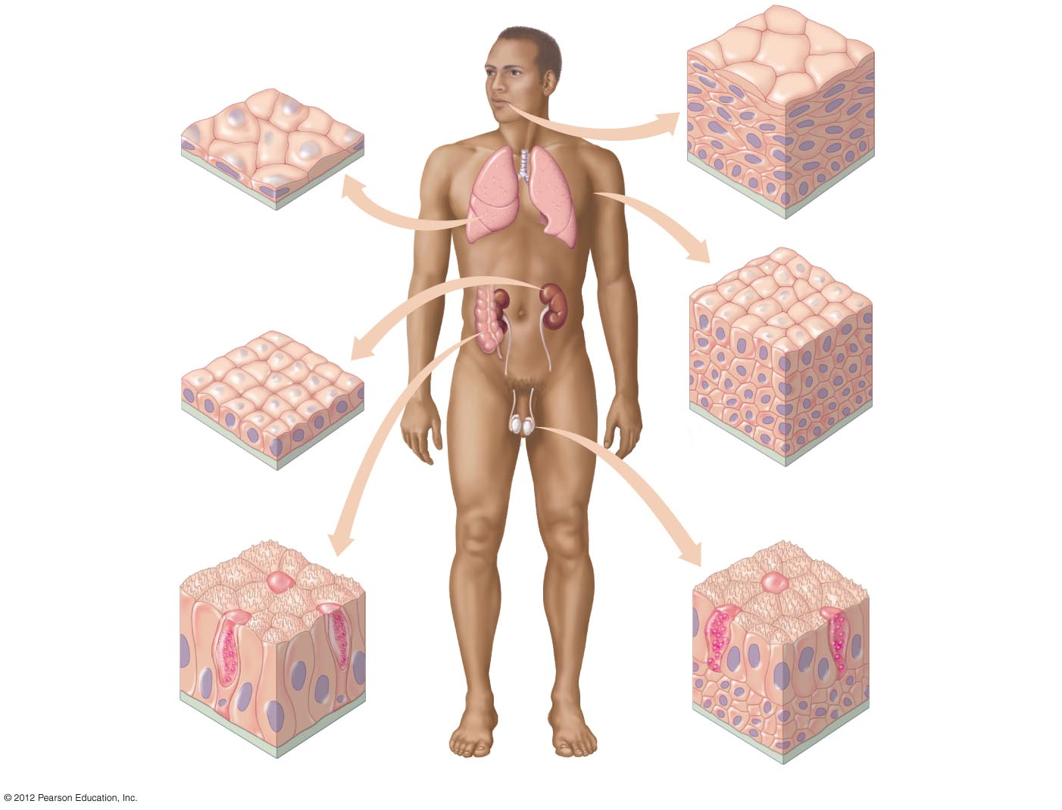
Stratified squamous
• Outer layer of skin,
mouth, vagina
• Protects against
abrasion, drying
out, infection
Simple squamous
• Lines blood vessels
and air sacs
of lungs
• Permits exchange
of nutrients, wastes,
and gases
Stratified cuboidal
• Lines ducts of
sweat glands
• Secretes water
and ions
Simple cuboidal
• Lines kidney
tubules and glands
• Secretes and
reabsorbs water
and small molecules
Simple columnar
• Lines most
digestive organs
• Absorbs nutrients,
produces mucus
Stratified columnar
• Lines epididymus,
mammary glands,
larynx
• Secretes mucus
Goblet cell
Basement membrane
a) Most epithelial tissues line or cover surfaces or body cavities.

Slide 8
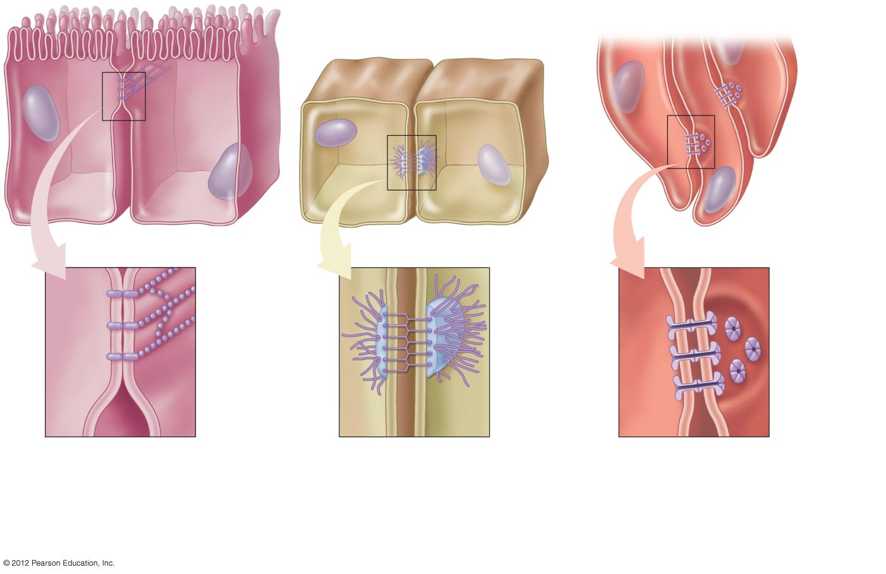
The Basement Membrane Provides Structural Support and Junctions
Tight junction proteins
Protein filaments
Protein channel
Intercellular space
Intercellular space
Intercellular space
a) Tight junctions form
leak-proof seals
between cells.
b) Adhesion junctions
anchor two cells together,
yet allow flexibility of
movement.
c) Gap junctions provide
for the direct transfer of
water and ions between
adjacent cells.

