Slide 1

Sources of Energy
Fat
  Triglycerides
  Long-term energy storage in animals
Glycogen
  Carbohydrate storage
  Short-term energy storage in animals

Slide 2
Cell Structures for Support and Movement
Cytoskeleton
  Structural support
Cilia
  Short, many
Flagella
  Long, single
Centrioles
  Cell division

Slide 3
Cells Use and Transform Matter and Energy
Anabolism
  Requires enzymes
  Used in making/assembling large molecules
  May require energy (ATP)
Catabolism
  Requires enzymes
  Breakdown of molecules
  May release energy

Slide 4
Glucose Provides the Cell with Energy
Energy in glucose is used to generate ATP
In absence of glucose, other carbohydrates, fats, and protein can be catabolized to generate ATP

Slide 5
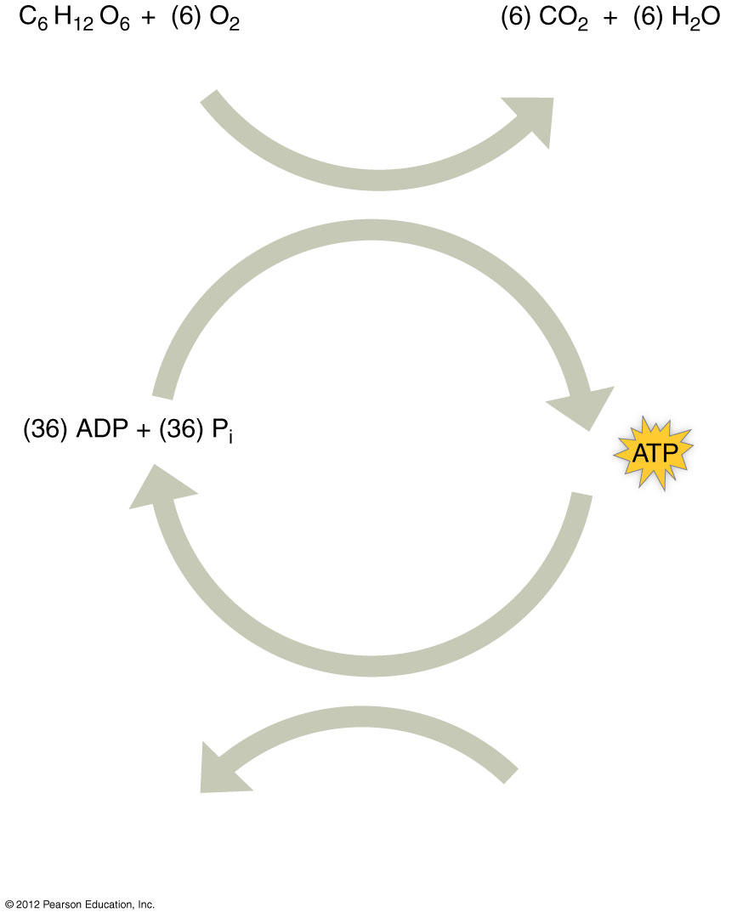
(glucose + oxygen)
(carbon dioxide + water)
Cellular
respiration
(Energy
required)
(Energy
released)
Cellular
work
Anabolism
Transport
Muscle contraction

Slide 6
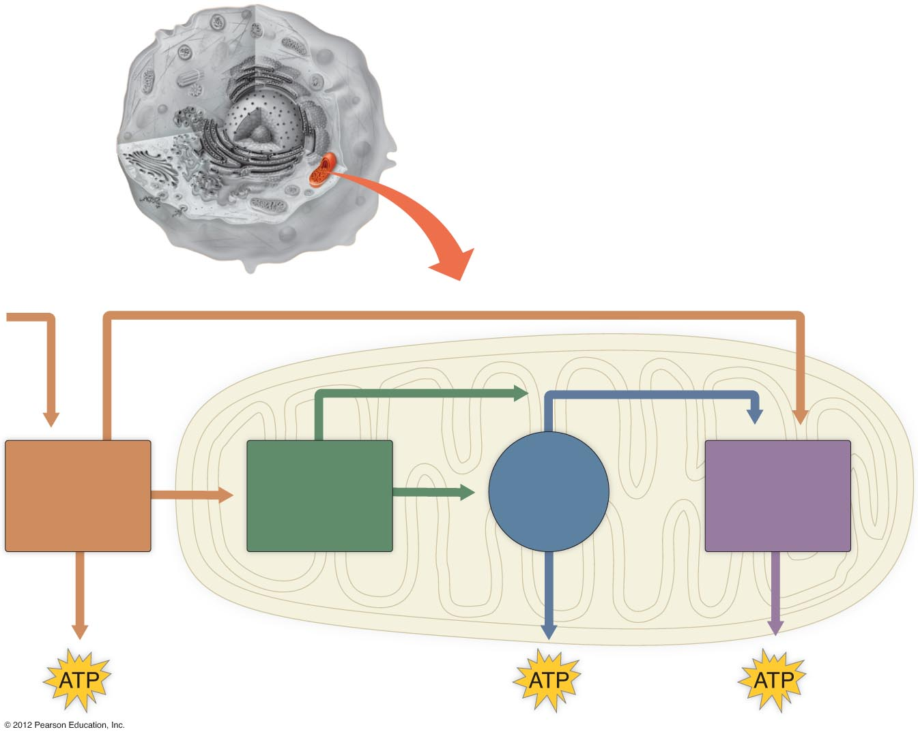
Energy
Energy
Energy
Energy
Citric
acid
cycle
Electron
transport
system
Glycolysis
Prepatory
step

Slide 7
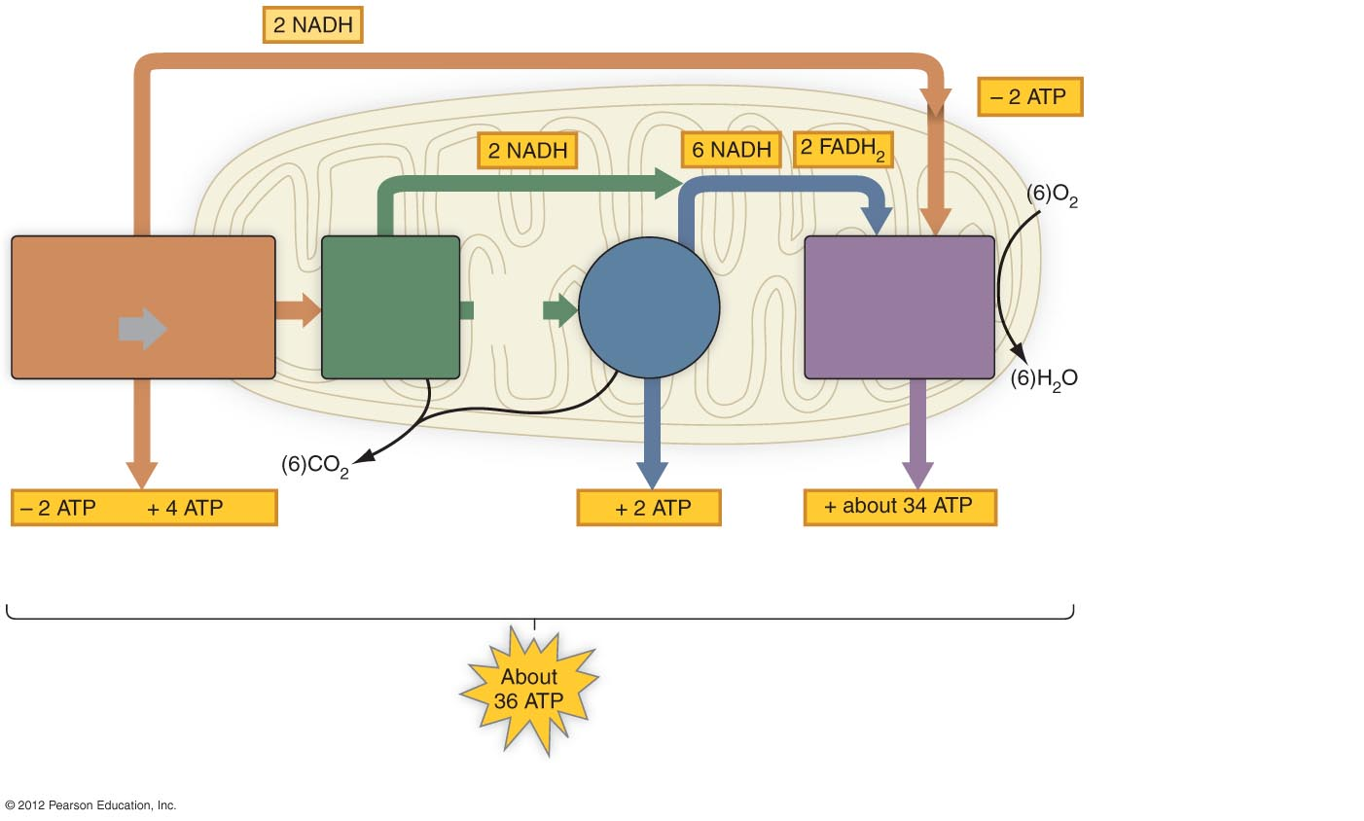
Mitochondrion
to shuttle electrons from
NADH in cytosol to NADH
within mitochondrion
Glycolysis
2
Acetyl
CoA
Citric
acid
cycle
Electron
transport chain
and oxidative
phosphorylation
2
Pyruvate
Preparatory
step
Glucose
to initiate
glycolysis
by substrate-level
phosphorylation
by substrate-level
phosphorylation
by oxidative
phosphorylation
a) Most of the ATP generated during cellular respiration is synthesized in the electron transport system.

Slide 8
Additional Energy Sources
Glycogen
Fats
  Triglycerides have twice the energy of carbohydrates
Proteins
  Have the same energy as carbohydrates

Slide 9
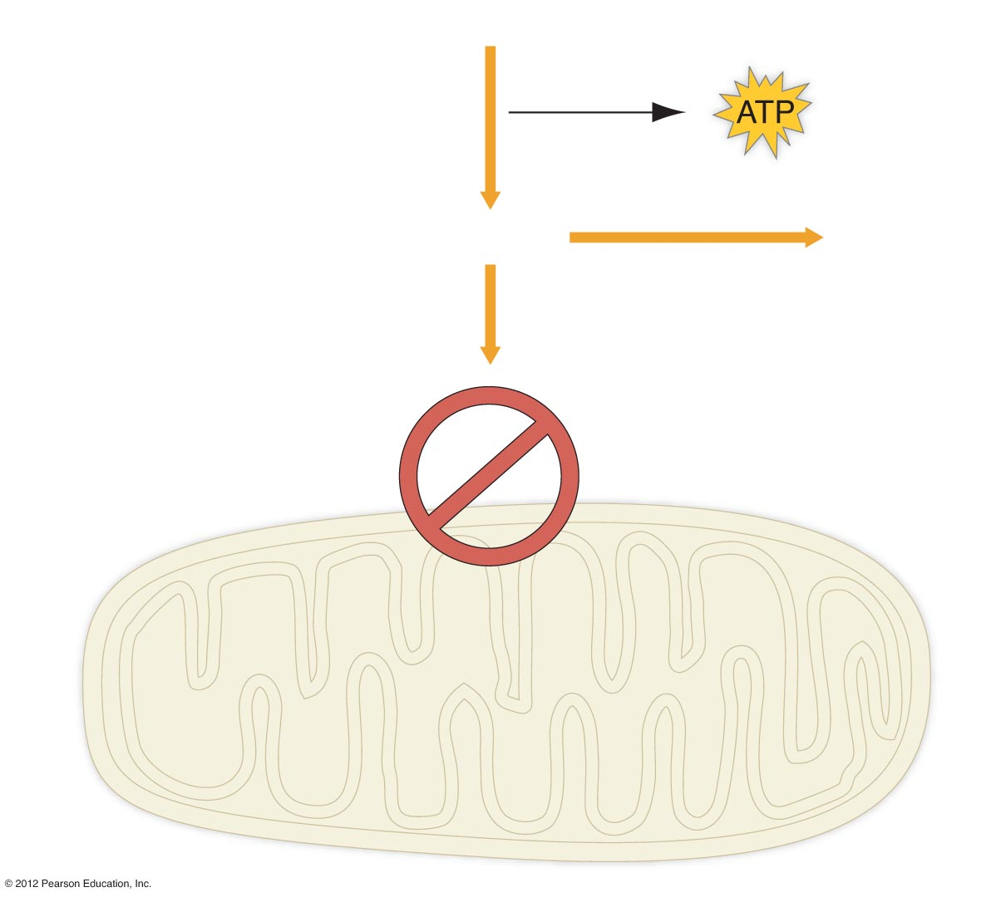
Anaerobic Pathways
Glucose
(Glycolysis)
Pyruvate
Lactic acid
buildup
Mitochondrial
metabolism
blocked without
oxygen
Mitochondrion

