Slide 1
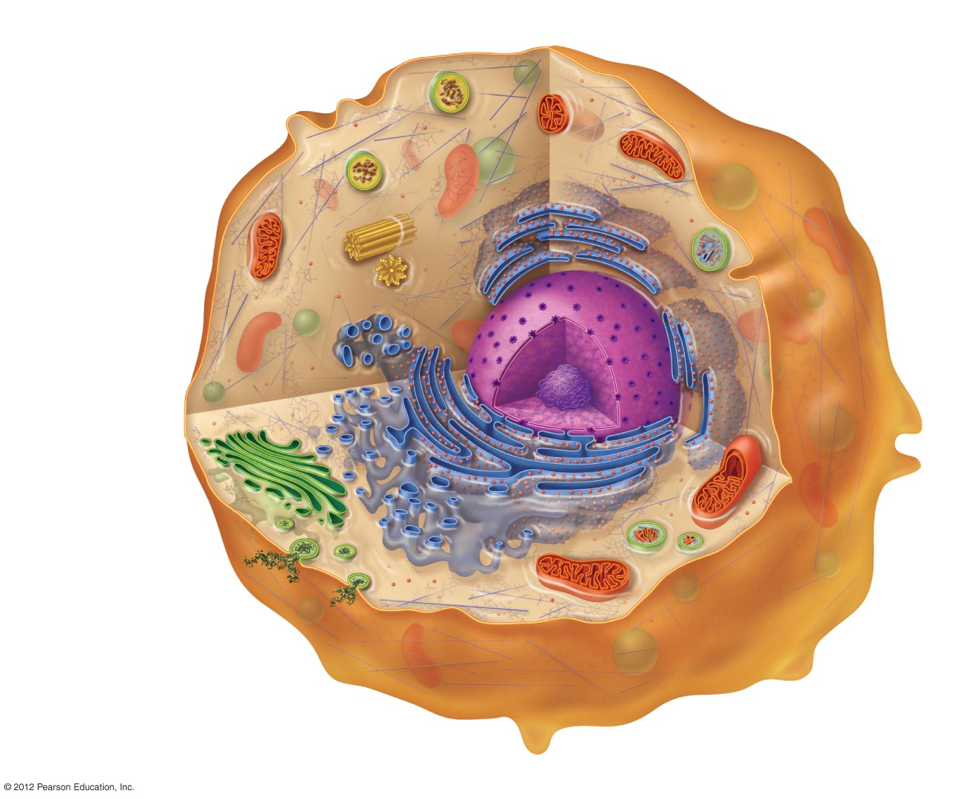

Cytosol
Semifluid gel material
inside the cell
Nucleus
Information
center for the
cell. Contains
DNA
Peroxisome
Destroys cellular toxic waste
Centrioles
Microtubular structures
involved in cell division
Cytoskeleton
Structural framework of
the cell
Smooth endoplasmic
reticulum
Primary site of
macromolecule
synthesis other than
proteins
Rough endoplasmic
reticulum
Primary site of
protein synthesis by
ribosomes
Golgi apparatus
Refines, packages, and
ships macromolecular
products
Secretory vesicle
Membrane-bound
shipping container
Ribosomes
Site of protein synthesis
Mitochondrion
Produces energy
for the cell
Plasma membrane
Controls movement of
materials into and out of cell
Lysosome
Digests damaged organelles
and cellular debris

Slide 2
Nucleus
Functions
  Contains the genetic information of the cell
  Controls the cell
Structural features
  Double-layered nuclear membrane
  Nuclear pores
  Chromosomes/chromatin
  Nucleolus

Slide 3
Ribosomes
Site of protein synthesis
Location
  Free: floating in cytoplasm
  Bound: attached to outer surface of endoplasmic reticulum

Slide 4
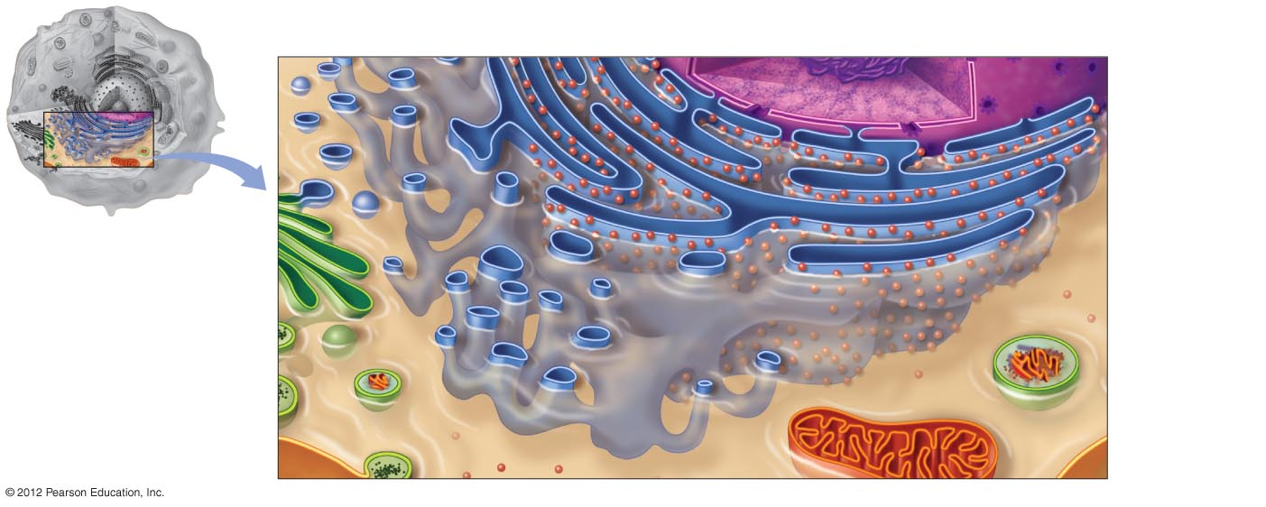
Endoplasmic Reticulum (ER)
Two types of endoplasmic reticulum (ER)
  Rough ER
    Has ribosomes on surface
    Protein manufacturing, modifications
  Smooth ER
    No ribosomes on surface
    Lipid synthesis
    Packages the proteins
Nucleus
Rough ER
Vesicle
Smooth ER

Slide 5
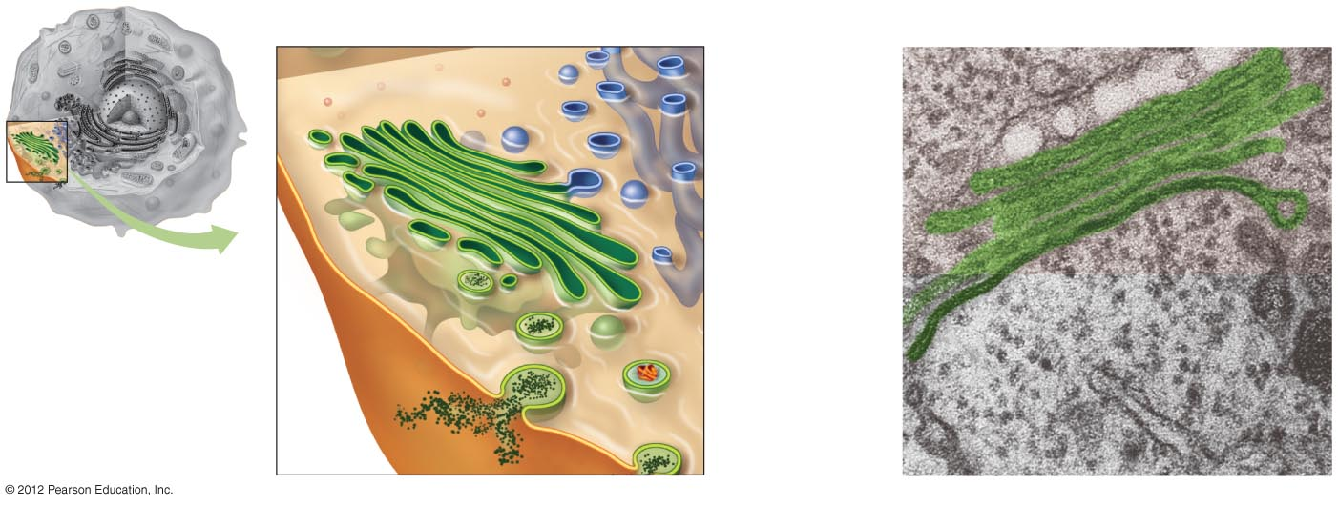
Golgi Apparatus
Refines synthesized products
Packaging and shipping center
Products are packaged into vesicles
Smooth ER
Golgi apparatus
Vesicles
Lysosome
Secretory vesicle
Plasma
membrane

Slide 6
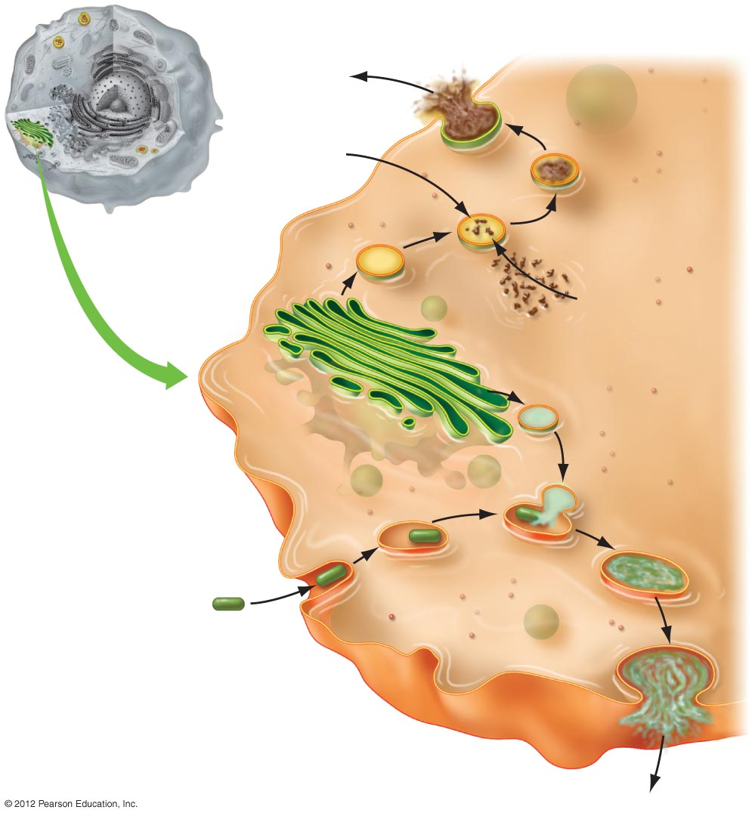
Vesicles
Storage and shipping vesicles
  Peroxisomes
    Contain enzymes that detoxify
  Lysosomes
    Contain digestive enzymes
Harmless
waste
Alcohol
Peroxisome
Golgi
apparatus
Cell toxic
waste
Lysosome
Residual
body
Bacterium
Plasma membrane

Slide 7
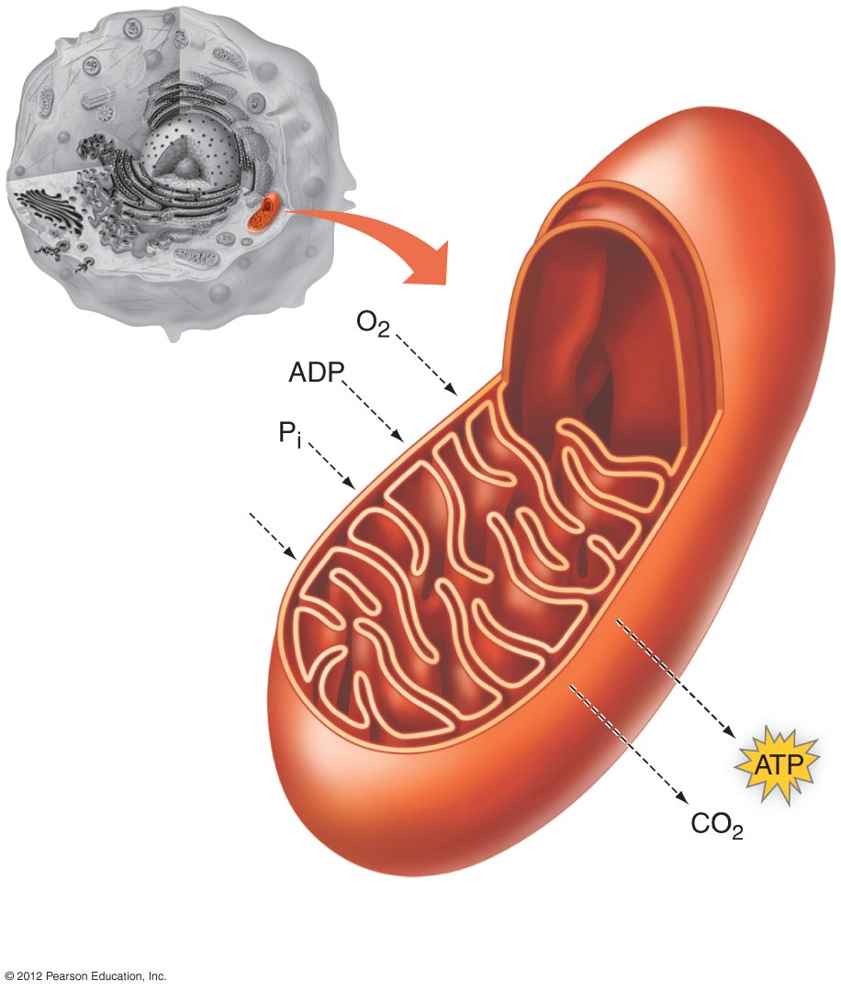
Mitochondria
“Power plant” of the cell
Surrounded by a double membrane
Utilizes O₂ and produces CO₂
Generates ATP
Nutrients
from
foodstuffs
Inner
membrane
Outer
membrane
a) The structure and overall function of a
mitochondrion.

