Slide 1
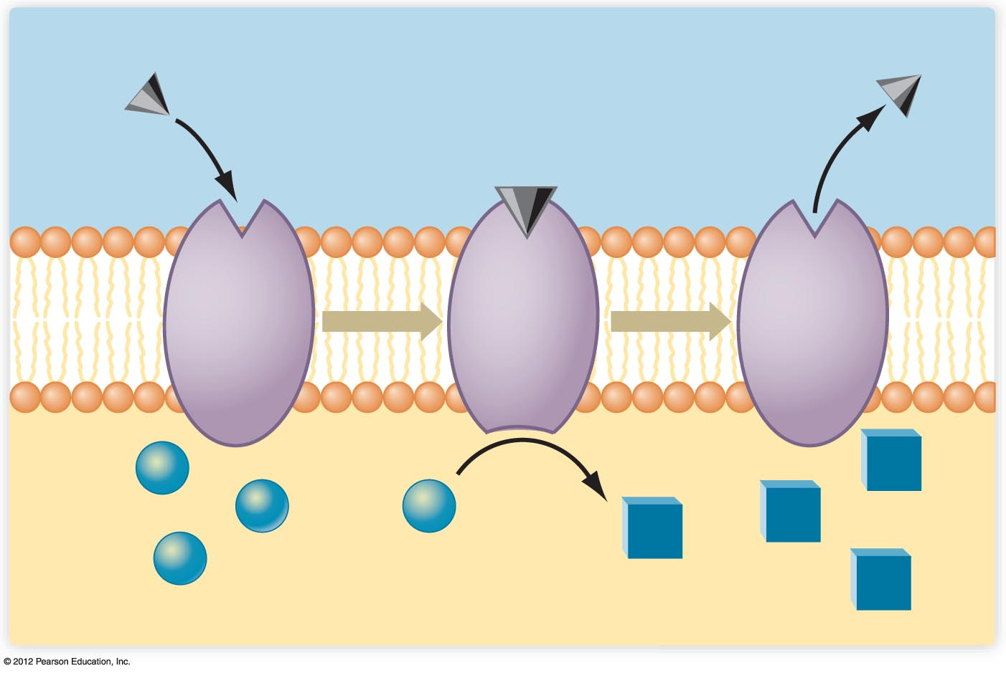

Extracellular environment
Receptor site
Substrate
Product
Cytoplasm

Slide 2
The Sodium–Potassium Pump:
Helps Maintains Cell Volume
Sodium–potassium pump expels unwanted ions, keeps needed ones, and maintains cell volume
ATP is used to expel 3 sodium ions for every 2 potassium ions brought into the cell

Slide 3
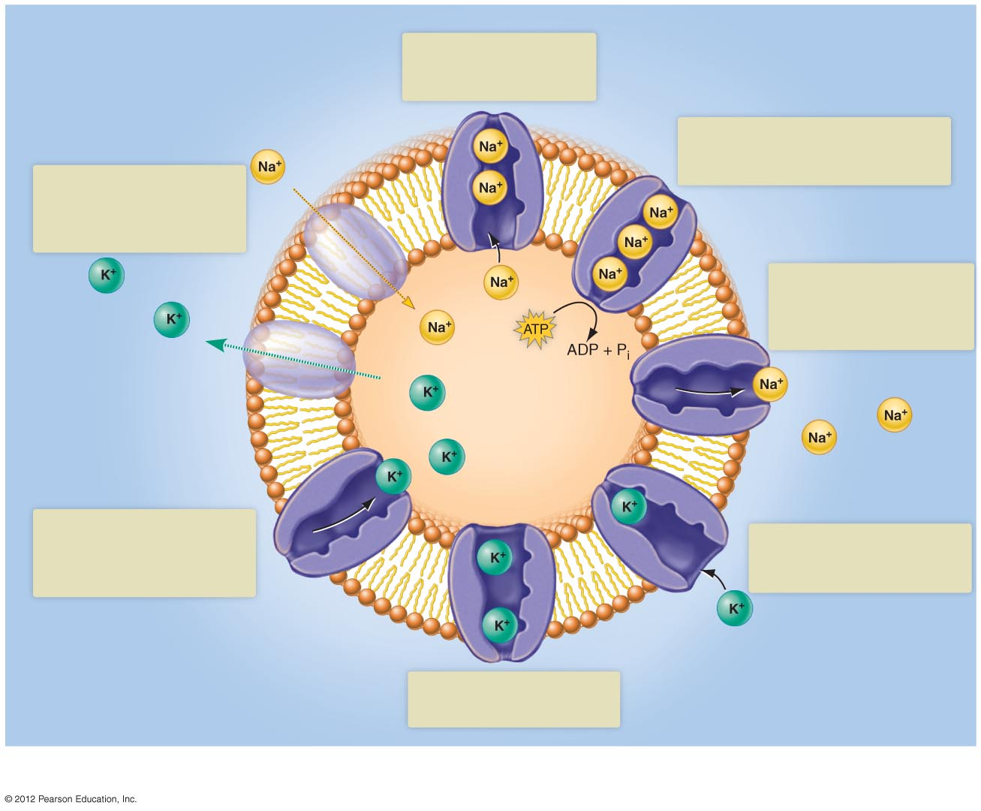
Extracelluar fluid
1
Sodium ions bind to
binding sites accessible
only from the cytoplasm.
2
Binding of three cytoplasmic Na⁺ to the sodium-potassium pump stimulates the breakdown of ATP.
7
Most of the potassium
diffuses out of the cell, but sodium diffuses in only
very slowly
3
Energy released by ATP
causes the protein to
change its shape,
expelling the sodium ions.
Cytoplasm
6
4
Potassium is transported
into the cell, and the sodium
binding sites become
exposed again.
The loss of sodium exposes
two binding sites for potassium.
5
Potassium binding triggers
another change of shape.
a) The cell membrane contains Na⁺ - K⁺ pumps, and also channels that permit the rapid outward diffusion of K⁺
but only a slow inward diffusion of Na⁺.

Slide 4
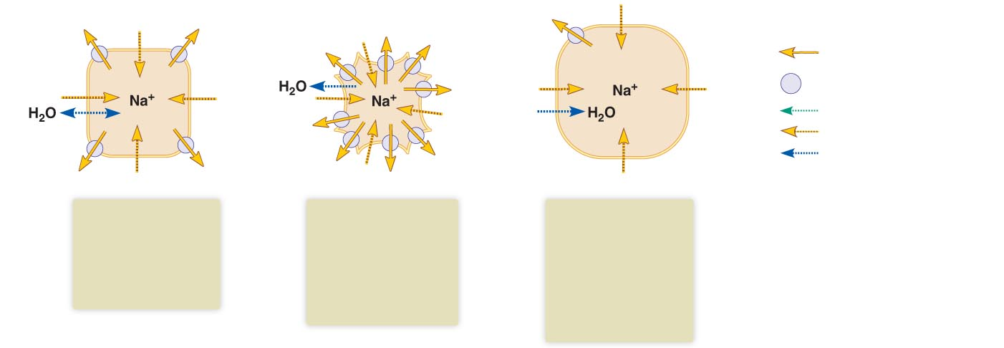
Key:
Active transport of Na⁺
Sodium-potassium pump
Diffusion of K⁺
Diffusion of Na⁺
Diffusion of H₂O
In the steady-state, the rate of outward sodium transport equals the rate of inward diffusion.
When the rate of outward sodium transport exceeds inward diffusion, water diffuses out and the cell shrinks.
When the rate of outward sodium transport is less than the rate of inward diffusion, water diffuses in and the cell swells
b) The rate of transport by the Na⁺ - K⁺ pumps determines cell volume.

Slide 5
Isotonic Extracellular Fluid Maintains Cell Volume
Tonicity: relative concentration of solutes in two fluids
Isotonic
  Extracellular and intracellular ionic concentrations are equal

Slide 6
Isotonic Extracellular Fluid Maintains Cell Volume
Hypertonic
  Extracellular ionic concentration higher than intracellular
  Water will diffuse out of cell
  Cell will shrink and die
Hypotonic
  Extracellular ionic concentration lower than intracellular
  Water will diffuse into cell
  Cell may swell and burst

Slide 7
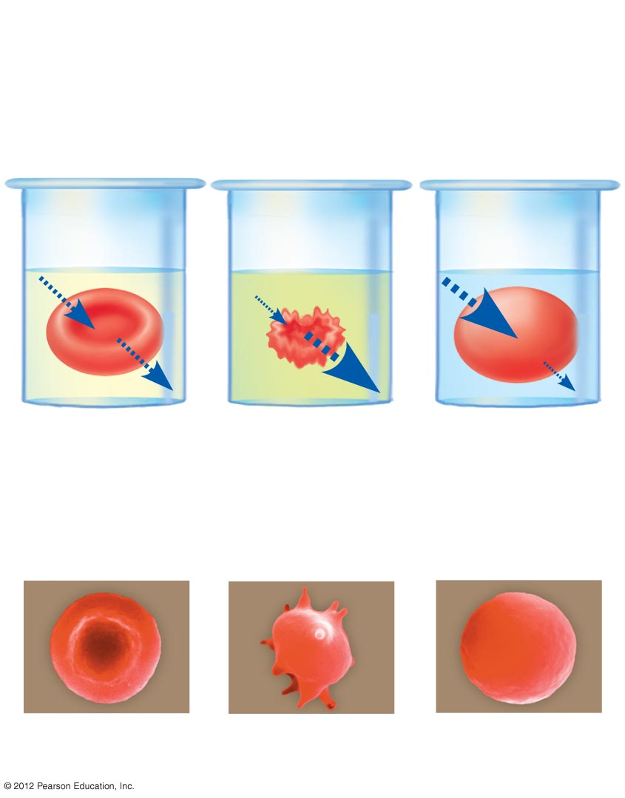
Isotonic
Hypertonic
Hypotonic
9 grams of
salt in 1 liter
of solution
18 grams of
salt in 1 liter
of solution
Pure water
a) Water movement into and out of human red blood
cells placed in isotonic, hypertonic, and hypotonic
solutions. The amount of water movement is indicated
by the sizes of the arrows.
b) Scanning of electron micrographs of red blood cells
placed in similar solutions.

