Slide 1

Molecules Cross the Plasma Membrane in Several Ways
Passive transport
  Cell does not need to expend energy for this
    Diffusion
    Osmosis
Active transport – cell must expend energy
Bulk transport
  Involves membranous vesicles to move larger substances
    Endocytosis
    Exocytosis

Slide 2
Passive Transport Moves with the Concentration Gradient
Passive transport is powered by the concentration gradient.
  Diffusion through lipid layer
  Diffusion through protein channels
  Facilitated transport
    Transport or carrier proteins in the membrane assist

Slide 3
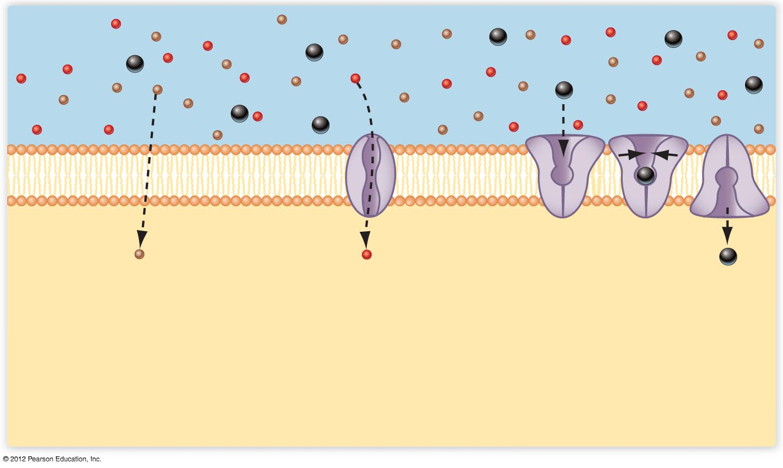
Higher
concentration
Lower
concentration
Diffusion through the lipid
layer. Lipid-soluble molecules
such as O₂ and CO₂ diffuse
freely through the plasma
membrane.
Diffusion through channels.
Some polar and charged
molecules diffuse through
protein channels that span
the membrane. Water
is a typical example.
Facilitated transport. Certain
molecules bind to a protein,
triggering a change in protein
shape that transports the
molecule across the membrane.
Glucose typically enters cells by
this method.

Slide 4
Active Transport
Active transport moves substances from an area of lower concentration to an area of higher concentration
  Requires a membrane protein (transporter)
  Requires ATP or other energy source

Slide 5
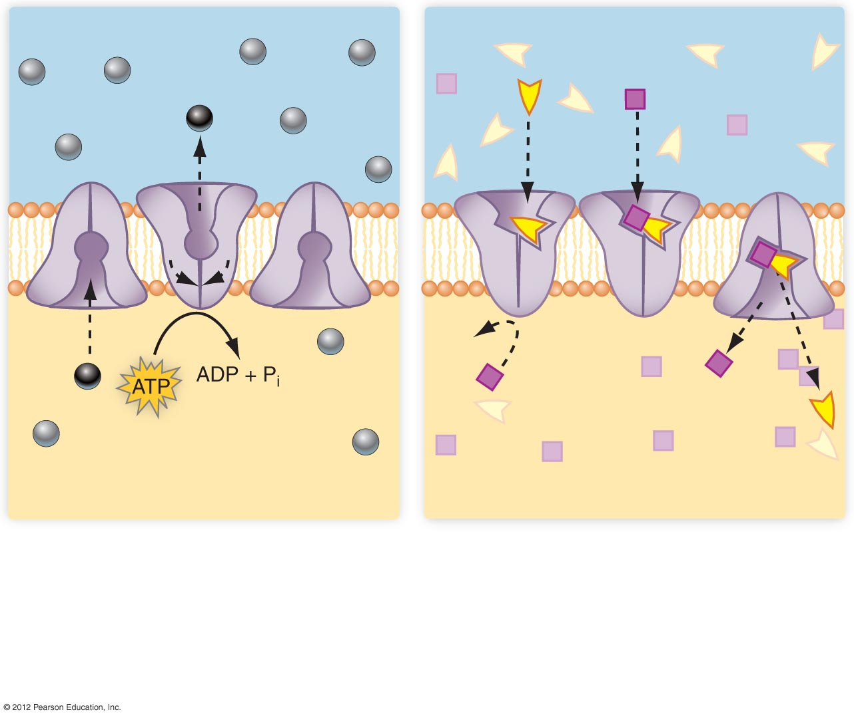
a) In active transport using ATP, energy
derived from the breakdown of ATP
is used to change the shape of the
carrier protein.
b) Some carrier proteins use energy
derived from the downhill transport of
one molecule to transport another
molecule uphill. In this example, the
energy to transport the square molecules
comes from the facilitated transport of the
spearhead molecules.

Slide 6
Endocytosis and Exocytosis Move Materials in Bulk
Used to move larger molecules
  Endocytosis: brings substances into the cell
  Exocytosis: expels substances from the cell

Slide 7
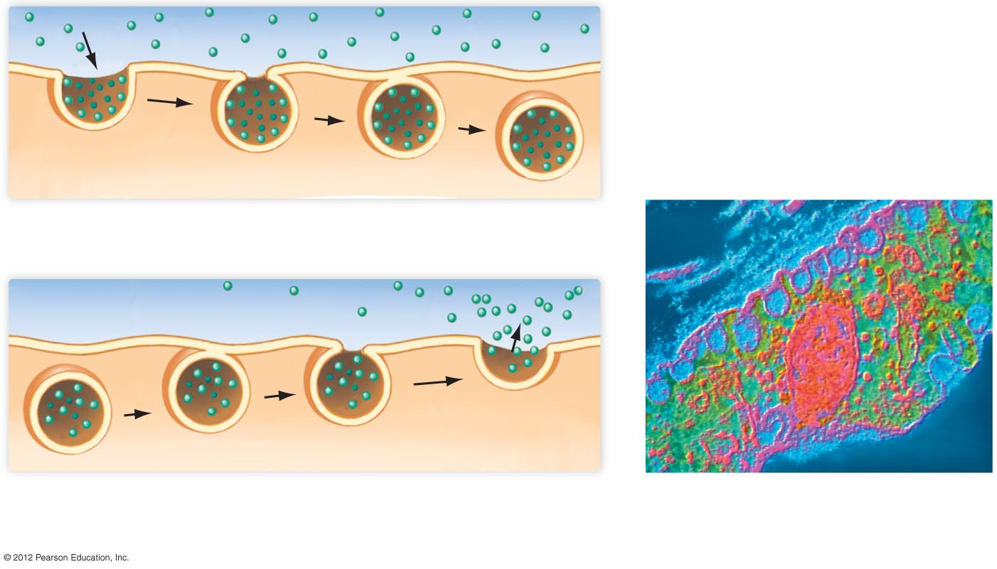
Extracellular environment
Plasma membrane
Cytoplasm
Vesicle
a) Endocytosis. In endocytosis, material is surrounded by
the cell membrane and brought into the cell.
b) Exocytosis. In exocytosis, a membranous vesicle fuses
with the plasma membrane, expelling its contents outside
the cell.
c) Photomicrograph showing
various stages of endocytosis.

