Slide 1

Plasma Membrane Surrounds the Cell
Separates a cell from its environment
Selectively permeable
  Permits movement of some substances into and out of the cell, but blocks others
Enables transfer of information between environment and cell

Slide 2
A Plasma Membrane Surrounds the Cell
Plasma membrane is a lipid bilayer
  Phospholipids
    polar head and nonpolar tail
  Cholesterol
    makes membrane a bit more rigid
  Proteins
    provide means of transport through membrane
  Carbohydrates
    recognition patterns (‘fingerprints’) for cells and organisms
Nonrigid
Fluid mosaic

Slide 3
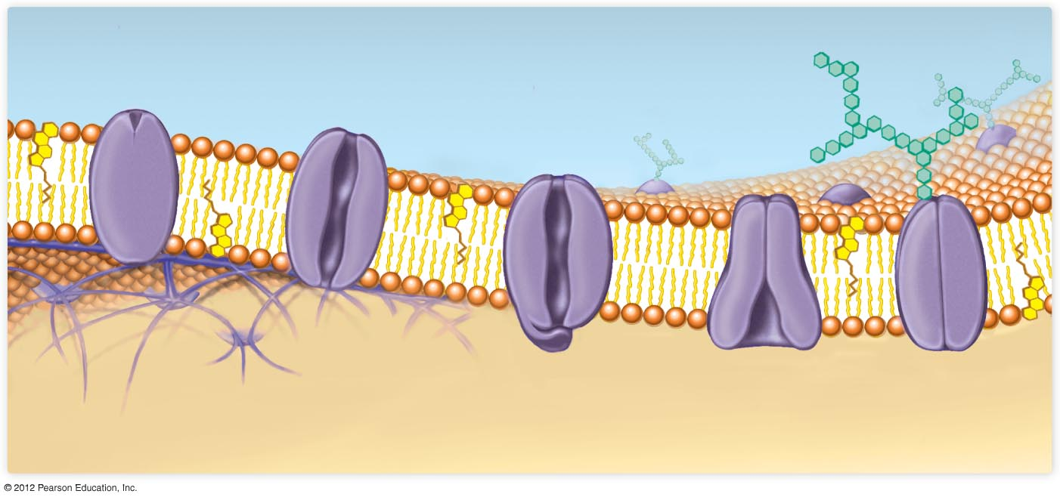
Extracellular environment
Receptor
protein
Channel
protein
(always open)
Gated
channel
protein
(closed
position)
Carbohydrate
groups
Cytoskeleton
filaments
Phospholipid
Lipid
bilayer
Transport
protein
Glycoprotein
Cytoplasm
Cholesterol

