Slide 1
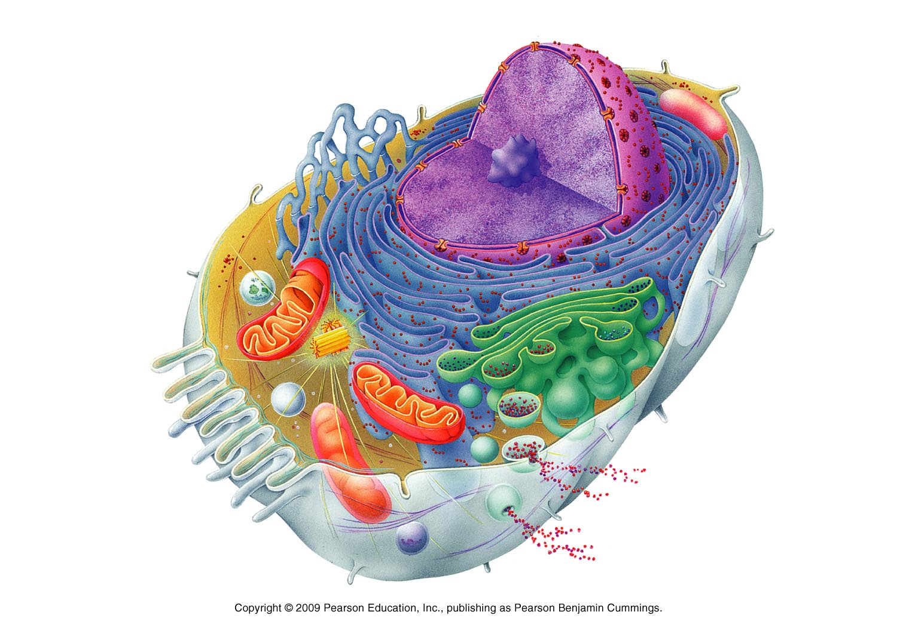

The Cell

Slide 2
Cell Doctrine
All living things are composed of cells
A single cell is the smallest unit that exhibits all of the characteristics of life
All cells come only from preexisting cells

Slide 3
Two Basic Cell Types Classified by Internal Organization
Prokaryotic Cells
Eukaryotic Cells
Plasma membrane
No nucleus
Cytoplasm
  fluid within membrane
No true organelles
Plasma membrane
Nucleus
  information center
Cytoplasm
  fluid within membrane
Organelles
  structures with specialized functions
All human cells are eukaryotic

Slide 4
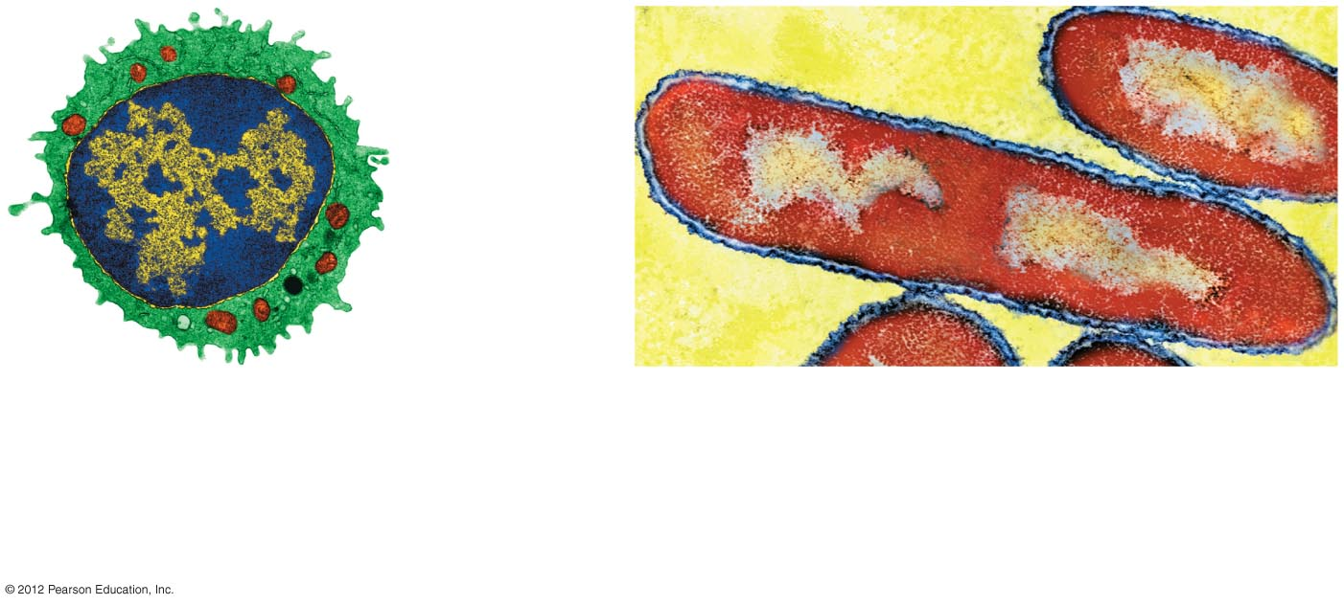
Plasma
membrane
Cell wall
Cytoplasm
Organelles
Nucleus
a) A eukaryotic animal cell has a large
nucleus and numerous small organelles.
The cytoplasm is enclosed by a flexible
plasma membrane.
b) Prokaryotic cells such as this bacterium have a
rigid cell wall surrounding the plasma membrane.
The genetic material is not surrounded by a
membrane, and there are no organelles in the cell.
The elongated bacterium in the center of the photo
is about to divide in two, as its genetic material is
concentrated at both ends of the cell.

Slide 5
Cell Structure Reflects Cell Function
Though eukaryotic cells are remarkably similar, there are structural differences
  Examples:
    Muscle cells
      Contain numerous organelles providing energy needed for muscle contraction
    Nerve cells
      Long and thin to carry impulses over distance

Slide 6
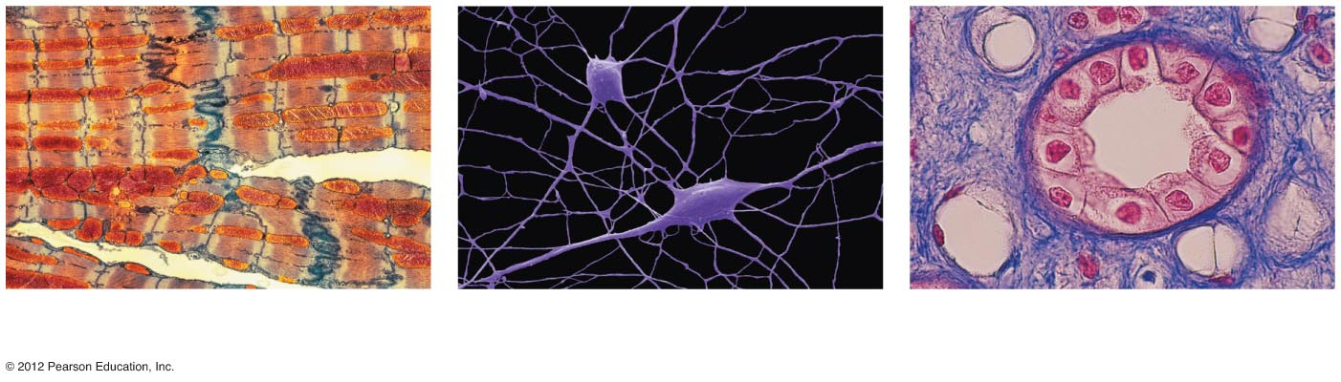
a) A portion of several muscle
cells of the heart (X 1,500).
b) Nerve cells of the central
nervous system (X 830).
c) Cells lining a tubule of a
kidney (X 250).

Slide 7
Cells Remain Small to Stay Efficient
Most cells cannot be seen without magnification
  Ideas on a large cell that we can see with our eyes?

Slide 8
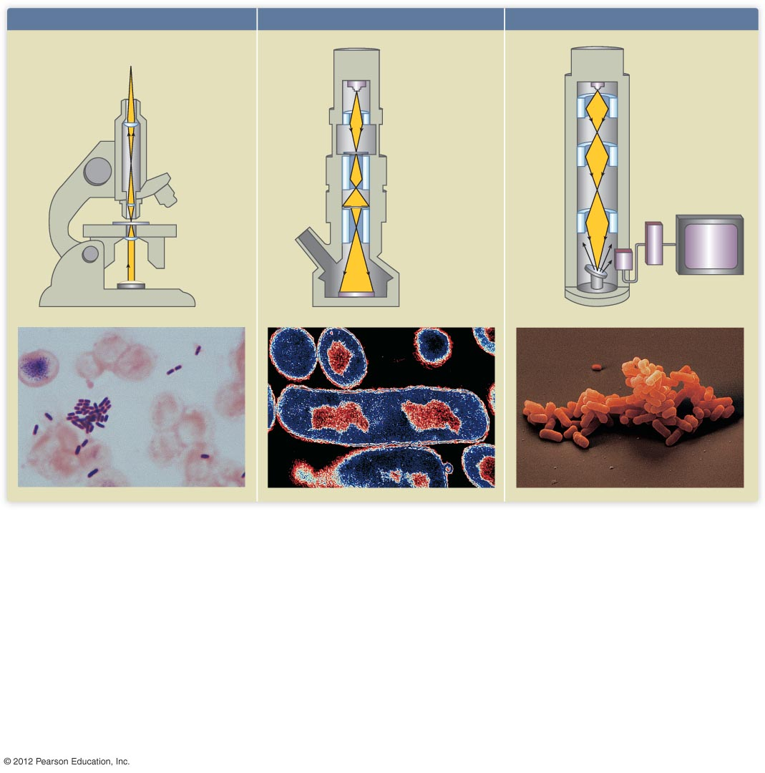
Light microscope
Electron microscope
Scanning election microscope
Eye or photographic plate
Electron
source
Glass lens
Magnetic lens
Specimen
Magnetic lens
Electron
detector
Glass lens
Viewing
window
Amplifier
Specimen
Magnetic lens
Glass lens
Image on
viewing
screen
Image on
photographic
plate or screen
Reflected
electrons
Light source
Specimen
a) The light microscope (LM). Most of
us have seen or used a light microscope.
The light microscope uses visible light
and a series of glass lenses to magnify a
small sample as much as 1,000-fold.
Focus can be difficult to maintain if
objects are at different depths in a
sample. Light does not transmit well
through very dense or thick samples.
Light microscopes have been in use for
over 300 years.
b) The transmission electron
microscope (TEM). A transmission
electron microscope bombards the sample
with a beam of electrons, some of which
pass through the sample. Electrons
behave like light waves, but since the
wavelengths of electrons are shorter than
visible light, the image has greater clarity
at any magnification. A good electron
microscope can magnify up to about
100,000 times, a hundred times greater
than the light microscope. The images
are two-dimensional (flat) because the
sample must be very thin, but the
magnification is sufficiently high that one
can see the structural details of organelles
within single cells.
c) The scanning electron microscope
(SEM). The scanning electron microscope
also focuses beams of electrons on the
object. It produces what appears to be
a three-dimensional view of the surface of
an object. A narrow beam of electrons is
scanned over the surface of an object
that has been coated with a thin coat of
metal so that the electron beam cannot
penetrate. As the beam passes, the
metal gives off secondary electrons, which
can be recorded to produce a visual
picture of the object’s surface. Scanning
electron microscopes have revealed
stunning images of the relationships
between cells and of the outer surfaces of
cells. The scanning electron microscope
can also magnify up to about 100,000
times.

Slide 9
Cells Remain Small to Stay Efficient
Small cells have a higher surface to volume ratio
High surface to volume ratio promotes efficiency in
  Acquisition of nutrients
  Disposal of wastes

Slide 10
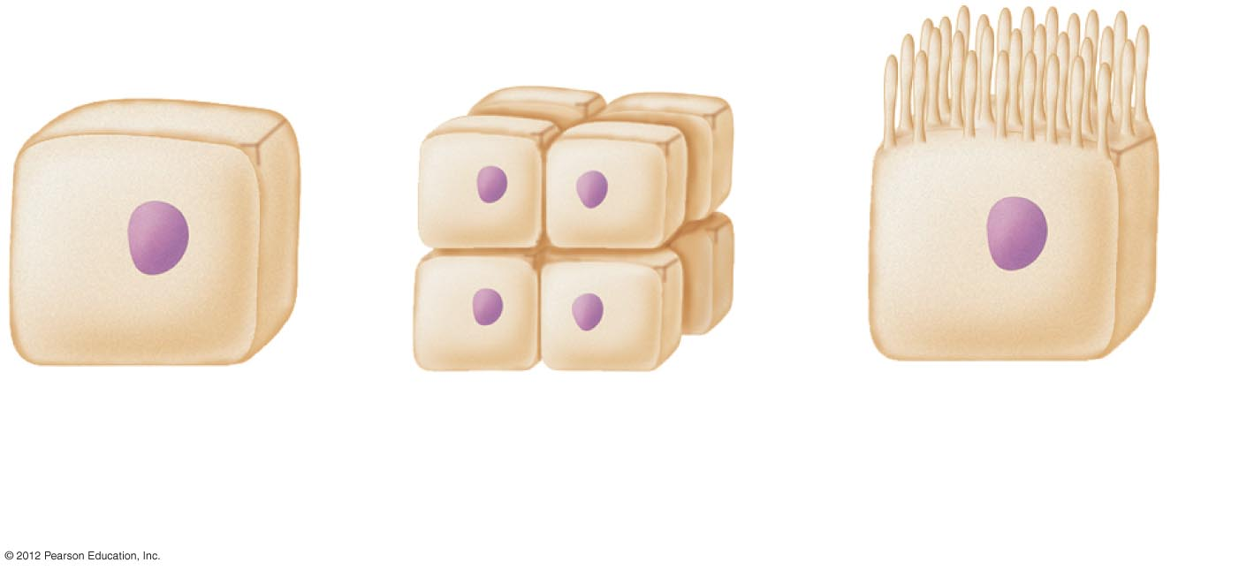
a) One large
cell.
b) Eight small
cells.
Cell with
microvilli
on one surface.

