Slide 1

Nucleic Acids Store Genetic Information
Two types
  DNA: deoxyribonucleic acid
  RNA: ribonucleic acid
Functions
  Store genetic information
  Provide information used in making proteins
Nucleic acids are long chains containing subunits known as nucleotides

Slide 2
Nucleic Acids Store Genetic Information
Nucleotides: building blocks of nucleic acids
Each nucleotide contains
  5 carbon sugar
    DNA nucleotides: deoxyribose
    RNA nucleotides: ribose
  Nitrogenous base
  Phosphate group

Slide 3
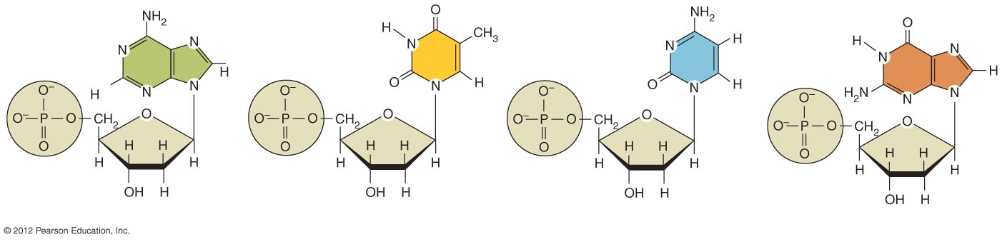
Adenine (A)
Thymine (T)
Cytosine (C)
Guanine (G)
Phosphate
Deoxyribose

Slide 4
Nucleic Acids Store Genetic Information
Structure of DNA (deoxyribonucleic acid)
  Double–stranded
  Nucleotides contain
    Deoxyribose (sugar)
    Nitrogenous bases
      Adenine
      Guanine
      Cytosine
      Thymine
  Pairing
    Adenine (A) – Thymine (T)
    Guanine (G) – Cytosine (C)

Slide 5
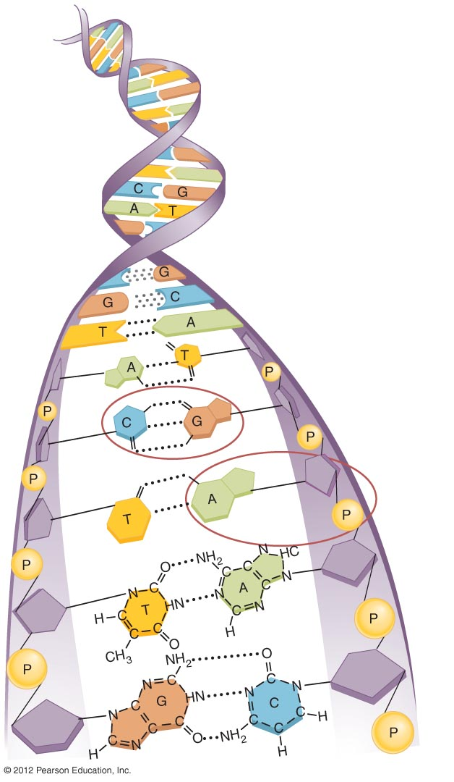
Base pair
Phosphate
Sugar
Nucleotide

Slide 6
Nucleic Acids Store Genetic Information
Structure of RNA (ribonucleic acid)
  Single–stranded
  Nucleotides contain
    Ribose
    Nitrogenous bases
      Adenine (A)
      Guanine (G)
      Cytosine (C)
      Uracil (U)

Slide 7
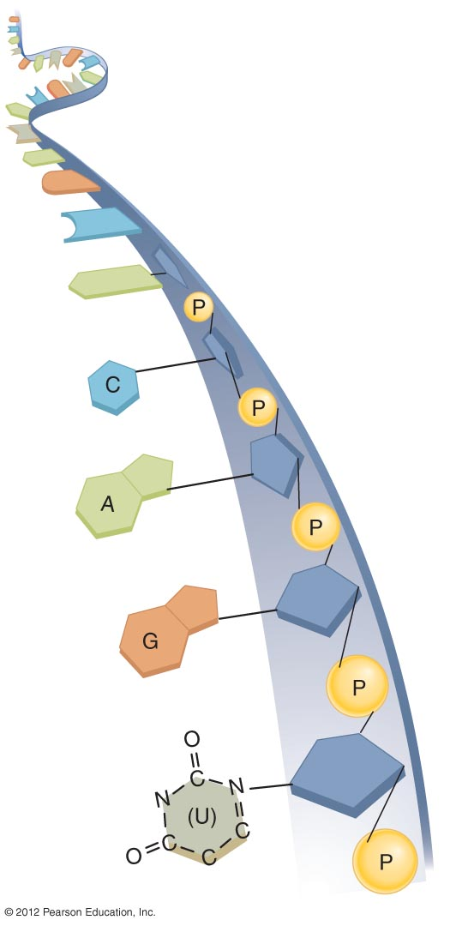
Phosphate
Ribose
Uracil

Slide 8
Nucleic Acid Function --- Nucleic Acids Store Genetic Information
Nucleic acid function
  DNA: instructions for making RNA
  RNA: instructions for making proteins
  Proteins: direct most of life’s processes
  DNA → RNA → Proteins

Slide 9
ATP Carries Energy
Structure and function of adenosine triphosphate (ATP)
  Universal energy source
  Bonds between phosphate groups contain potential energy
  Breaking the bonds releases energy
    ATP → ADP + P + energy

Slide 10
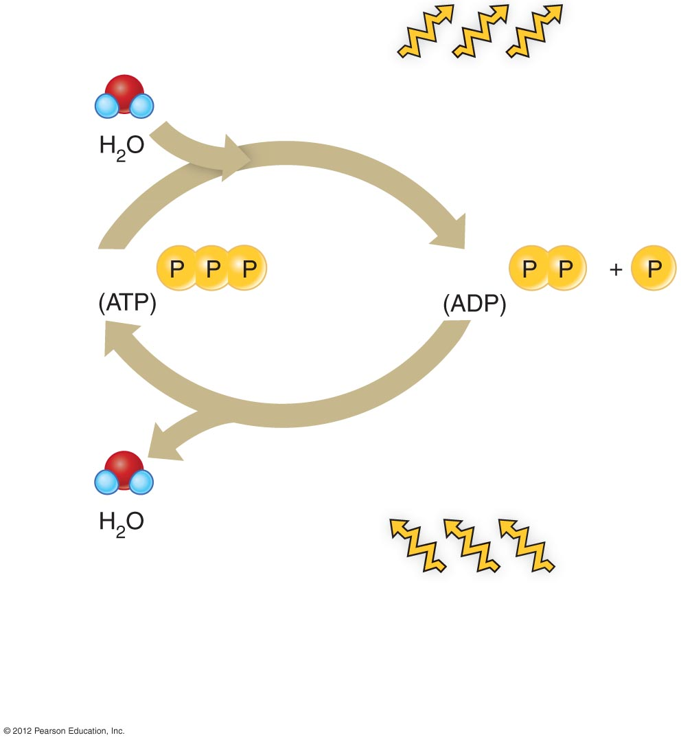
Hydrolysis of ATP
produces useful energy
for the cell
Adenosine
Adenosine
Energy for ATP synthesis
comes from food or body
stores of glycogen or fat
b) The breakdown and synthesis of ATP.
  The breakdown (hydrolysis) of ATP yields
  energy for the cell. The reaction is reversible,
  meaning that ATP may be resynthesized
  using energy from other sources.

