Slide 1

Proteins
Long chains (polymers) of subunits called amino acids
Amino acids
  20 different types
  Amino end, carboxyl end, R group
Amino acids are joined by peptide bonds
  produced by dehydration synthesis reactions

Slide 2
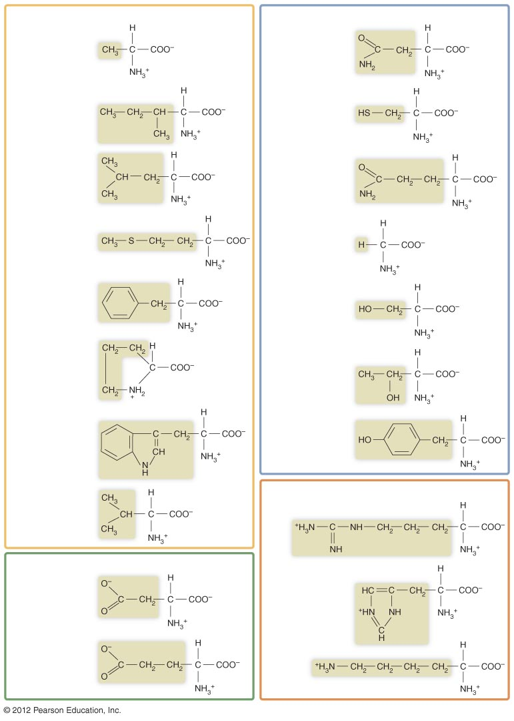
Amino acids with nonpolar R groups
Amino acids with uncharged polar R groups
Alanine (Ala)
Asparagine (Asn)
Isoleucine (Ile)
Cysteine (Cys)
Leucine (Leu)
Glutamine (Gln)
Methionine (Met)
Glycine (Gly)
Phenylalanine (Phe)
Serine (Ser)
Proline (Pro)
Threonine (Thr)
Tryptophan (Trp)
Tyrosine (Tyr)
Amino acids with positively charged R groups
Valine (Val)
Arginine (Arg)
Amino acids with negatively charged R groups
Aspartic acid (Asp)
Histidine (His)
Lysine (Lys)
Glutamic acid (Glu)

Slide 3
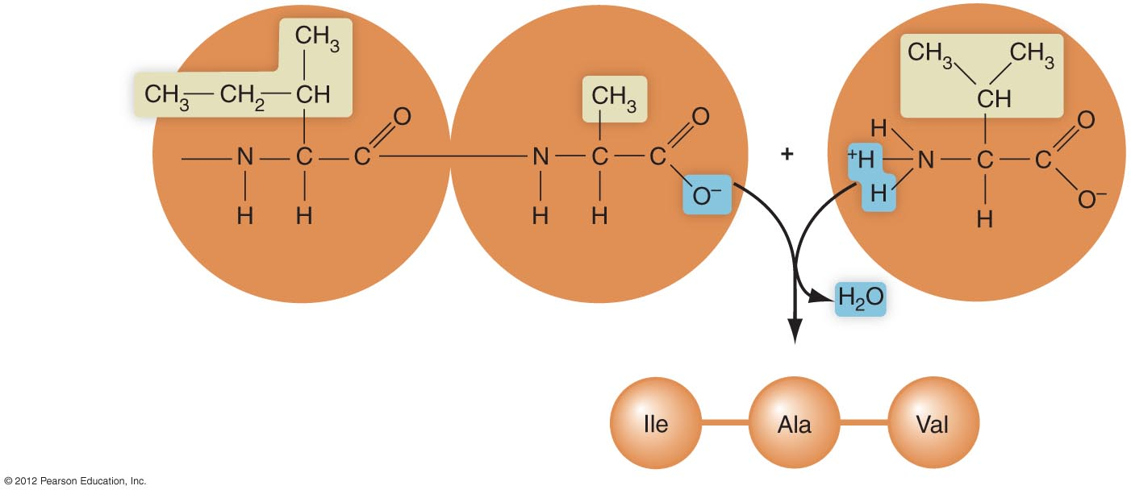
Amino
acids
Isoleucine (Ile)
Alanine (Ala)
Valine (Val)
Polypeptide

