Slide 1

Lipids: Insoluble in Water
Three important classes of lipids
  Triglycerides: energy storage molecules
  Phospholipids: cell membrane structure
  Steroids: carbon-based ring structures

Slide 2
Triglycerides
Also known as fats and oils
Composed of glycerol and three fatty acids
  Fatty acids
    Saturated (in fats)
    Unsaturated (in oils)
Energy storage molecules

Slide 3
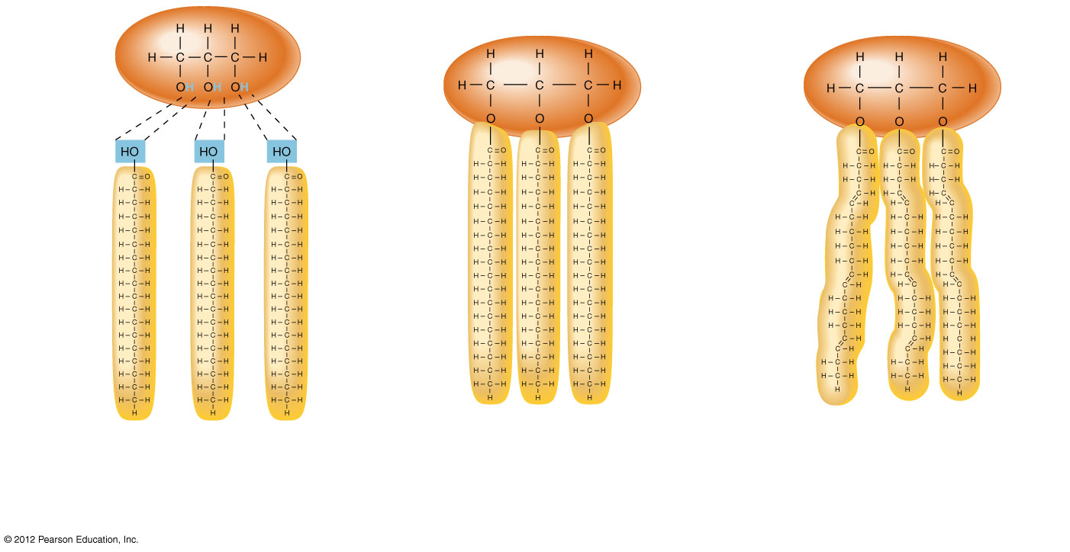
Glycerol
Saturated
fatty acid
a) Triglycerides (neutral fats) are
synthesized from glycerol and
three fatty acids by dehydration
synthesis.
b) Triglycerides with saturated fatty acids have straight tails, allowing them to pack closely together.
c) Triglycerides with unsaturated
fatty acids have kinked tails,
preventing them from packing
closely together.

Slide 4
Phospholipids
Structure
  Glycerol + two fatty acids and phosphate group
  One end of molecule is water soluble (hydrophilic)
  Other end of molecule is water insoluble (hydrophobic)
Function
  Primary component of cell membranes

Slide 5
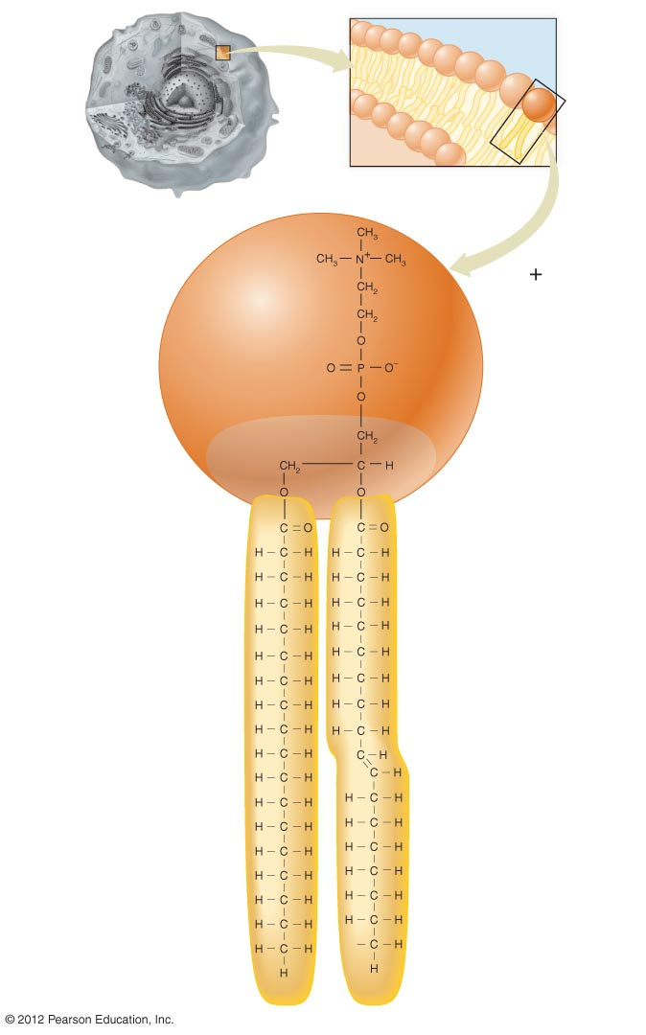
Membrane structure
Phosphate
Polar head
Glycerol
Fatty acid
Nonpolar tail

Slide 6
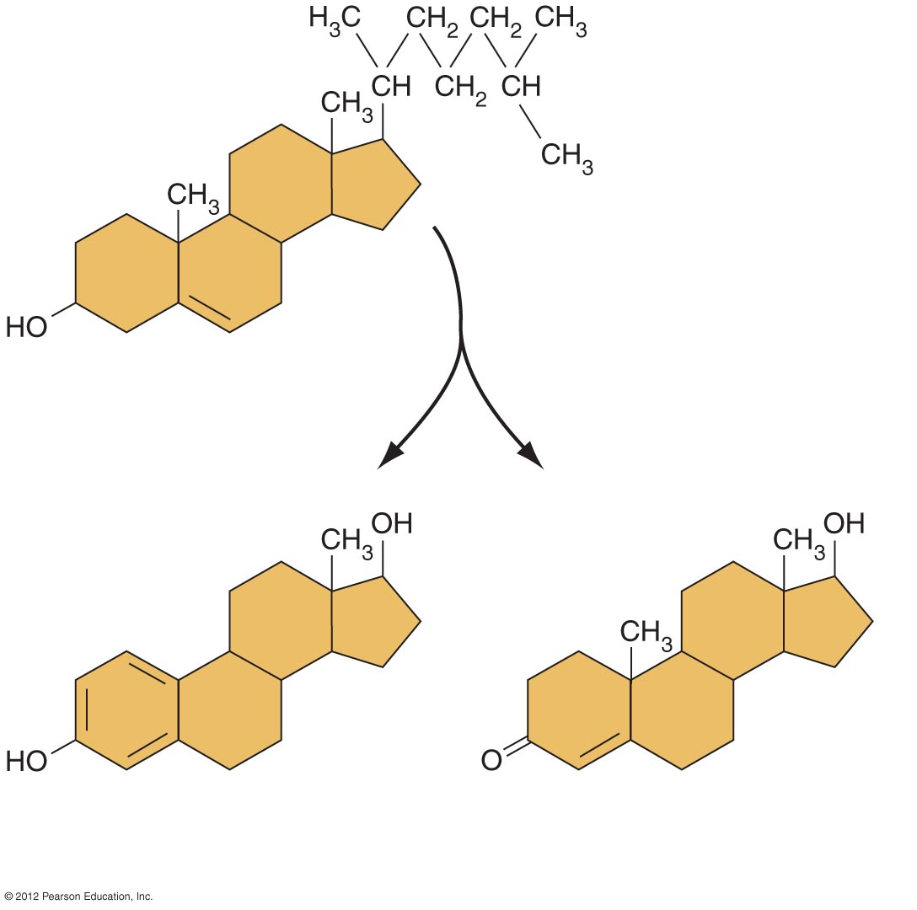
Steroids
Structure
  Composed of four carbon rings
Examples:
    Cholesterol
    Hormones
      Estrogen
      Testosterone
a) Cholesterol:
A normal component of
the cell membrane.
c) Testosterone:
Male sex hormone
synthesized from cholesterol.
b) Estrogen (estradiol):
Female sex hormone
synthesized from cholesterol.

