Slide 1

The Organic Molecules of Living Organisms
Carbon
  The building block of living things
  Comprises ~18% of the body by weight

Slide 2
Macromolecules Are Synthesized and Broken Down within the Cell
Dehydration synthesis
  Removes equivalent of a water molecule
  Requires energy
  Builds macromolecules from smaller subunits
Hydrolysis
  Adds the equivalent of a water molecule
  Releases energy
Dehydration synthesis is the reverse of hydrolysis

Slide 3
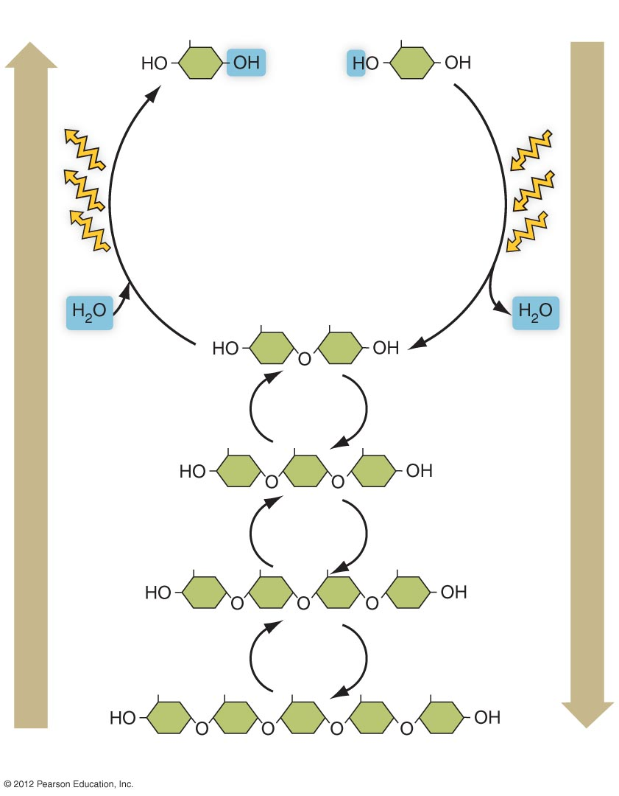
Sugars
Energy
Energy
Hydrolysis
Dehydration synthesis
Carbohydrate

Slide 4
Carbohydrates: Used for Energy and Structural Support
General formula: C_{n}(H₂0)_{n}
Monosaccharides: simple sugars
  Glucose
  Fructose
  Galactose
  Ribose
  Deoxyribose

Slide 5
Oligosaccharides: More than One Monosaccharide Linked Together
Monosaccharides can be linked together via dehydration synthesis
Disaccharides: two monosaccharides linked together
  Sucrose: glucose + fructose
  Maltose: glucose + glucose
  Lactose: glucose + galactose

Slide 6
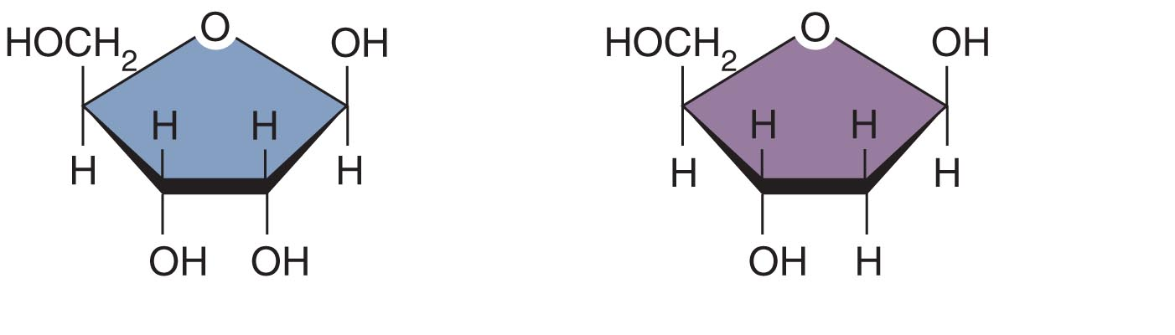
Ribose
Deoxyribose
a) The five-carbon monosaccharides ribose and deoxyribose.

Slide 7
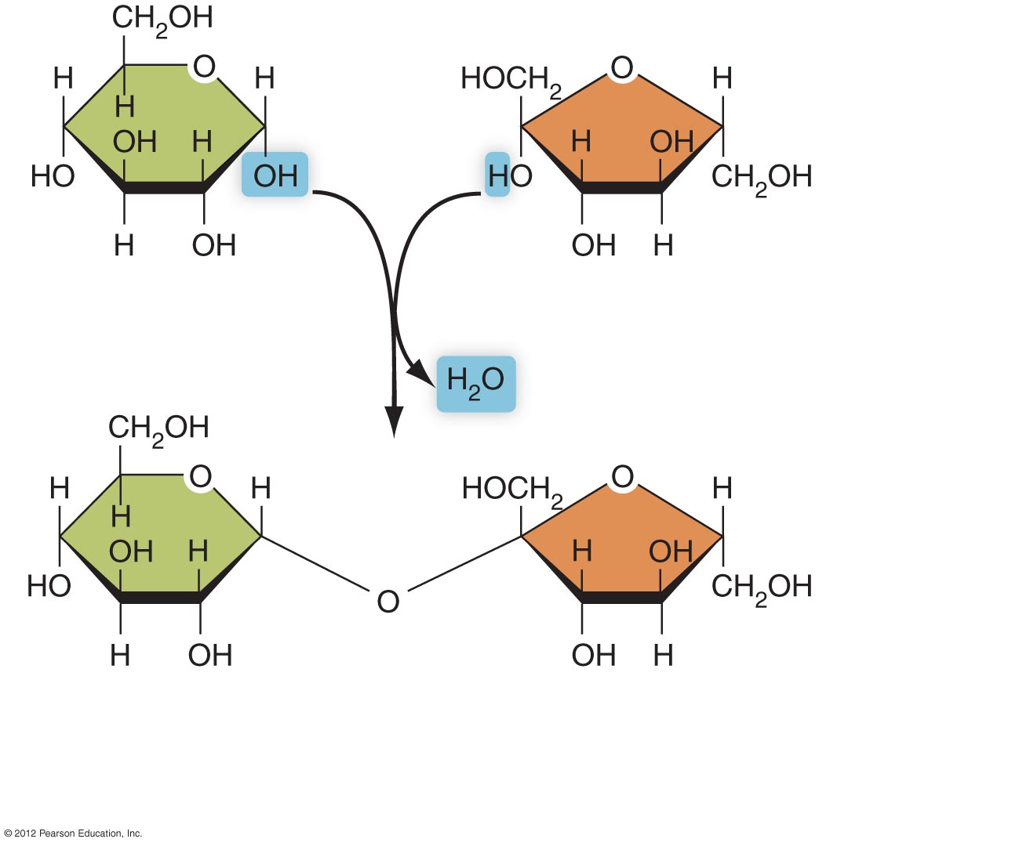
Glucose
(a monosaccharide)
Fructose
(a monosaccharide)
Sucrose (a disaccharide)
b) Two 6-carbon monosaccharides (glucose and fructose) are
joined together by dehydration synthesis, forming sucrose.

Slide 8
Polysaccharides Store Energy
Polysaccharides: thousands of monosaccharides joined in chains and branches
  Starch: made in plants; stores energy
  Glycogen: made in animals; stores energy
  Cellulose: indigestible polysaccharide made in plants for structural support

Slide 9
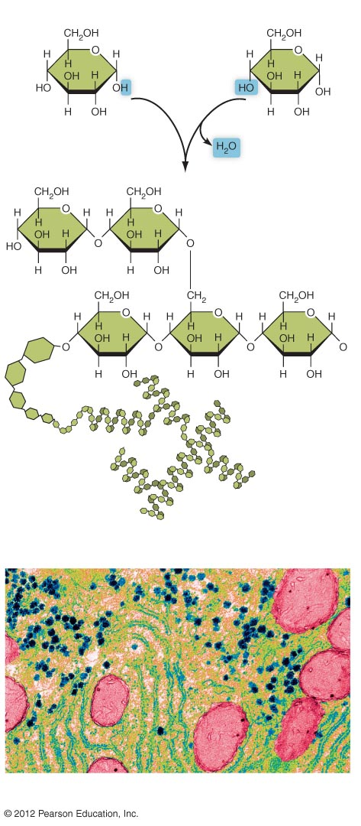
Glucose
Glucose
Dehydration
synthesis
a) Glycogen is formed by
dehydration synthesis from
glucose subunits.
b) A representation of the highly branched nature of glycogen.
Glycogen granules
c) A portion of an animal cell showing granules of stored glycogen
(blue). The large pink structures are mitochondria.

