Slide 1

Life Depends on Water
Water molecules are polar
Water is liquid at body temperature
Water can absorb and hold heat energy
Water is the biological solvent
Water helps regulate body temperature

Slide 2
Water Is the Biological Solvent
Solvent: liquid in which other substances dissolve
Solute: any dissolved substance
Hydrophilic: molecules that are attracted to water and interact easily with water
Hydrophobic: molecules that do not interact with or dissolve in water

Slide 3
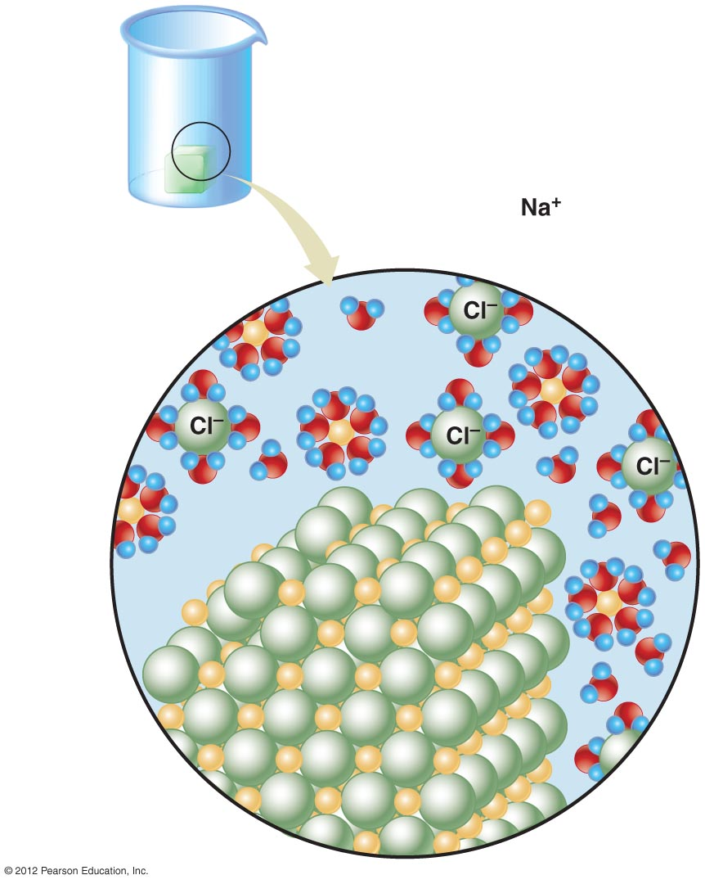
Ions
in solution
Molecules
of water
Salt crystal

Slide 4
The Importance of Hydrogen Ions
Acids:
  Donate hydrogen ions (protons)
  Increase hydrogen ion concentration in solutions
Bases
  Accept hydrogen ions (protons)
  Lower hydrogen ion concentration in solutions
pH Scale
  A measure of hydrogen ion concentration

Slide 5

pH
values
Concentrations
of H⁺
(moles/liter)
14
Drain opener
13
10^{–13}
Bleach
12
More alkaline
11
10^{–11}
Ammonia cleanser
10
Soapy water
9
10^{–9}
Baking soda
8
Neutral pH
7
10^{–7}
Human blood, tears
6
Saliva, urine
5
10^{–5}
Black coffee
4
Tomatoes
More acidic
10^{–3}
3
Vinegar, cola
2
Lemon juice
1
10^{–1}
Hydrochloric acid
0
Concentrated nitric acid

Slide 6
Buffers
Minimize pH change
Help maintain stable pH in body fluids
Carbonic acid and bicarbonate act as one of the body’s most important buffer pairs
    HCO₃⁻ + H⁺ H₂CO₃

