Slide 1
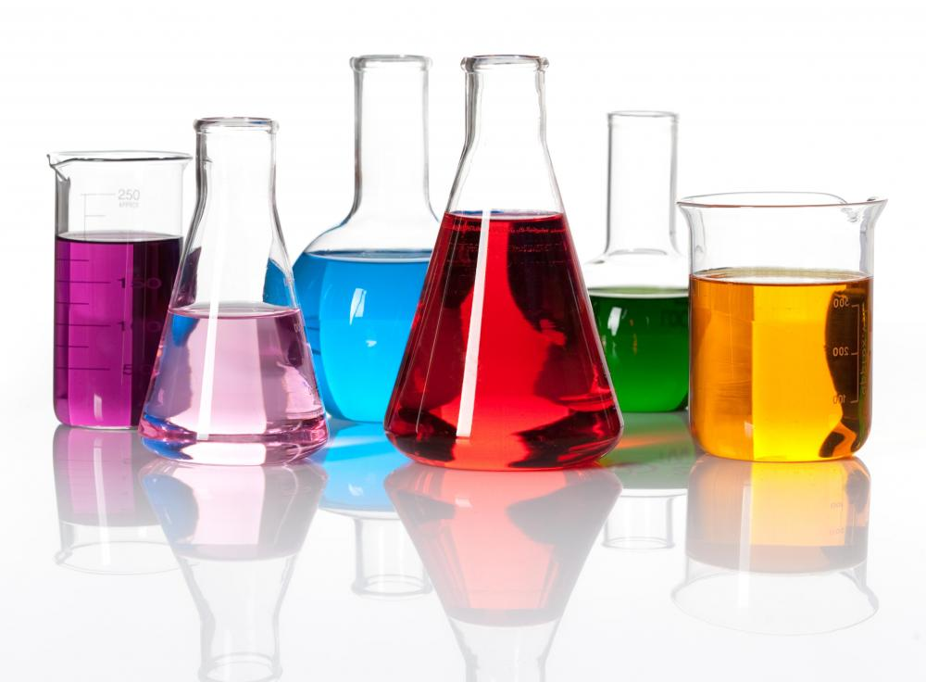

Chemistry

Slide 2
All Matter Consists of Elements
Chemistry is the study of matter
Matter is:
  Anything that has mass and occupies space
  Composed of elements
Elements
  Cannot be broken down to a simpler form
  Periodic table of elements – lists all known elements

Slide 3
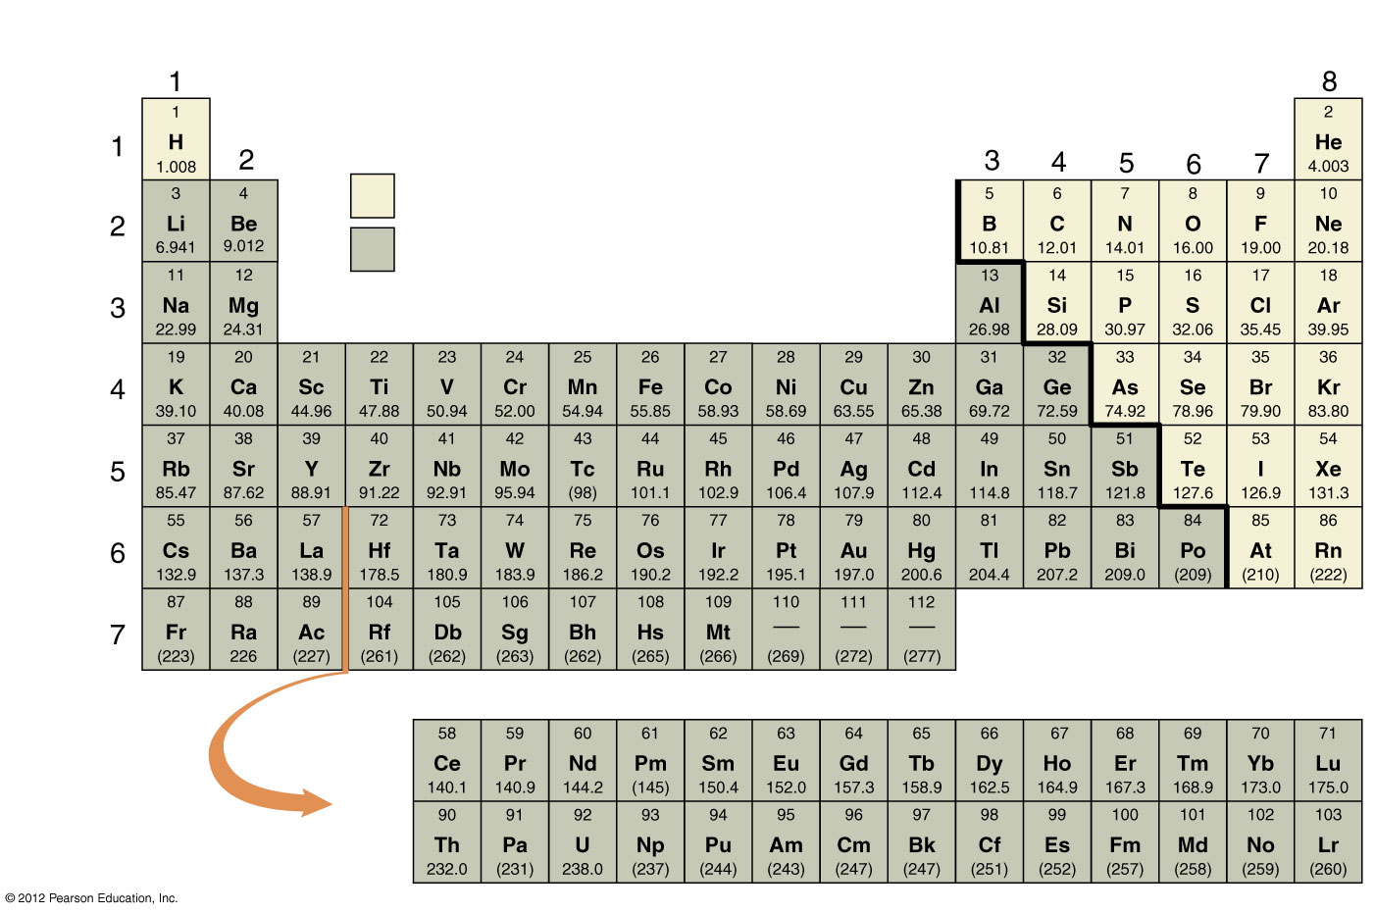
Group
number
Element symbol
Atomic
number
Atomic mass
Nonmetals
Metals
Transition elements
Metals
Non
metals
Lanthanides
Actinides

Slide 4
Atoms – Smallest Functional Unit of Elements
Atoms consist of
  Nucleus (central core)
    Protons
      positive charge
      have mass
    Neutrons
      no charge
      have mass
  Shells (surrounding nucleus)
    Electrons
      negative charge
      no discernable mass

Slide 5
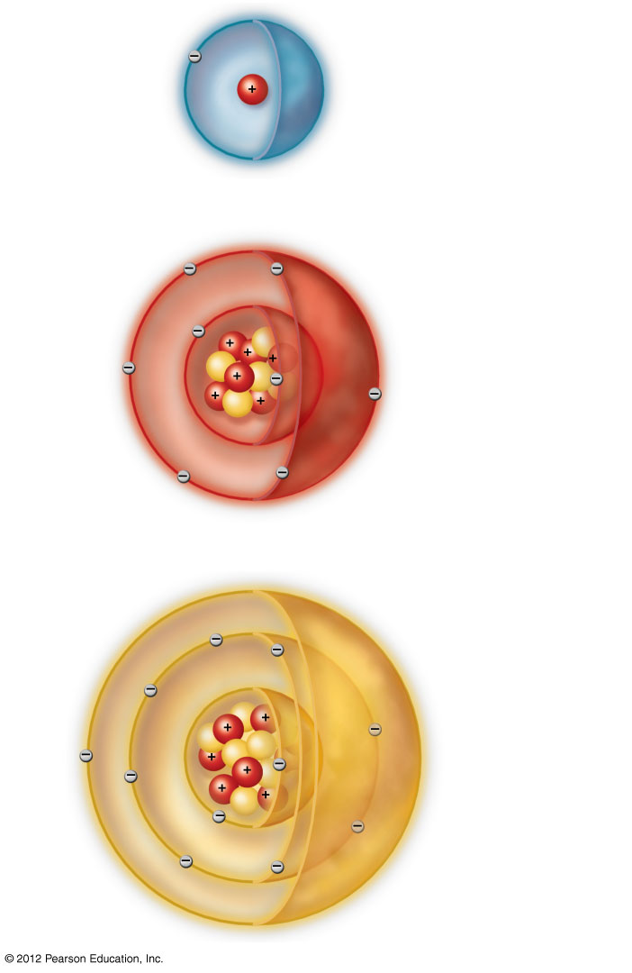
Electron
Proton
a) Hydrogen
1 proton
Shell
Neutron
b) Oxygen
8 protons
8 neutrons
8 electrons
in 2 shells
Nucleus
c) Sodium
11 protons
11 neutrons
11 electrons
in 3 shells

Slide 6
More About Atoms
Atomic symbol: one or two letters
  Na: sodium
  O: oxygen
Atomic number
  Number of protons
Atomic mass
  Roughly equal to number of protons plus neutrons

Slide 7
Energy Fuels Life’s Activities
Energy: the capacity to do work
Potential energy: stored energy
Kinetic energy: energy in motion,
doing work
Potential energy can be transformed into kinetic energy

Slide 8
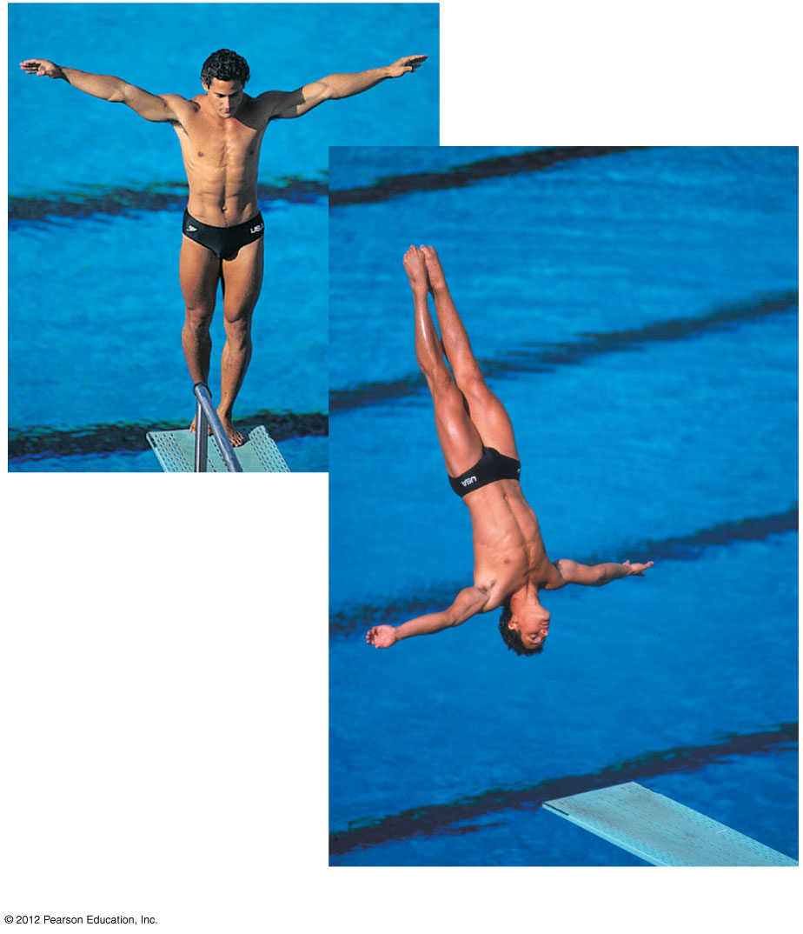
a) Potential energy is
locked up in the
chemical bonds of
energy-storage
molecules in Greg
Louganis’ tissues.
b) Kinetic energy is energy in motion.

