Slide 1
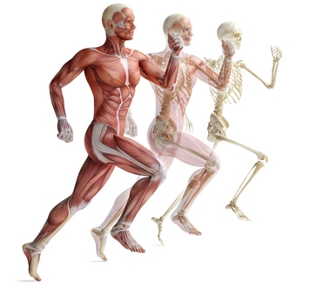
Human Biology and Science
Michael D. Johnson

Slide 2
Science Is Both a Body of Knowledge and a Process
Science is the study of the natural world
Science is two things
  Knowledge about the natural world
  The process used to acquire knowledge
    Called the scientific method

Slide 3
The Scientific Method Is a Process for Testing Ideas
Steps in the scientific method
  Observe and generalize
  Formulate a hypothesis
  Make a testable prediction
  Experiment or observe
  Modify the hypothesis as necessary and repeat

Slide 4
The Scientific Method Is a Process for Testing Ideas
1) Observe and generalize
  Make generalizations based on observations about the world with inductive reasoning
        ‘Specific to general reasoning’
    Observation: “Every winter in the past was colder than the preceding summer.”
    Generalization: “Winter will always be colder than summer.”

Slide 5
The Scientific Method Is a Process for Testing Ideas
2) Formulate a hypothesis
  A hypothesis is a tentative statement about the natural world

Slide 6
The Scientific Method Is a Process for Testing Ideas
3) Make a testable prediction
  Hypotheses should be tested under many different conditions
  Testable predictions
    Should be based on the hypothesis
    Should employ deductive reasoning
    Are often in the form of “if…then” statements
    Should be specific in order to be testable

Slide 7
The Scientific Method Is a Process for Testing Ideas
4) Experiment and observe
  Truth or falsehood of prediction is tested by observation and experimentation
  Experiment: A carefully planned and executed manipulation of the natural world.
    In controlled experiments, all but one variable are accounted for
    Placebo – “false treatment”

Slide 8
The Scientific Method Is a Process for Testing Ideas
5) Modify the hypothesis as necessary and repeat Steps 3 and 4
  If prediction is false, the hypothesis must be modified.
  If the prediction is true, only one small part of the hypothesis has been tested. Further testing required.
  Hypotheses cannot be proved true, only supported or disproved.

Slide 9
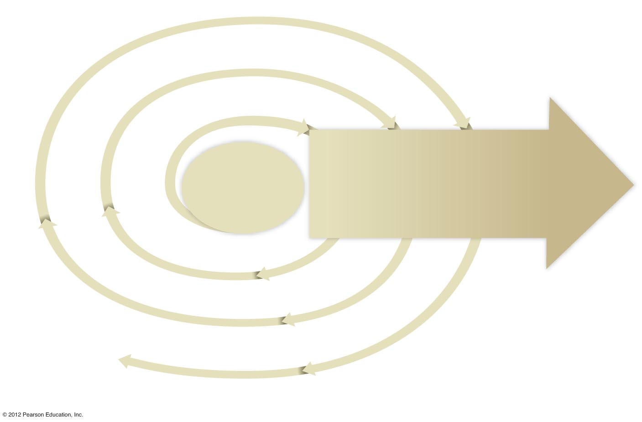
Inductive reasoning
Inductive reasoning
Inductive reasoning
2
5
5
4
4
1
Formulate
a
hypothesis
Modify
hypothesis
as
necessary
and repeat
steps
3 and 4
Modify
hypothesis
as
necessary
and repeat
steps
3 and 4
Direction of
Increasing
confidence
in
hypothesis
Experiment
or
observe
Experiment
or
observe
Observe
and
generalize
3
Deductive
reasoning
Make a testable
prediction
reasoning
3
Deductive
reasoning
Make a testable
prediction
Deductive
3
Make a testable
prediction

Slide 10
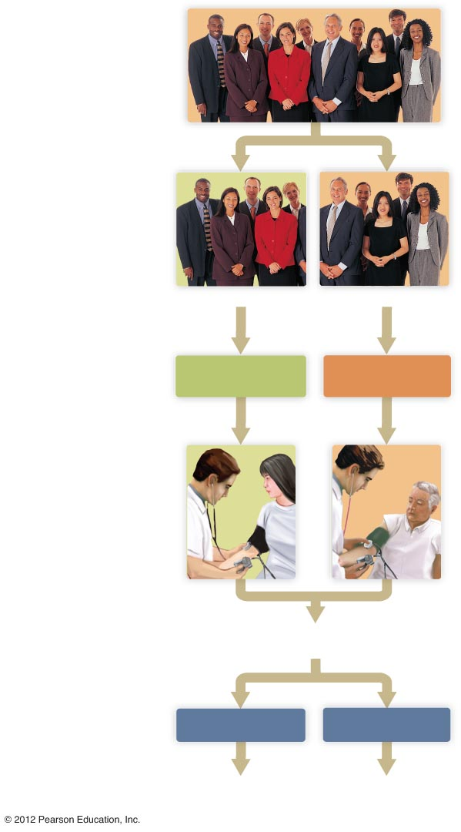
Select a large number
of appropriate subjects.
Randomly divide the subjects into two groups.
Group 1
Group 2
Treat the groups equally
in all ways but one.
Experimental group:
receives treatment
Control group:
receives placebo
Observe or make measurements.
Are blood pressures lower
in the experimental group?
Compare results.
Yes
No
Hypothesis received support.
Modify hypothesis to fit the new findings.

Slide 11
Making Findings Known
Findings can be disseminated in
  Peer-reviewed journals
    Experts must approve articles before publication
    Results are assumed to be valid only for conditions under which experiment was done
  Popular press
  Electronic publications
    Internet is less regulated than print and broadcast media

Slide 12
Hypothesis Becomes a Theory
For a hypothesis to become a theory it must
  Be broad
  Be extensively tested
  Be supported over time
  Explain a broad range of facts
  Have a high degree of reliability
Theories may be refuted in the future

Slide 13
Learning to Be a Critical Thinker
Become a skeptic
  Not everything you see is true
    Who is stating it is true?
    Are they paid for their opinion?
  Most typical media outlets summarize the source data
    Sources for science are peer-reviewed journals
      Ex) Nature or Science

Slide 14
Learning to Be a Critical Thinker
Appreciate the value of statistics
  Helps organize data
  Determine confidence in data
Learn to read graphs
  Pictorial view of data

Slide 15
Learning to Be a Critical Thinker
Distinguish anecdotes from scientific evidence
  Anecdotal is testimony or unverified report
  Scientific is proven through experimentation
Separate facts from conclusions
  Conclusion is some ones judgment from the facts they have

Slide 16
Learning to Be a Critical Thinker
Understand the differences between correlation and causation
  Two events may both occur at the same time but not be related
    Therefore they are correlated but do not cause eachother
  Ex) Drownings and ice cream sales both increase at the same time
    Correlated but do not cause each other

Slide 17
The Role of Science in Society
Science improves technology and the human condition
  Benefits from the appliance of technology
Science has limits
  Physical explanations in natural world
Science helps us to make informed choices
  Look at the facts and draw your own conclusions

Slide 18
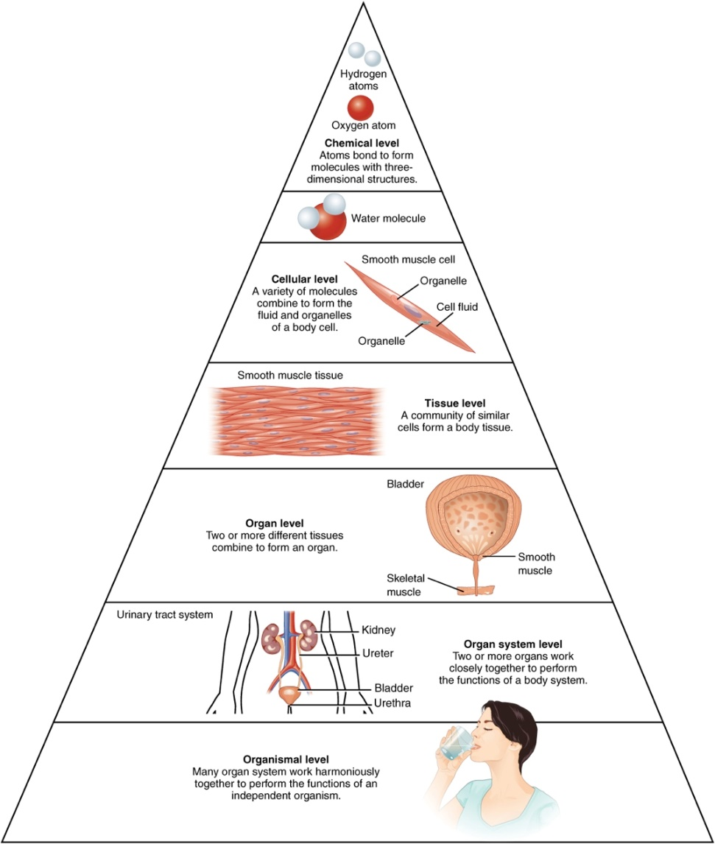
The Body
Levels of Structural Organization of the Human Body
The organization of the body often is discussed in terms of six distinct levels of increasing complexity.

Slide 19
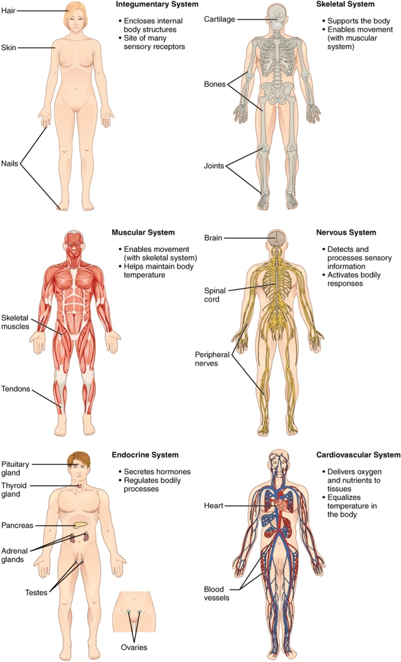
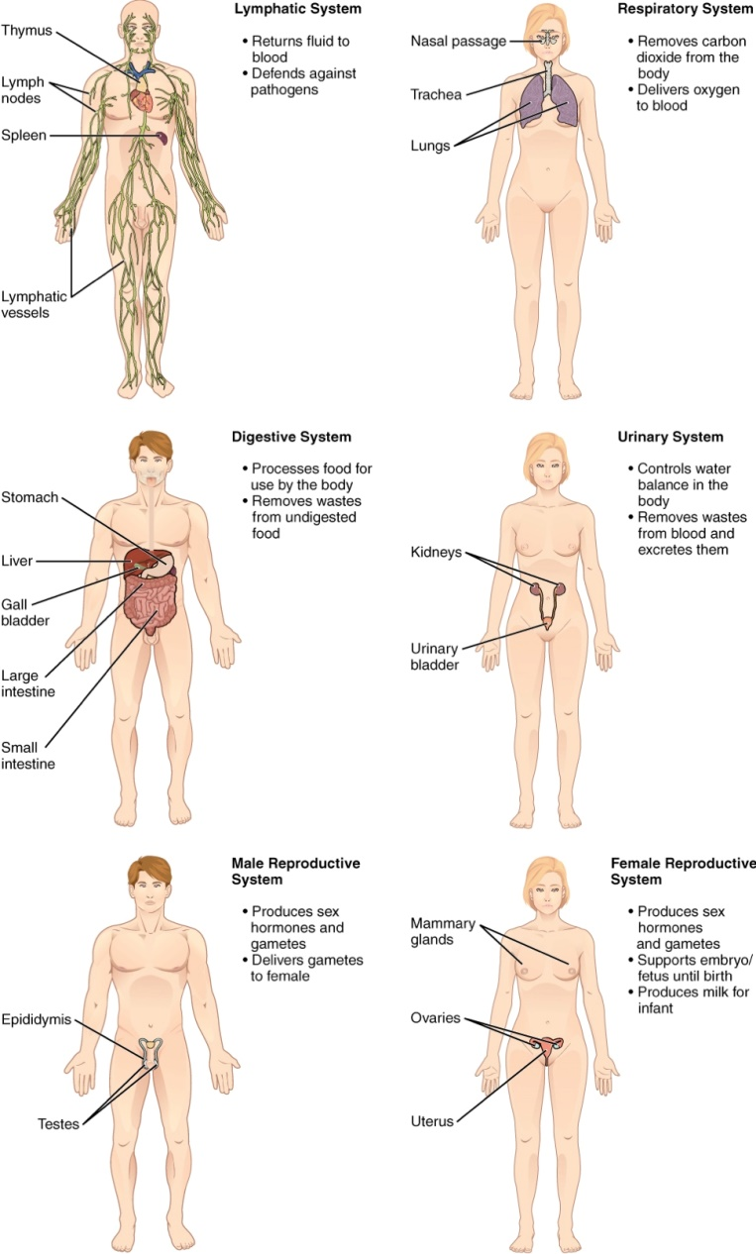
The Body

Slide 20
Body Cavities
Anterior cavity
  Thoracic cavity
    Two pleural cavities
    Pericardial cavity
  Abdominal cavity
  Pelvic cavity
Posterior cavity
  Cranial cavity
  Spinal cavity

Slide 21
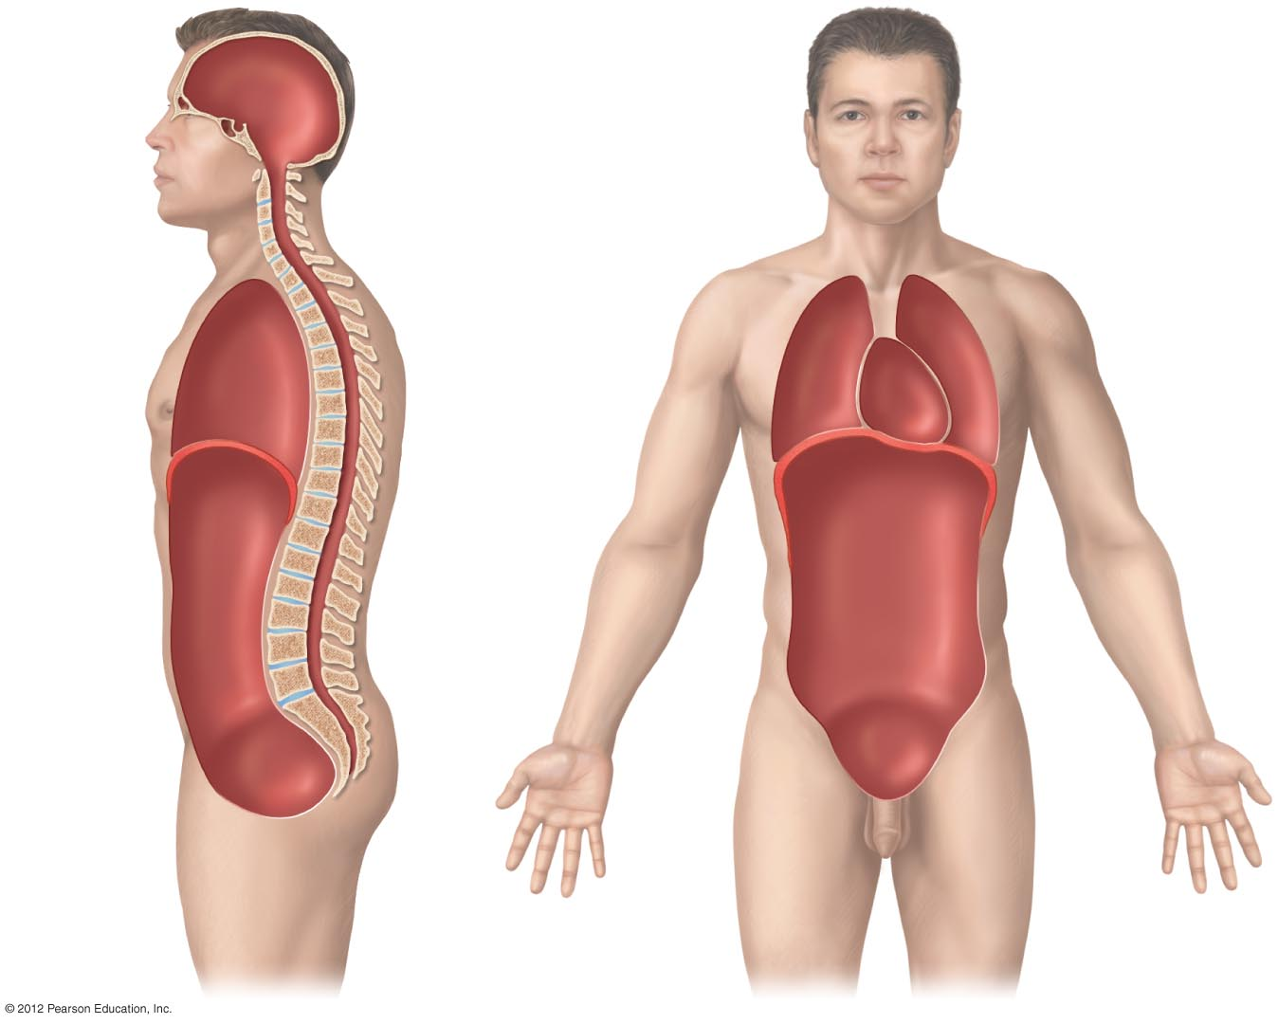
Cranial cavity
Posterior cavity
Vertebral canal
Pericardial cavity
Thoracic cavity
Pleural cavity
Diaphragm separates thoracic and abdominal cavities
Anterior cavity
Abdominal cavity
Pelvic cavity

Slide 22
Tissue Membranes
Serous membrane
  reduces friction between organs
Mucous membrane
  lubricates surface, captures debris
Synovial membrane
  lines spaces in movable joints
Cutaneous membrane
  skin

Slide 23
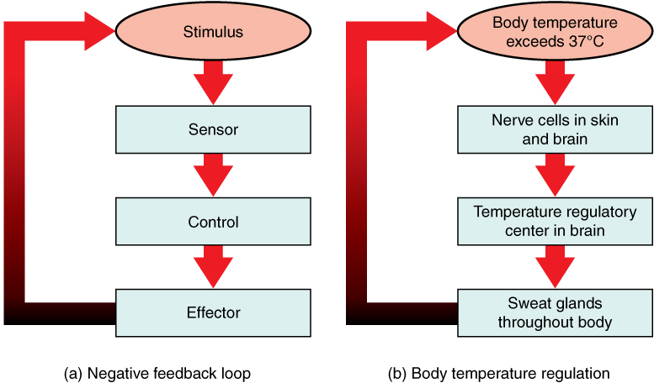
Feedback – Negative Loop
In a negative feedback loop, a stimulus—a deviation from a set point—is resisted through a physiological process that returns the body to homeostasis.
A negative feedback loop has four basic parts.
Body temperature is regulated by negative feedback.

Slide 24
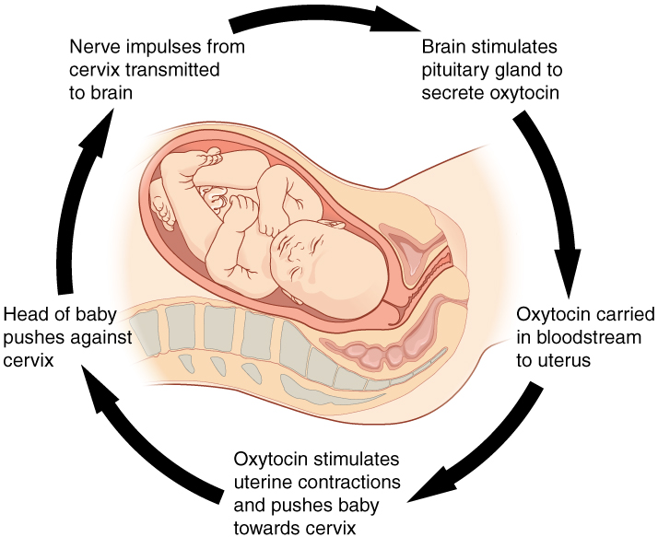
Feedback – Positive Loop
Normal childbirth is driven by a positive feedback loop. A positive feedback loop results in a change in the body’s status, rather than a return to homeostasis.

Slide 25
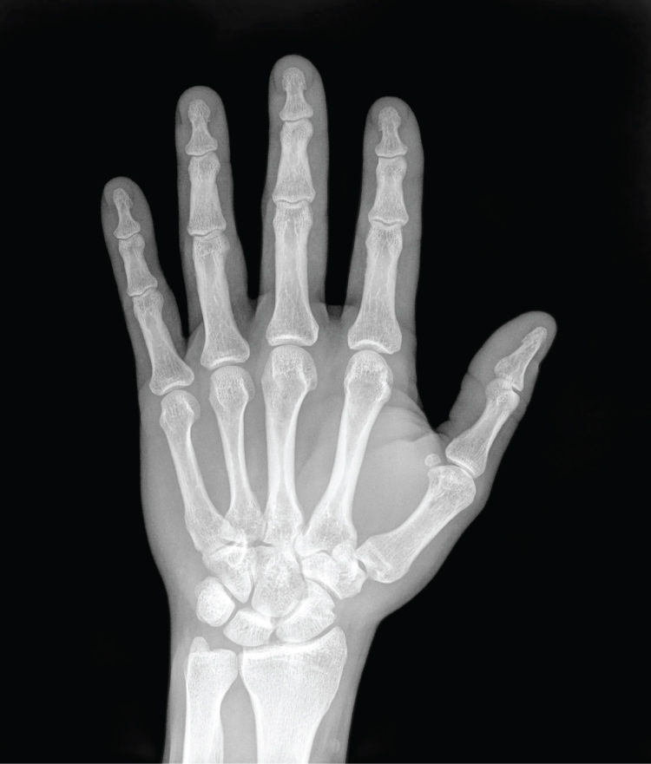
Medical Imaging – X-Ray
High energy electromagnetic radiation allows the internal structures of the body, such as bones, to be seen in X-rays like these.

Slide 26
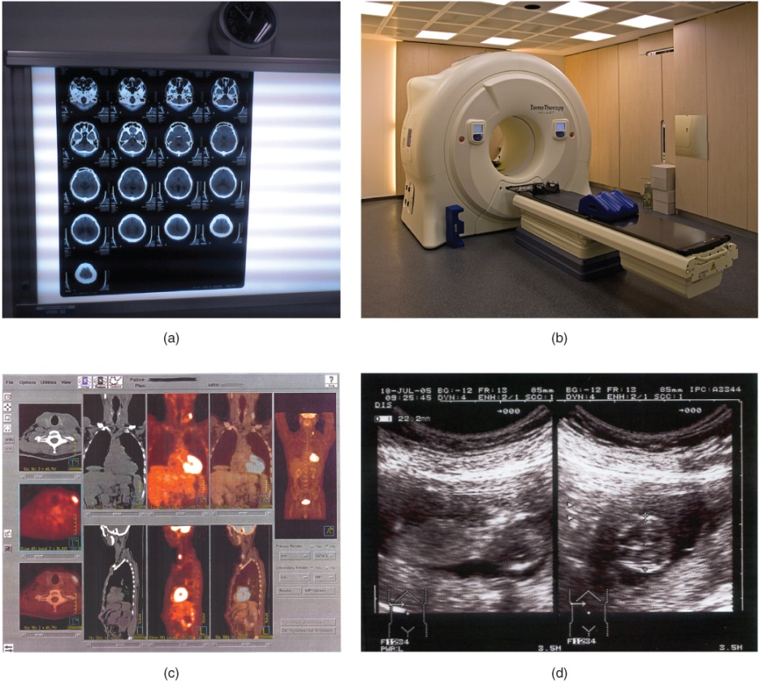
Medical Imaging
The results of a CT scan of the head are shown as successive transverse sections.
An MRI machine generates a magnetic field around a patient.
PET scans use radiopharmaceuticals to create images of active blood flow and physiologic activity of the organ or organs being targeted.
Ultrasound technology is used to monitor pregnancies because it is the least invasive of imaging techniques and uses no electromagnetic radiation.

