Slide 1
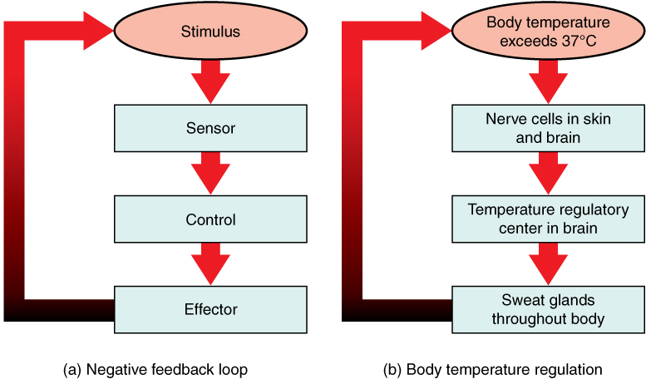

Feedback – Negative Loop
In a negative feedback loop, a stimulus—a deviation from a set point—is resisted through a physiological process that returns the body to homeostasis.
A negative feedback loop has four basic parts.
Body temperature is regulated by negative feedback.

Slide 2
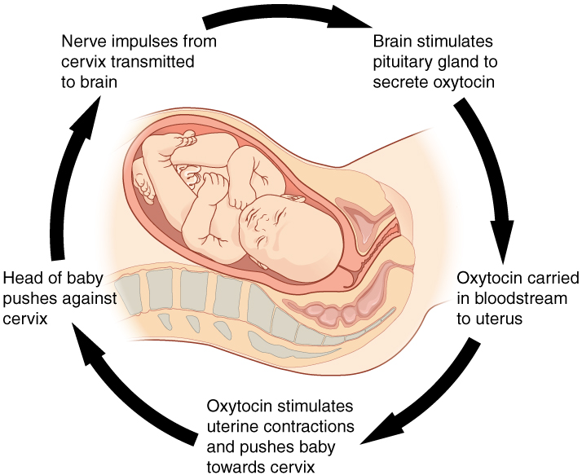
Feedback – Positive Loop
Normal childbirth is driven by a positive feedback loop. A positive feedback loop results in a change in the body’s status, rather than a return to homeostasis.

Slide 3
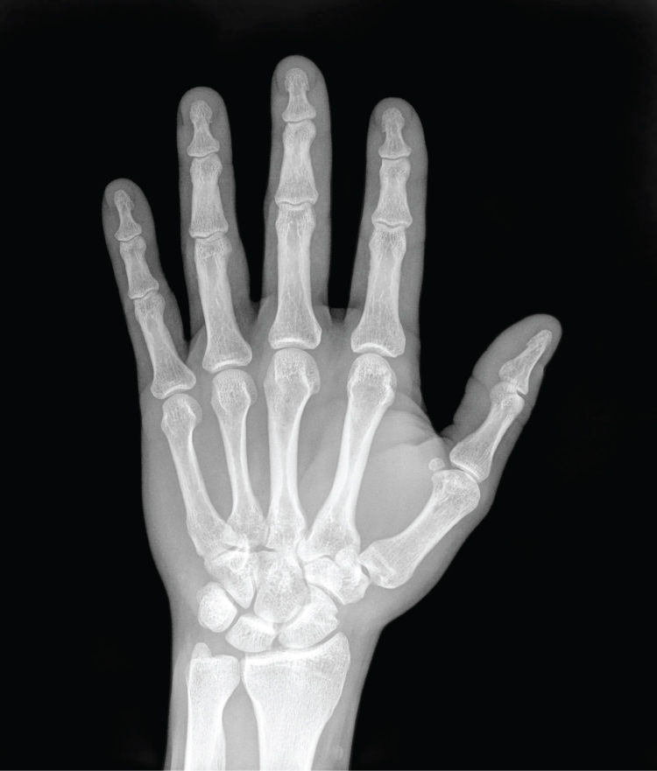
Medical Imaging – X-Ray
High energy electromagnetic radiation allows the internal structures of the body, such as bones, to be seen in X-rays like these.

Slide 4
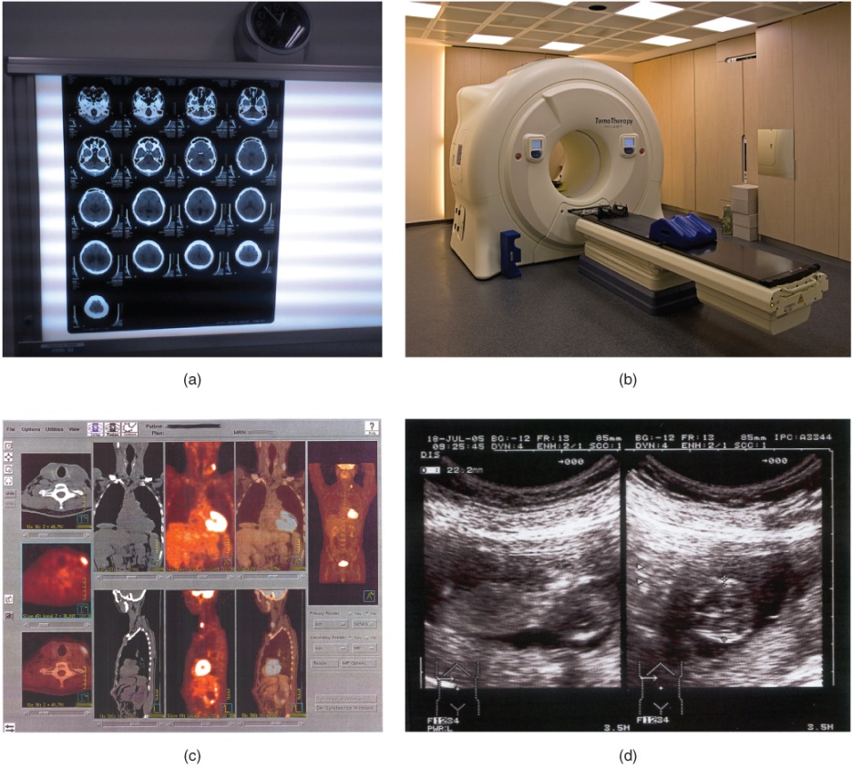
Medical Imaging
The results of a CT scan of the head are shown as successive transverse sections.
An MRI machine generates a magnetic field around a patient.
PET scans use radiopharmaceuticals to create images of active blood flow and physiologic activity of the organ or organs being targeted.
Ultrasound technology is used to monitor pregnancies because it is the least invasive of imaging techniques and uses no electromagnetic radiation.

