Slide 1
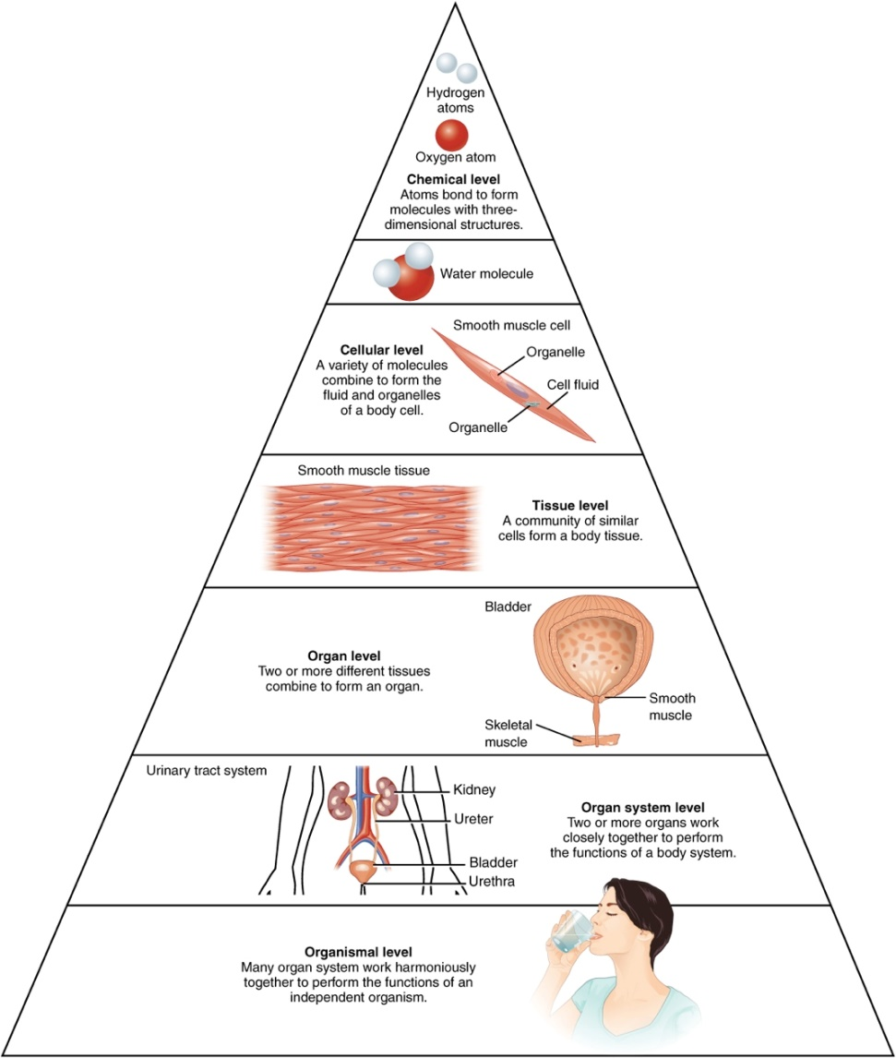

The Body
Levels of Structural Organization of the Human Body
The organization of the body often is discussed in terms of six distinct levels of increasing complexity.

Slide 2
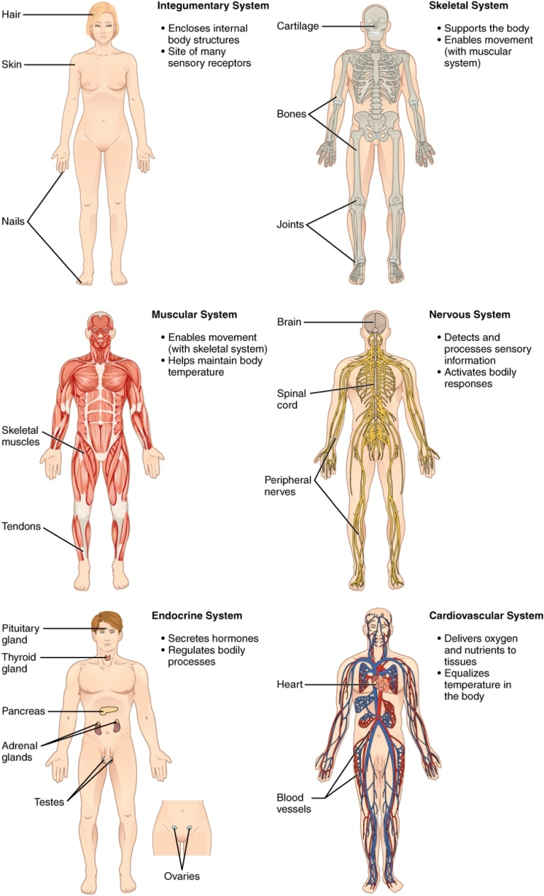
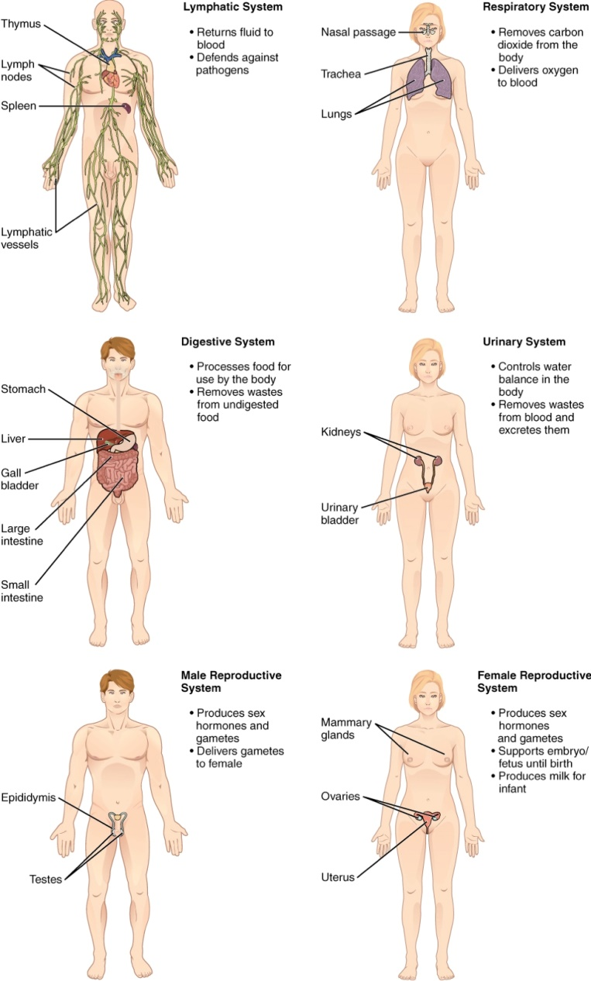
The Body

Slide 3
Body Cavities
Anterior cavity
  Thoracic cavity
    Two pleural cavities
    Pericardial cavity
  Abdominal cavity
  Pelvic cavity
Posterior cavity
  Cranial cavity
  Spinal cavity

Slide 4
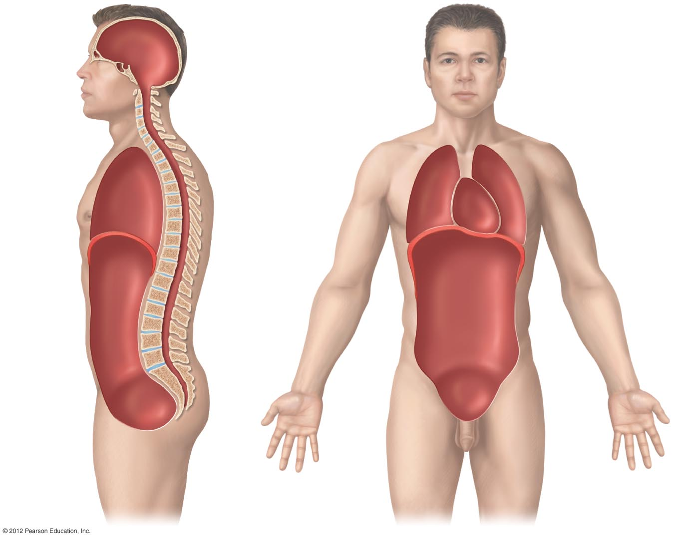
Cranial cavity
Posterior cavity
Vertebral canal
Pericardial cavity
Thoracic cavity
Pleural cavity
Diaphragm separates thoracic and abdominal cavities
Anterior cavity
Abdominal cavity
Pelvic cavity

Slide 5
Tissue Membranes
Serous membrane
  reduces friction between organs
Mucous membrane
  lubricates surface, captures debris
Synovial membrane
  lines spaces in movable joints
Cutaneous membrane
  skin

