Slide 1

The Scientific Method Is a Process for Testing Ideas
4) Experiment and observe
  Truth or falsehood of prediction is tested by observation and experimentation
  Experiment: A carefully planned and executed manipulation of the natural world.
    In controlled experiments, all but one variable are accounted for
    Placebo – “false treatment”

Slide 2
The Scientific Method Is a Process for Testing Ideas
5) Modify the hypothesis as necessary and repeat Steps 3 and 4
  If prediction is false, the hypothesis must be modified.
  If the prediction is true, only one small part of the hypothesis has been tested. Further testing required.
  Hypotheses cannot be proved true, only supported or disproved.

Slide 3
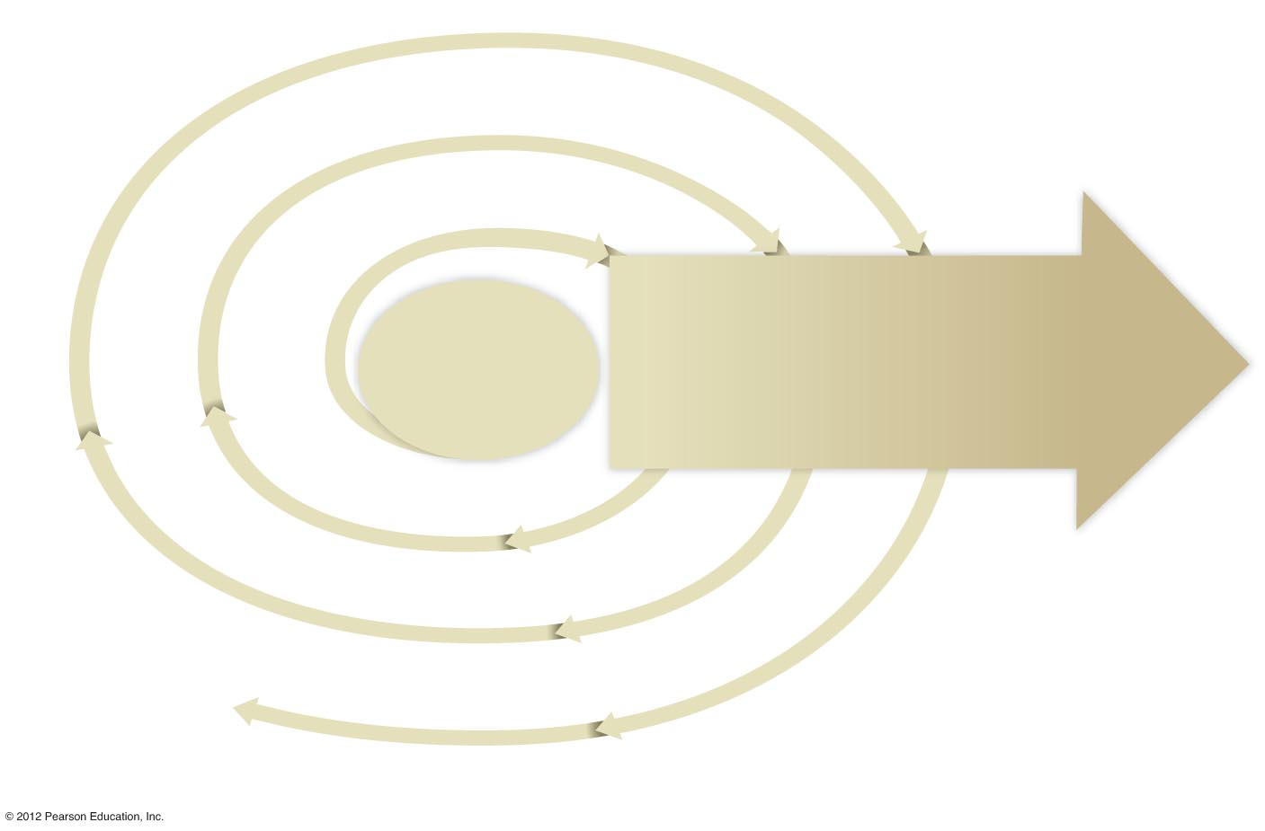
Inductive reasoning
Inductive reasoning
Inductive reasoning
2
5
5
4
4
1
Formulate
a
hypothesis
Modify
hypothesis
as
necessary
and repeat
steps
3 and 4
Modify
hypothesis
as
necessary
and repeat
steps
3 and 4
Direction of
Increasing
confidence
in
hypothesis
Experiment
or
observe
Experiment
or
observe
Observe
and
generalize
3
Deductive
reasoning
Make a testable
prediction
reasoning
3
Deductive
reasoning
Make a testable
prediction
Deductive
3
Make a testable
prediction

Slide 4
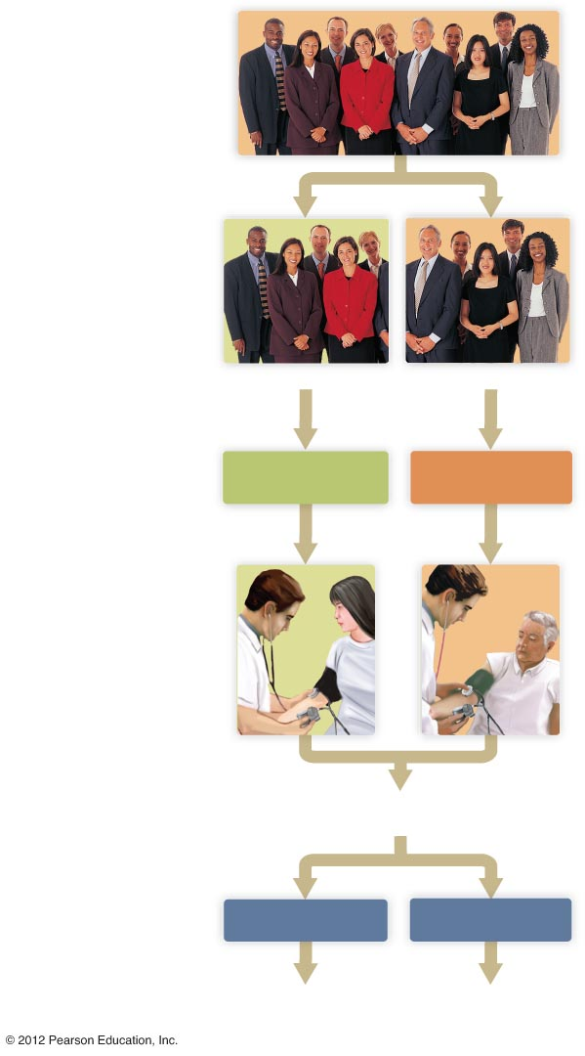
Select a large number
of appropriate subjects.
Randomly divide the subjects into two groups.
Group 1
Group 2
Treat the groups equally
in all ways but one.
Experimental group:
receives treatment
Control group:
receives placebo
Observe or make measurements.
Are blood pressures lower
in the experimental group?
Compare results.
Yes
No
Hypothesis received support.
Modify hypothesis to fit the new findings.

