Slide 1
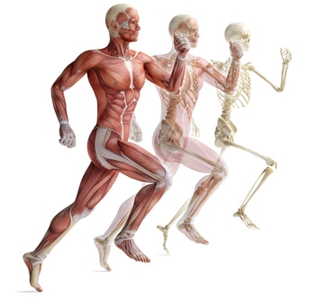

Human Biology and Science
Michael D. Johnson

Slide 2
Science Is Both a Body of Knowledge and a Process
Science is the study of the natural world
Science is two things
  Knowledge about the natural world
  The process used to acquire knowledge
    Called the scientific method

Slide 3
The Scientific Method Is a Process for Testing Ideas
Steps in the scientific method
  Observe and generalize
  Formulate a hypothesis
  Make a testable prediction
  Experiment or observe
  Modify the hypothesis as necessary and repeat

Slide 4
The Scientific Method Is a Process for Testing Ideas
1) Observe and generalize
  Make generalizations based on observations about the world with inductive reasoning
        ‘Specific to general reasoning’
    Observation: “Every winter in the past was colder than the preceding summer.”
    Generalization: “Winter will always be colder than summer.”

Slide 5
The Scientific Method Is a Process for Testing Ideas
2) Formulate a hypothesis
  A hypothesis is a tentative statement about the natural world

Slide 6
The Scientific Method Is a Process for Testing Ideas
3) Make a testable prediction
  Hypotheses should be tested under many different conditions
  Testable predictions
    Should be based on the hypothesis
    Should employ deductive reasoning
    Are often in the form of “if…then” statements
    Should be specific in order to be testable

